Slide 1
Wildfire in the Foothills
Lesson 6: Family Preparedness - Get Ready!

Slide 2
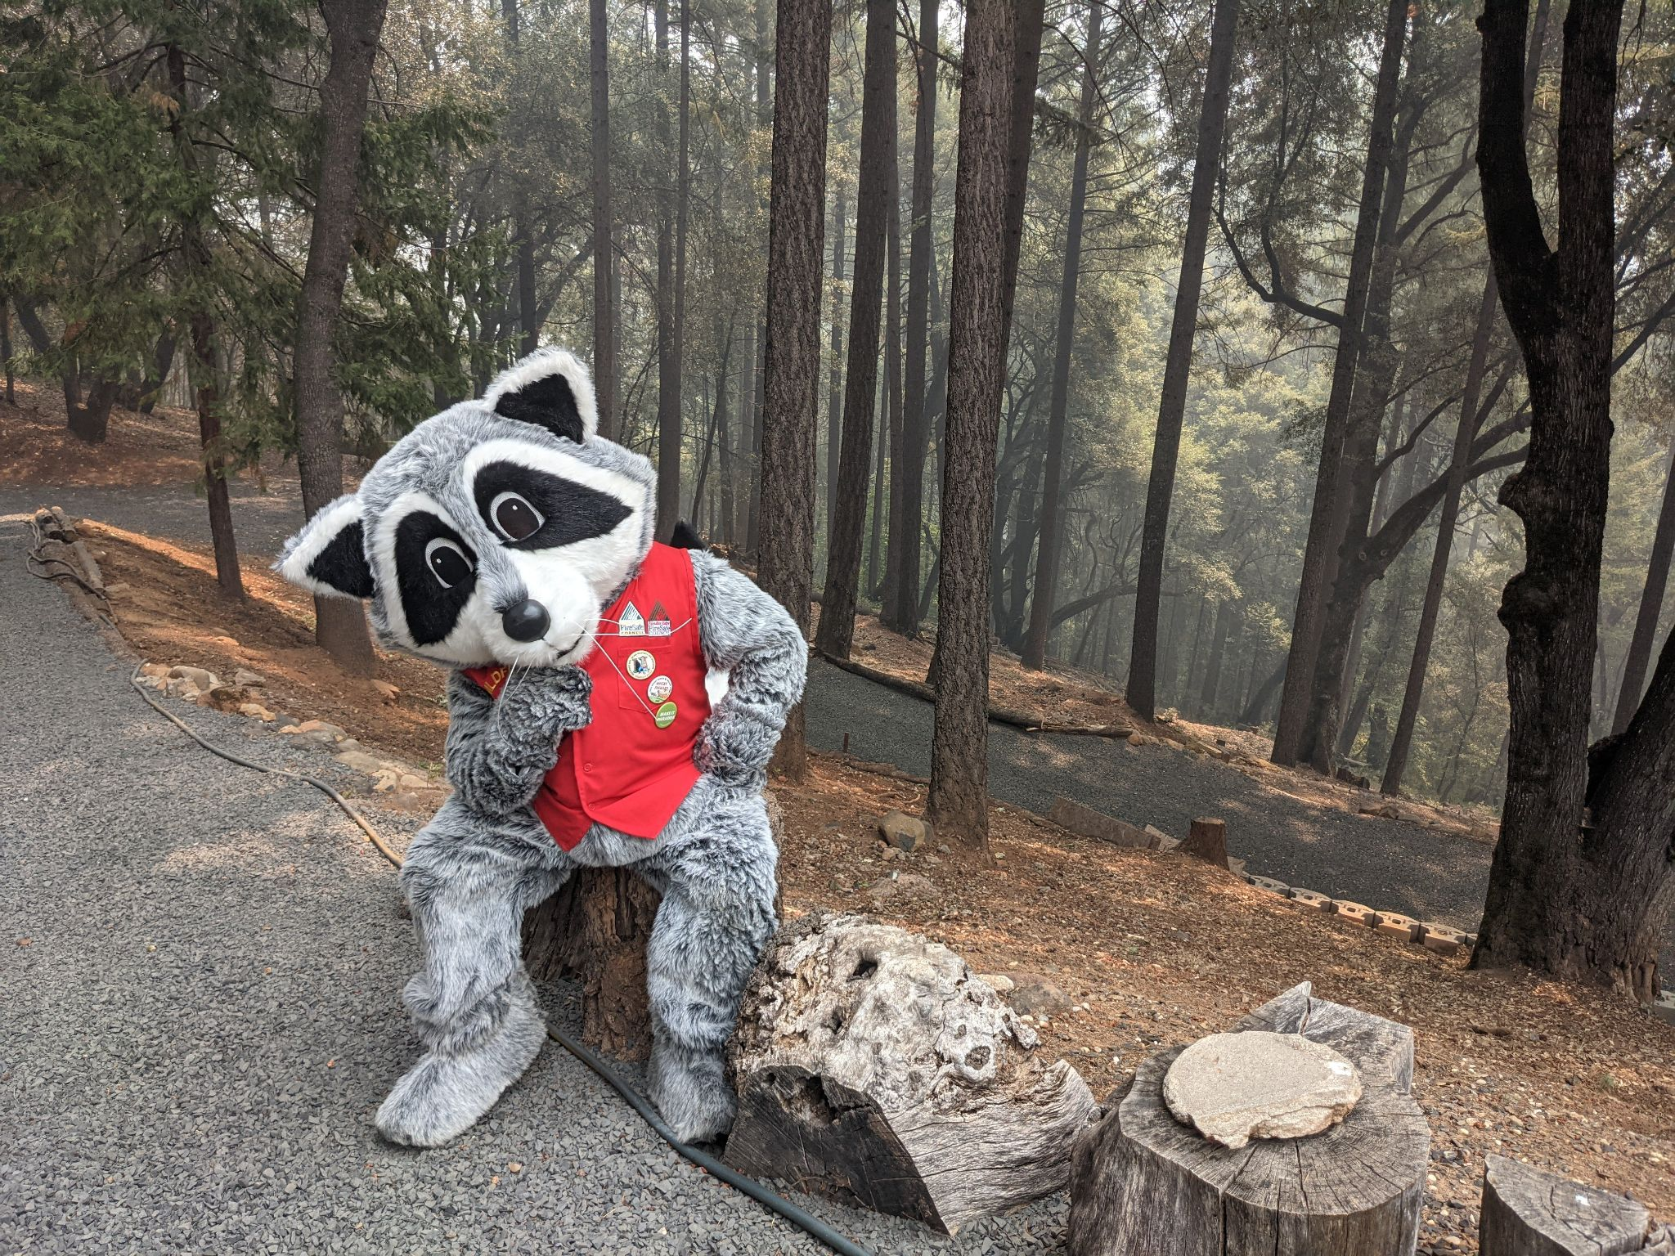
What can we do now to prepare for a wildfire close to home?

Slide 3
Can you recall a time your family has talked about what to do if there is a wildfire nearby?
If so, what were some actions or ideas you remember talking about?
If not, can you think of something you have learned in this program so far that you would like to share with them?
Notes:
Two-minute journal write.

Slide 4
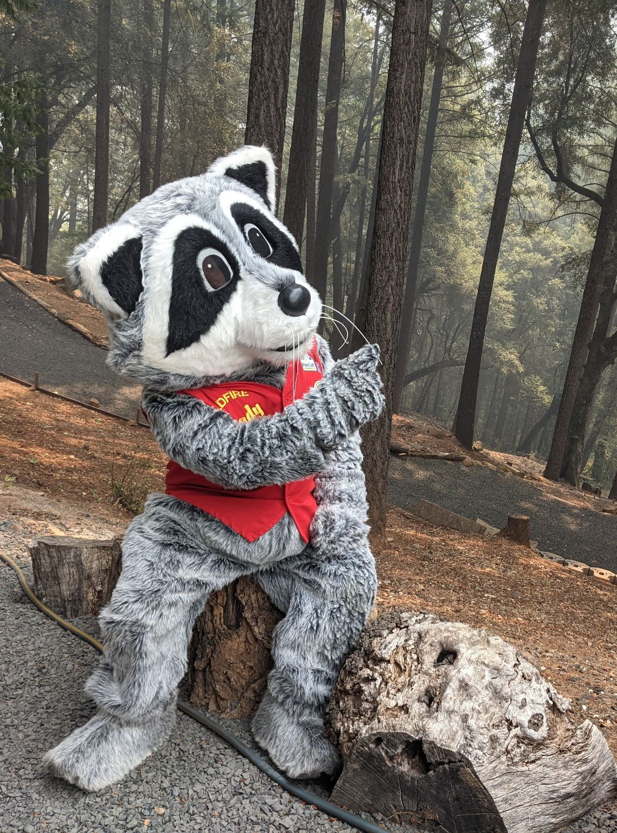
Today, we will learn about two important steps to wildfire preparedness:
Making a Go Bag and putting together a Family Emergency Plan.
Notes:
These actions are important for wildlife preparedness and are also useful to be prepared for other types of emergency situations. This lesson focuses on task-based, achievable things that students can do for themselves and their families. Appropriate discussion and idea sharing is encouraged as you go through the steps and components of each topic.

Slide 5
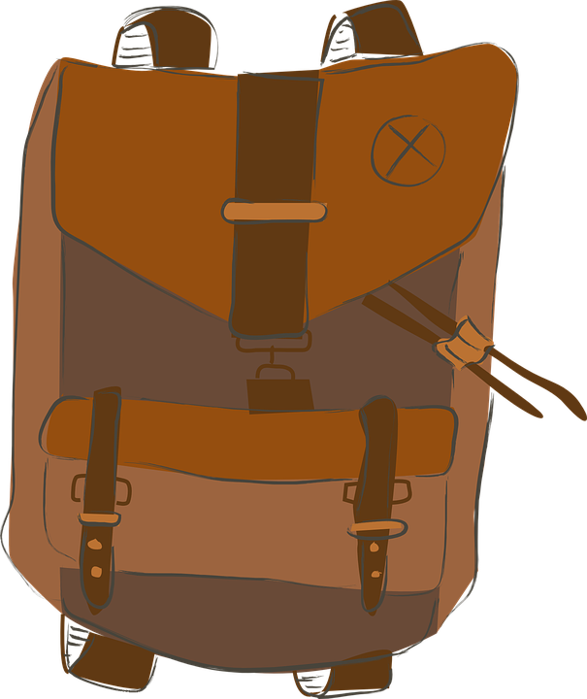
A Go Bag is something you pre-pack that holds essential items you will need for 72 hours. It should be light enough for one person to carry and packed in a sturdy bag that can be grabbed quickly.
Notes:
Every family member should have their own Go Bag. If students do not have a spare backpack, the Go Bag could be put in a duffel/gym bag, suitcase, or carried in a laundry basket or box. Having a Go Bag ready will give you confidence that you have your most important items with you, and you don’t have to worry about leaving behind valuables during a rushed and stressful decision. It is recommended to have a year-round Go Bag, but if this is not possible, it is especially important to have one packed during fire season (June-November). If possible, have a Go Bag ready year-round, as wildfire season becomes longer and more unpredictable.

Slide 6
What would you put in your Go Bag?

Slide 7
Can you think of some items for each category?
Basic Needs (Health and Safety) | Communication and Information
Tools | Comfort and Keepsakes
Notes:
Using a chart may help students think of important items. If students are feeling overwhelmed or stuck, move on to go through each category as a class.

Slide 8
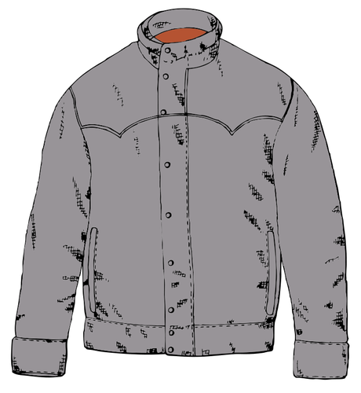
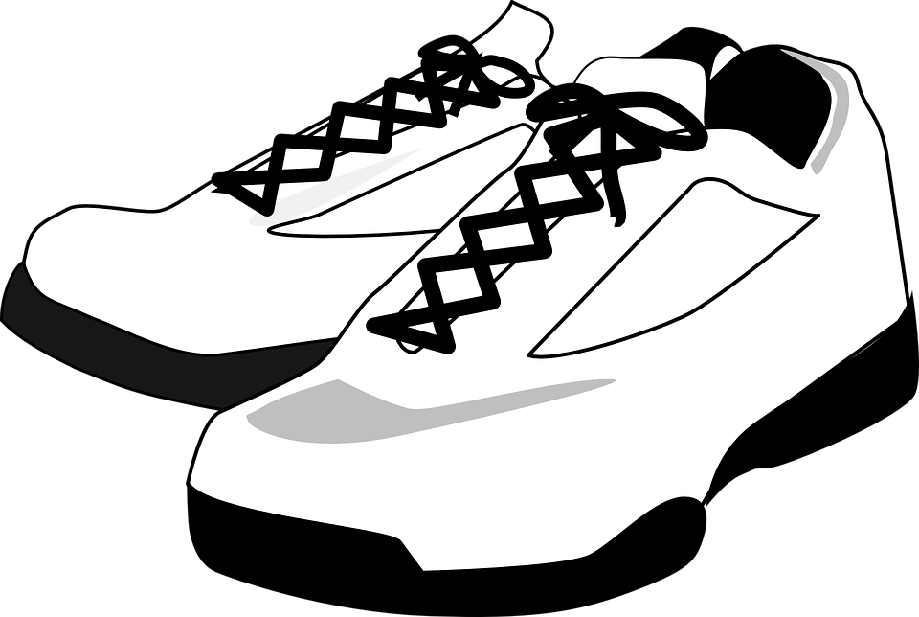
Basic Needs
Water bottle
Nutritious packaged snacks (trail mix or energy bars keep well)
Change of clothes
Sturdy shoes and a jacket
Glasses/contacts if you use them
Prescription medication you regularly take
Toiletry bag
(toothbrush, toothpaste, hand sanitizer, small liquid soap, wet wipes)
Notes:
Add a N95 face mask and goggles for smoke protection if possible.
A puffy jacket is warm, lightweight, and packs down small.
Would you add anything to this list?

Slide 9
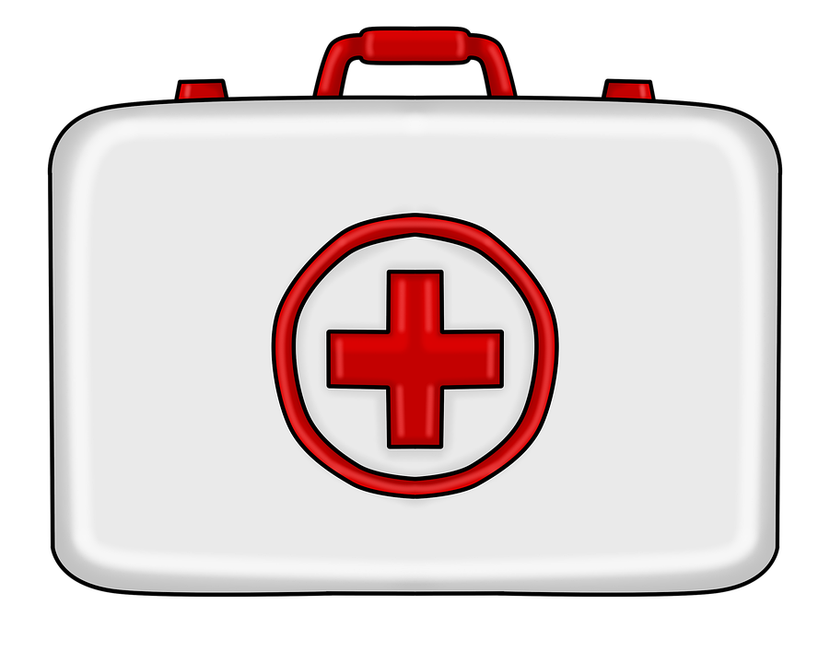
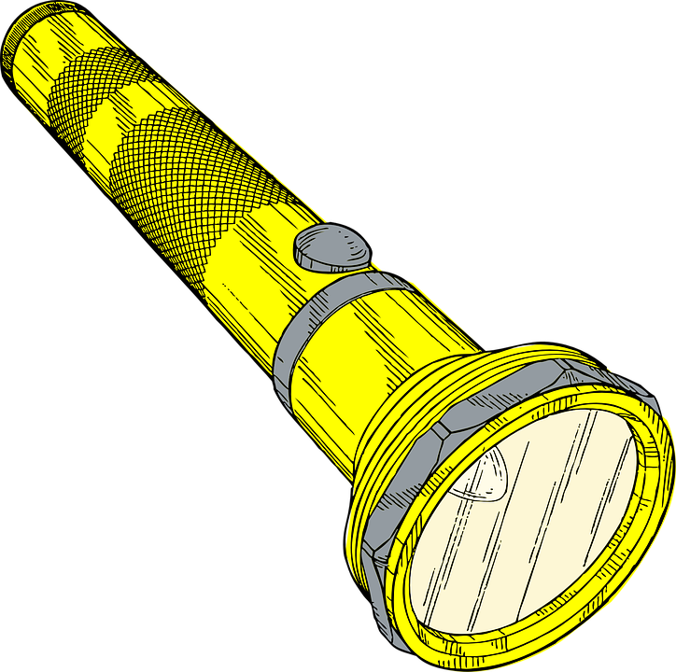
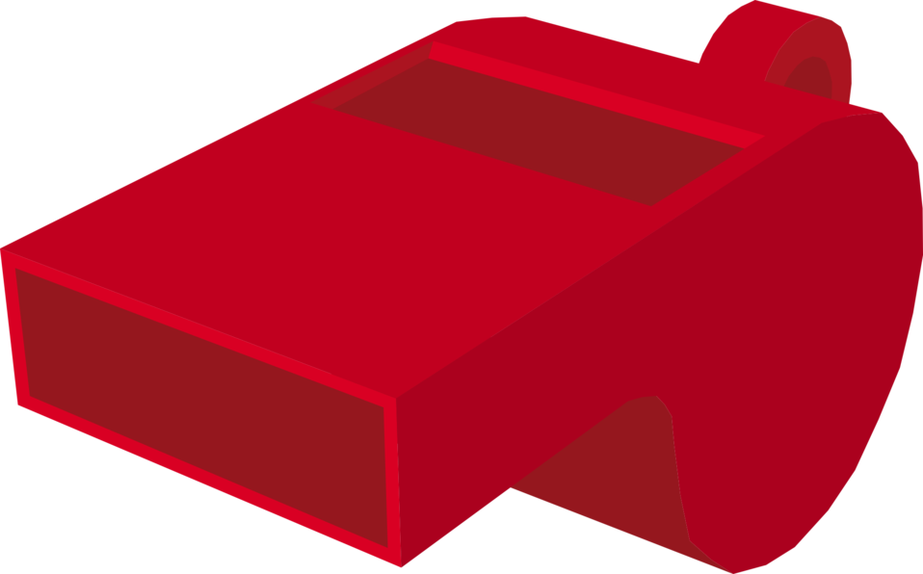
Tools
Flashlight/headlamp with extra batteries
Whistle
Money
Sunglasses
Waterproof zip bag
Small First Aid Kit
(Bandaids, Q-tips, elastic bandage, gloves, small scissors, bandana)
Plastic poncho
Notes:
Would you add anything to this list?

Slide 10
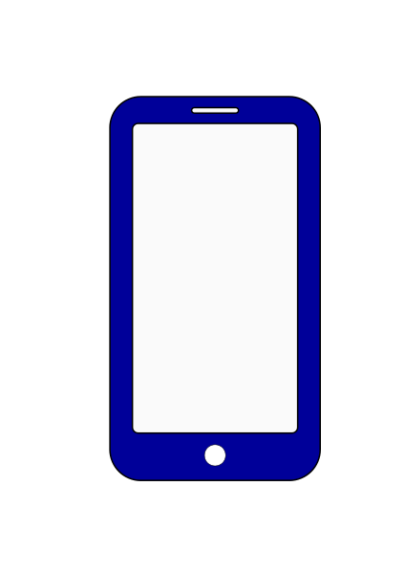
Communication and Information
Cell phone and charger
Battery or crank powered radio
Copy of your Family Emergency Plan
Printed evacuation route map
Fill a small notebook with important phone numbers.
Notes:
In a wildfire emergency, there may not be cell service because of damage to power lines or a public safety power shut off. Cell phones can also run out of battery. It is important to have numbers physically written down. Important phone numbers can be the numbers listed on the Family Communication Plan plus a contact person at your families’ workplace, relatives who live out of the area, close friends, and neighbors. The radio can be used to listen to local emergency updates.
Would you add anything to this list?

Slide 11
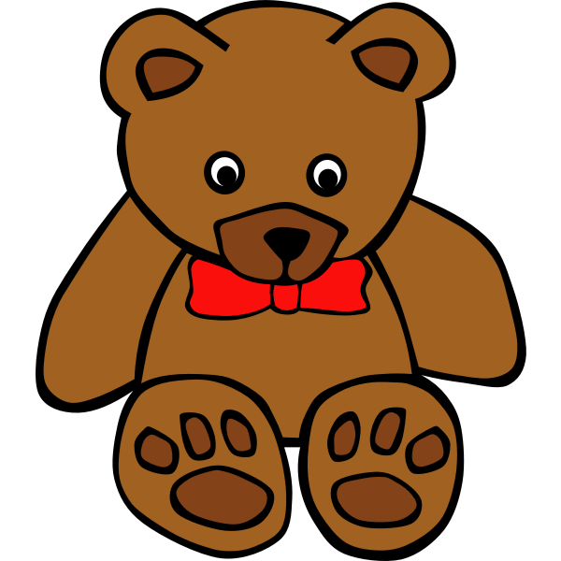
Comfort and Keepsakes
Headphones
Writing or drawing materials for your notebook
Book
Blanket
Photographs and momentos
Favorite toy, stuffed animal, or other comforting item
Notes:
There may not be room for all these items in the Go Bag, but here are some suggestions of comforting and special items. Students may not feel comfortable sharing these items but can write them down in their journal.
Would you add anything to this list?

Slide 12
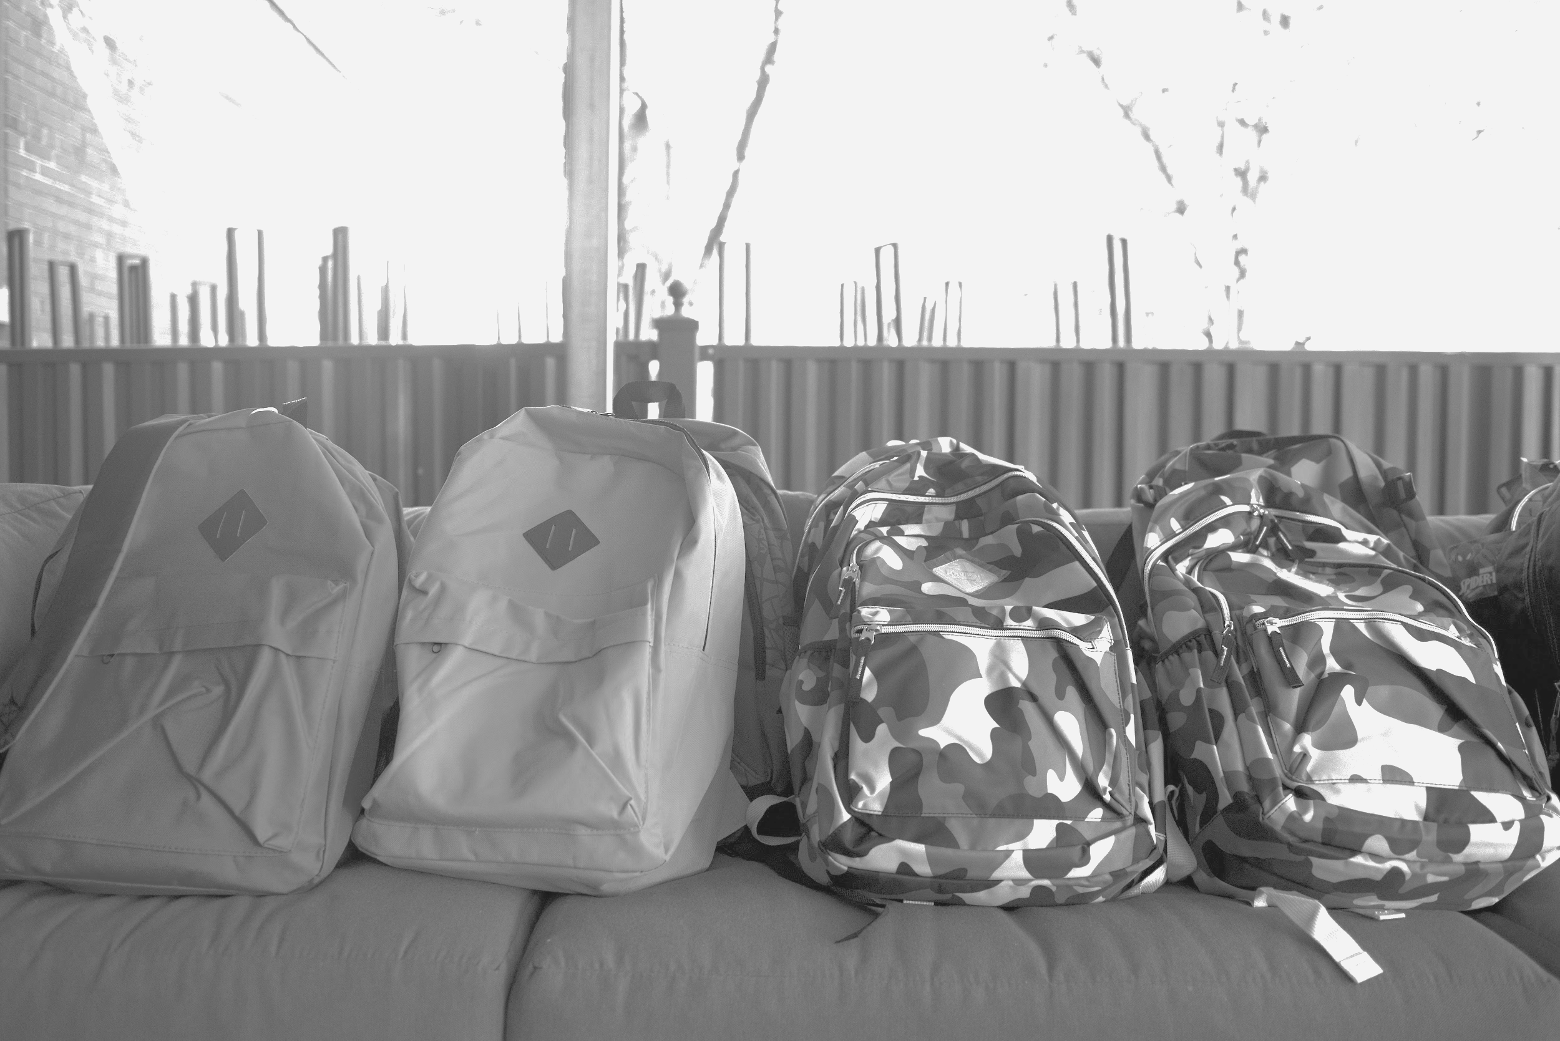
Your Go Bag should be kept in a visible place where it can be grabbed quickly, like near the front door. Check your Go Bag periodically for expired items and make sure you replace anything you use.
Notes:
The Go Bag should be saved for emergencies and not taken as an overnight bag for recreational trips. If students need to use the backpack, Go Bag items can be stored together in a box and re-packed into the backpack during fire season.

Slide 13
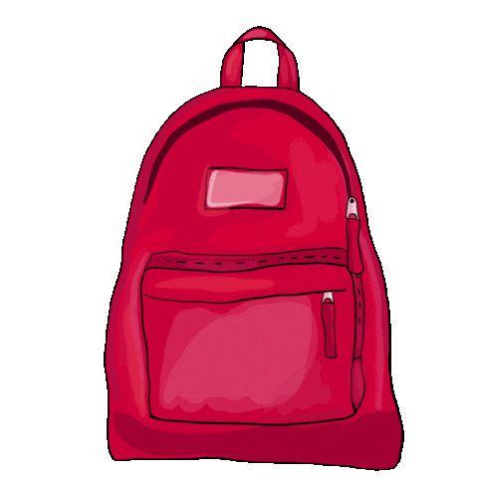
Now that you know what goes inside a Go Bag, your next task is to make one.
Do you know friends or family members who have Go Bags? If not, what would you tell them about what you learned?
Notes:
Pass out the student handout from the National Fire Protection Association, Backpack Emergency Go Kit!.
Link to print: Go Kit!
If students have items listed in their journals that are not included on the page, they can write or draw them in.
Now that each family member has a Go Bag, the next step is to make a Family Emergency Plan.

Slide 14
A Family Emergency Plan is a written document that prepares each family member to know their role and stay connected during an emergency. The plan should include what to do if you are all home together or separated.
Notes:
Having a family emergency plan will set up students and their families to stay safer and calmer in the event of an emergency or evacuation. This document should be kept in a place that is easy to access, such as on the refrigerator or in an envelope with other emergency related documents such as printed local maps, copies of important documents, and area-specific emergency information.

Slide 15
Step 1: Hold a family meeting.
Step 2: Fill in the front side of the Family Communication Plan together.
Step 3: Flip over the paper and add points for a Family Action Plan. This action plan outlines a task that each family member is responsible for, if leaving the house together.
Step 4: Practice your plan!
Notes:
Pass out a printed Family Communication Plan sheet to each student and give them a chance to look it over.
The next slides walk through the important pieces of the Family Emergency Plan including collecting important contact information, a plan to safely exit the house, where to meet, and the action plan.
Link to print: Family Communications Plan for Kids

Slide 16
Notes:
A closer look at what is on the Family Communication Plan, from FEMA’s Ready program.
Start off by filling in the school’s information together. Leave the rest of the spaces blank for students to fill in during the family meeting.
Front side includes: Out-of-town contact, work and contact information for two guardians, neighborhood meeting place, regional meeting place, school information and contact information for up to three children.
If the family is split up, each family member should use the out-of-town contact as their designated check-in person.

Slide 17
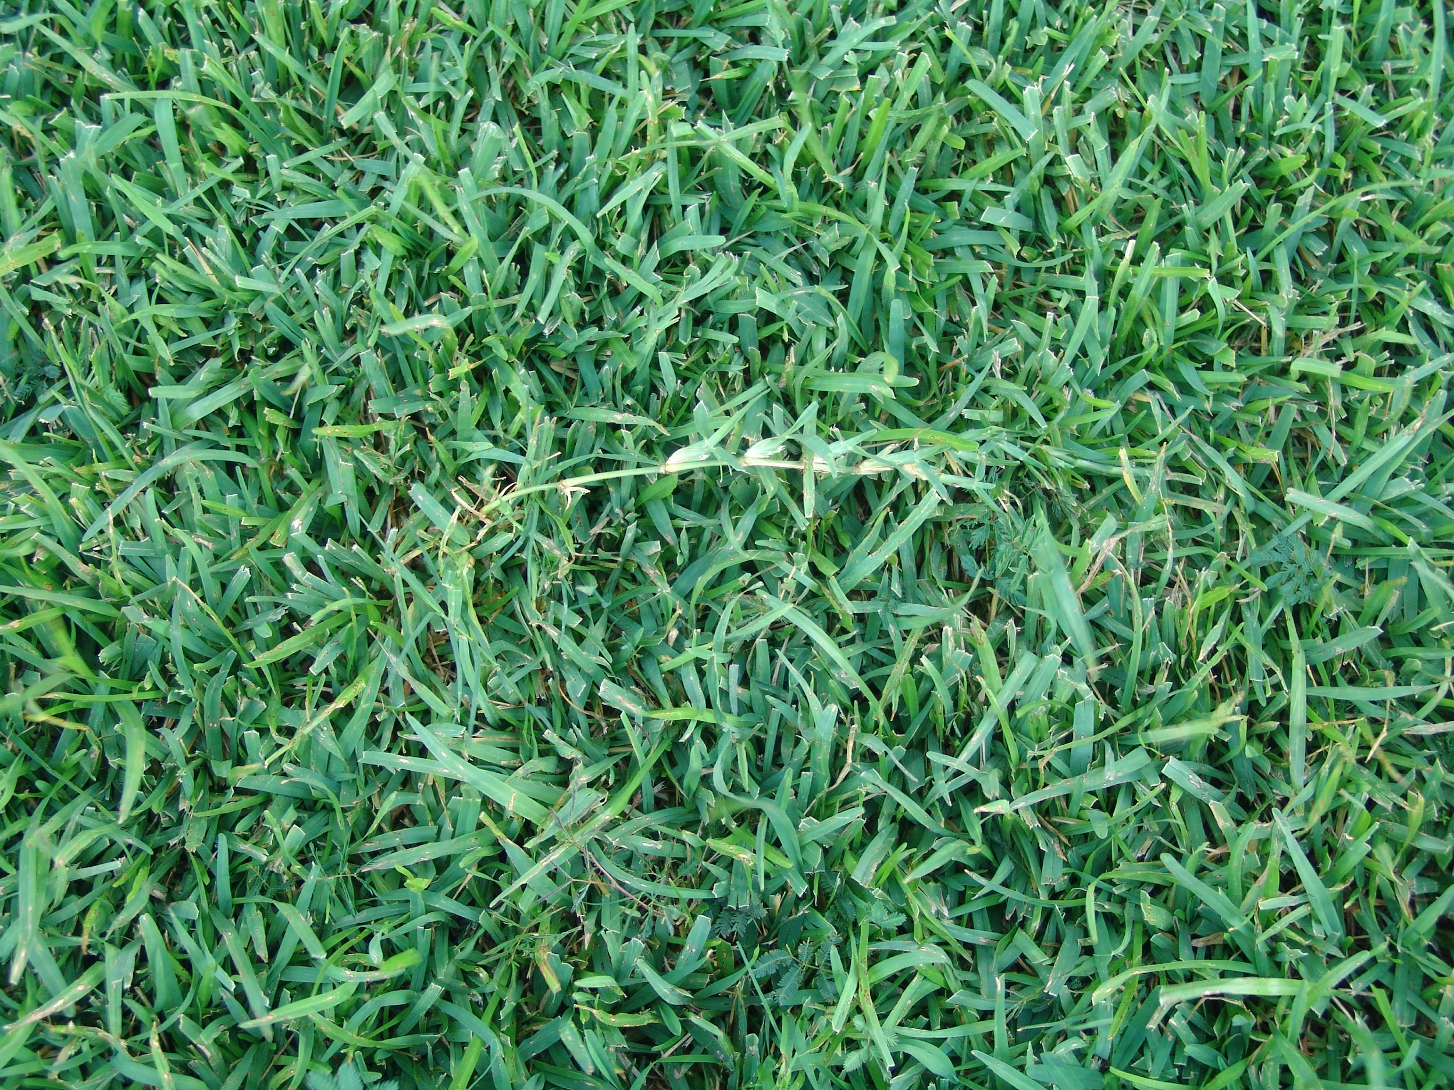
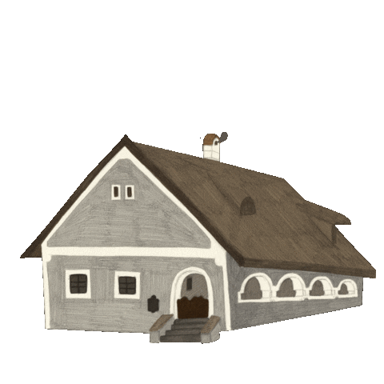
Two safe exit points from inside the house.
Notes:
Flip over the paper.
Students can pre-write,“Two safe exit points from the house are _____________ and _____________.”
This is important in the event of a house-fire or if a typical exit point is unsafe to use.

Slide 18
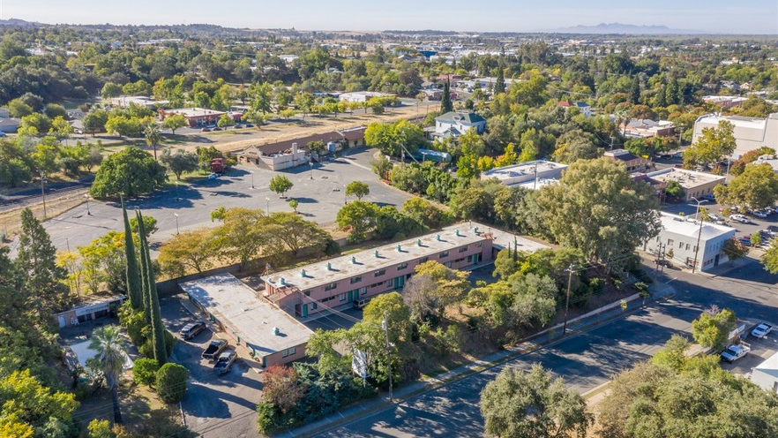
Pick a neighborhood meeting place.
Notes:
Perhaps this place is a street corner, trusted neighbor’s house, or somewhere with a clear landmark.
This will be added to the front side of the plan during the family meeting, but students can share ideas in class about areas in their neighborhood they would suggest and why it is a good place to meet.

Slide 19
Pick a regional meeting place and a
backup regional meeting place.
Notes:
If the family is spread out, it may not be possible to all meet back home. Depending on the fire’s progress, road closures, or evacuation orders, a backup meeting place should be designated. This place should be somewhere easy to access with people around who could help you, such as a school, public library, store, or police station. If you are not able to get home or to either meeting location, stay with friends, teachers, or a trusted adult and evacuate with them. Begin your Family Communication Plan by checking in with your designated contact person to let them know who you are with and where you are going.

Slide 20
Action Plan
Pre-write the names of each family member to fill in during your family meeting.
Examples of tasks to split up:
Pack food and water.
Get pets and their essential supplies ready.
Gather everyone’s Go Bags.
Get the car ready and load supplies.
Check in with a neighbor or family contact.
Notes:
The Action Plan lists a task each person is responsible for before leaving the house together.
Potential questions for student discussion:
Why is it a good idea to have each family member responsible for a task? Is there anything you can think of now that you feel the most comfortable doing? What could you do to help younger siblings or pets? What tasks do you think are better left to an adult?
(More focus on evacuation steps will be part of the next lesson after students have made their family plans.)

Slide 21
Notes:
Students are often concerned about the wellbeing of their pets and animals. Finish the lesson about preparedness by talking about how to make a plan for animals. (2-minute introduction video from the TakeAction program.)
Link to print more information: Prepare Your Pets for Disasters (Ready.gov- Trifold 2 pages)
Local information: North Valley Animal Disaster Group – Animal evacuation, rescue and shelter-in-place in Butte County.
Students can add the phone number for the North Valley Animal Disaster Group Hotline (530) 895-0000 to their Family Communication Plans.

Slide 22
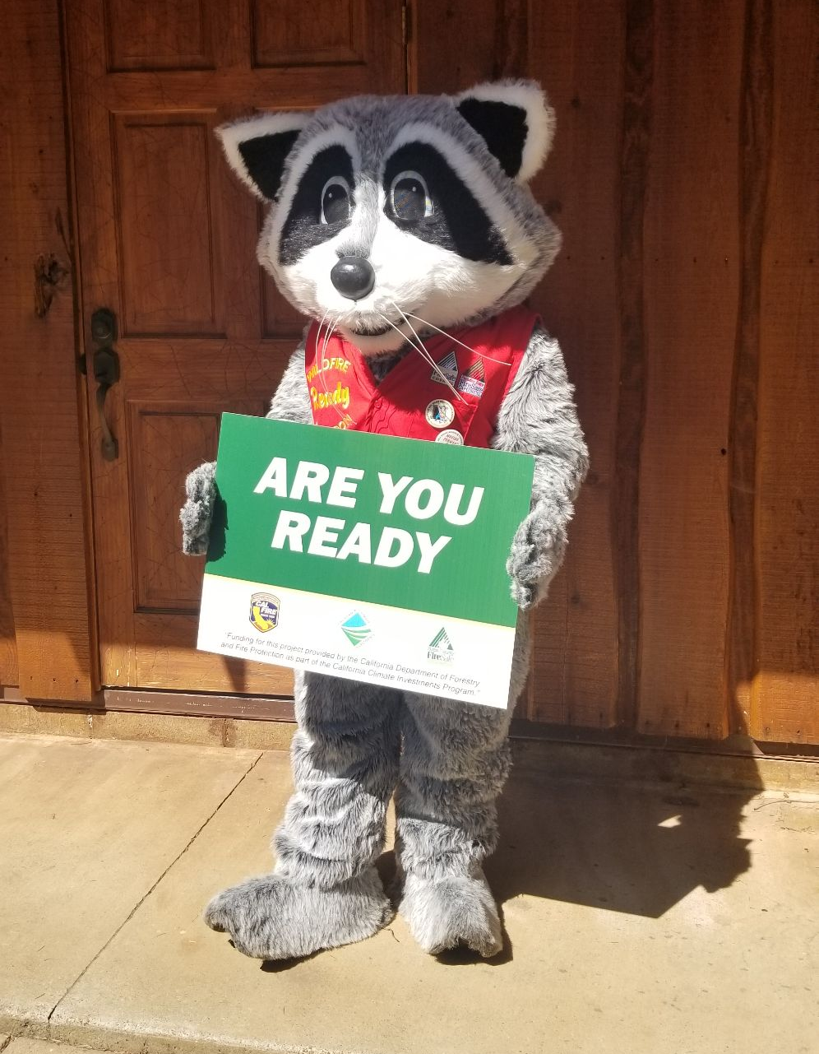
Make a 3-5 minute how-to video about one of the following topics:
Making a Go Bag.
Making a Family Communication Plan.
Making a plan for pets and animals.
Notes:
See activity description in the lesson plan.

Slide 23
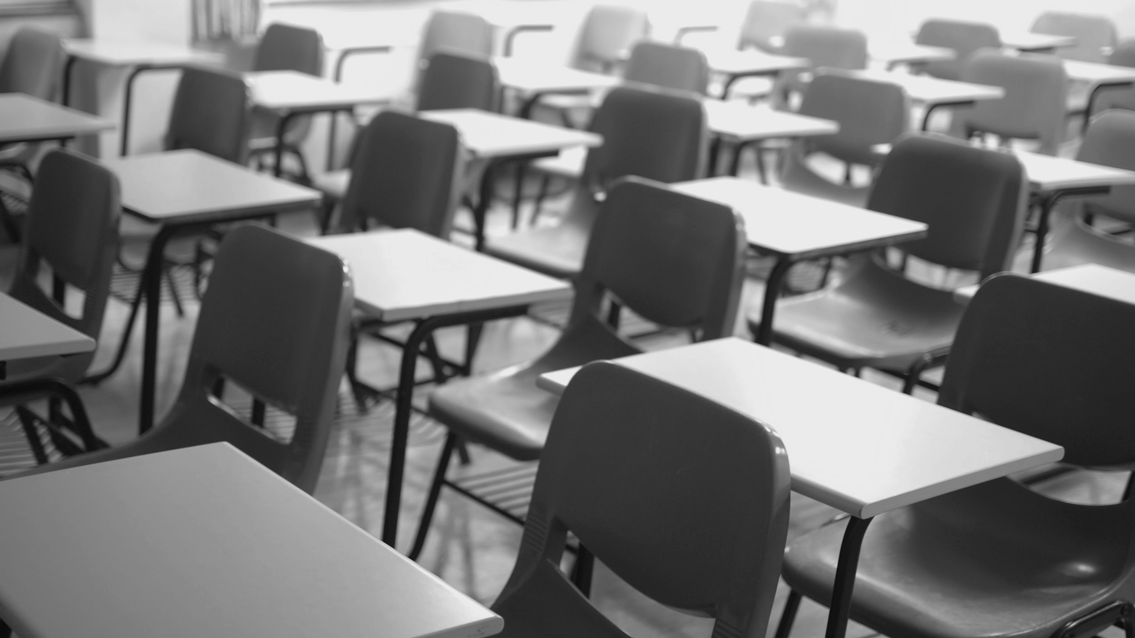
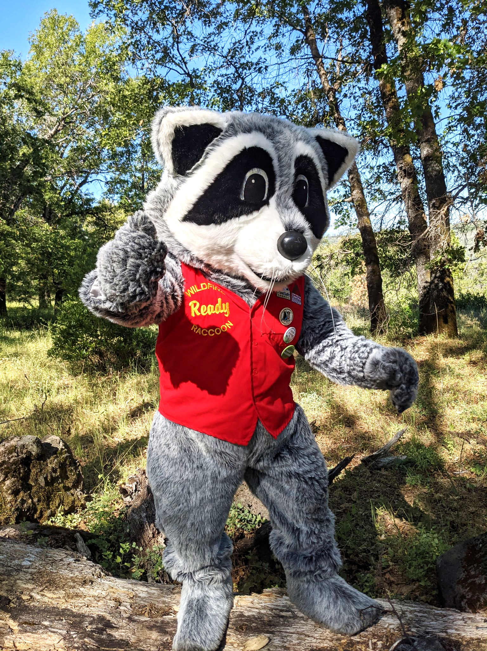
You have completed Lesson 6.

