Slide 1
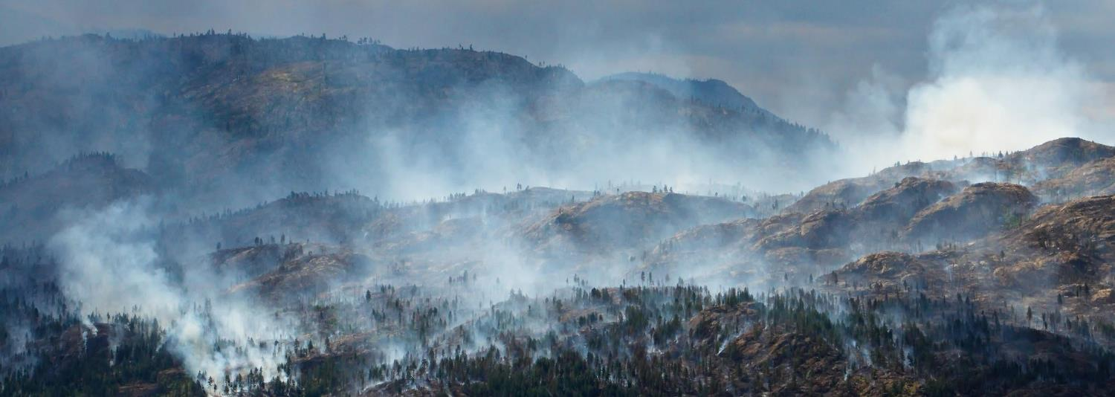
Wildfire in the Foothills
Lesson 4: Community Wildfire Mitigation
Notes:
Lesson time: Approx. 60 minutes

Slide 2
﻿“There will always be fire on the landscape. We can't always control when and where, but we can be prepared.”
- Paradise Forest Management Plan (2021)

Slide 3
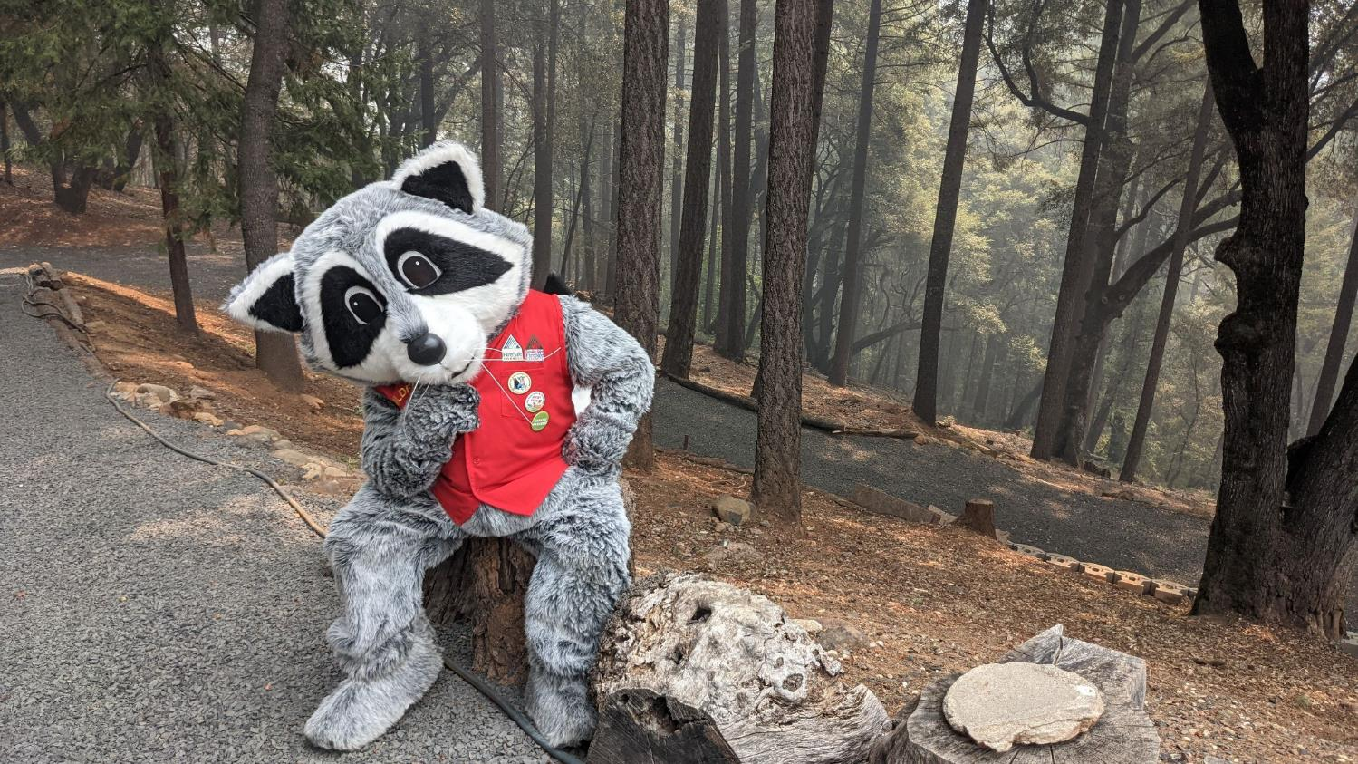
What actions are being taken around Butte County to build community wildfire resilience?

Slide 4
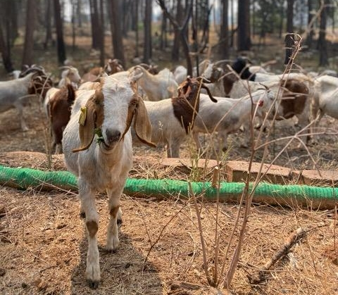
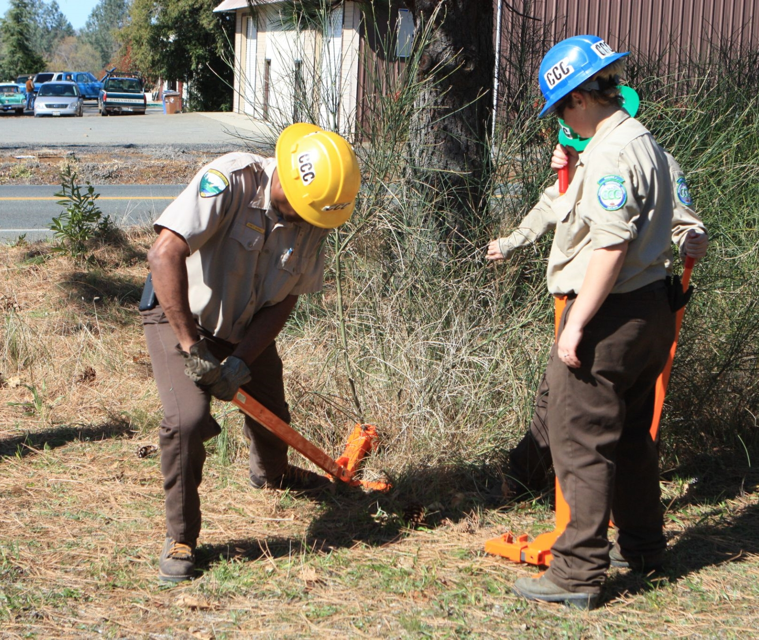
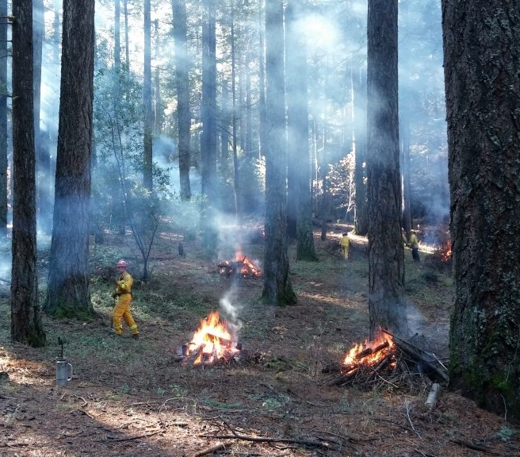
Snapshots of projects around Butte County.
What might be happening here?
Notes:
Have you seen anything that looks like this happening around us?

Slide 5
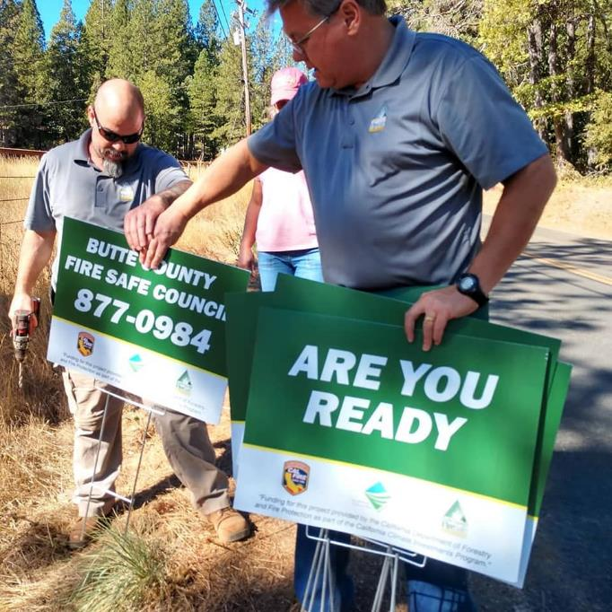
The mission of the Butte County Fire Safe Council is:
“To provide safety in Butte County through wildfire hazard education, mitigation, and wildfire recovery.”

Slide 6
Mitigation:
The action of reducing the severity, seriousness, or painfulness of something.

Slide 7
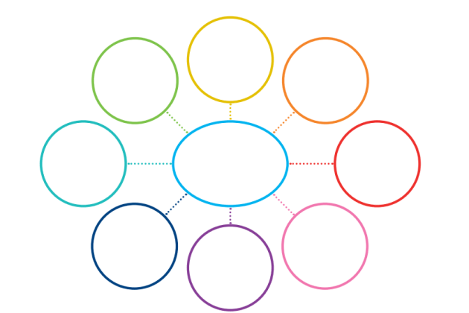
Have you noticed any actions around the community being taken to reduce the seriousness of a wildfire?
Wildfire
Mitigation
Notes:
Have each student make a mind map in their journal. Add in ideas or actions they have seen or already know about.
The pictures from slide four might remind them of things they have seen. Share ideas after two minutes.

Slide 8
Chart what you learn in the upcoming videos.
Name of mitigation action/program | What is being done? | What is the desired outcome?
Example: Youth Education: Wildfire in the Foothills | Educate more Butte County 6th-graders about how they can help their community and family be more fire-safe. | Butte County residents are well prepared and stay safe during a wildfire.
Notes:
Students can add to their charts during the video and share with a neighbor after each video, before moving to the next topic.

Slide 9
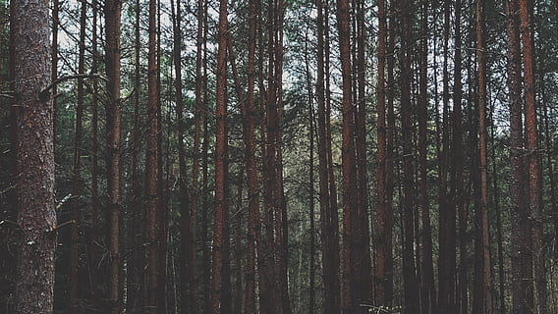
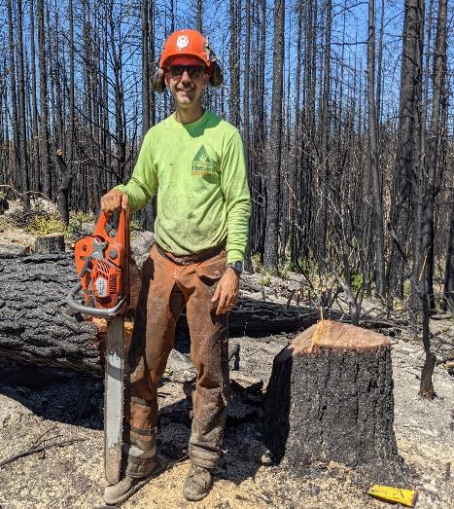
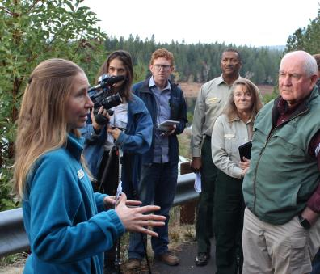
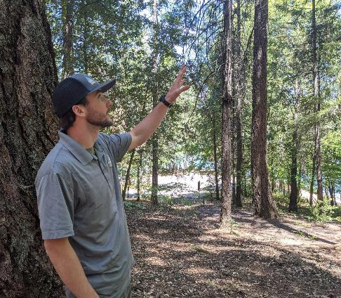
Butte County Fire Safe Council
Video Link
Notes:
Video Link: https://youtu.be/NNkh7mf18rw
Fire Safe Councils are grassroots, community-led organizations that mobilize residents to protect their homes, communities, and environments from catastrophic wildfire.
Video Length: 5:54

Slide 10
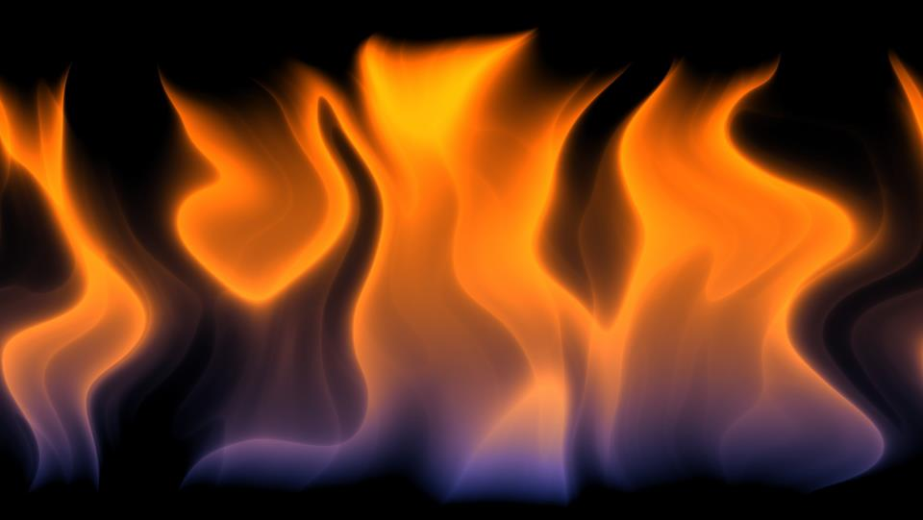
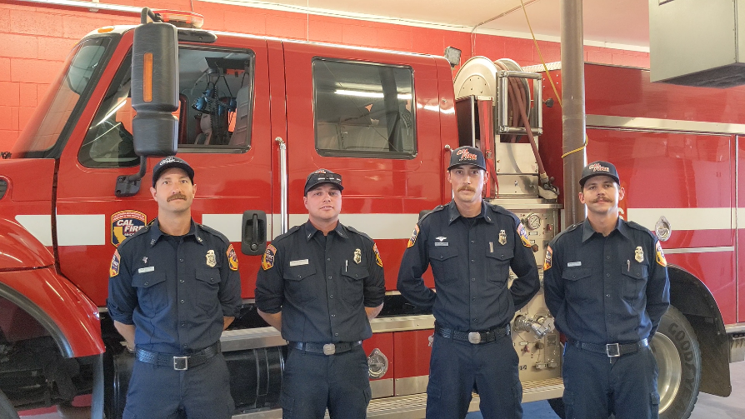
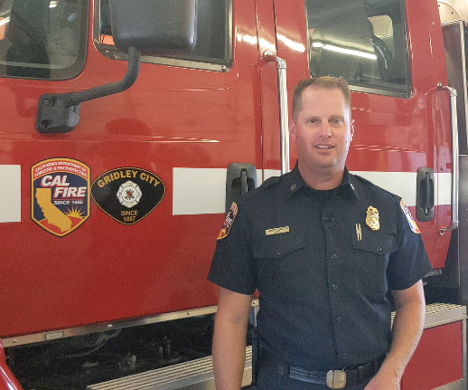
CAL FIRE
Video Link
Notes:
Video Link: https://youtu.be/1JehSD9RuxM
Meet the CAL FIRE fire professionals at Gridley Station 74 and learn about some of the equipment and methods firefighters use to protect and defend our communities.
Video Length: 5:30

Slide 11
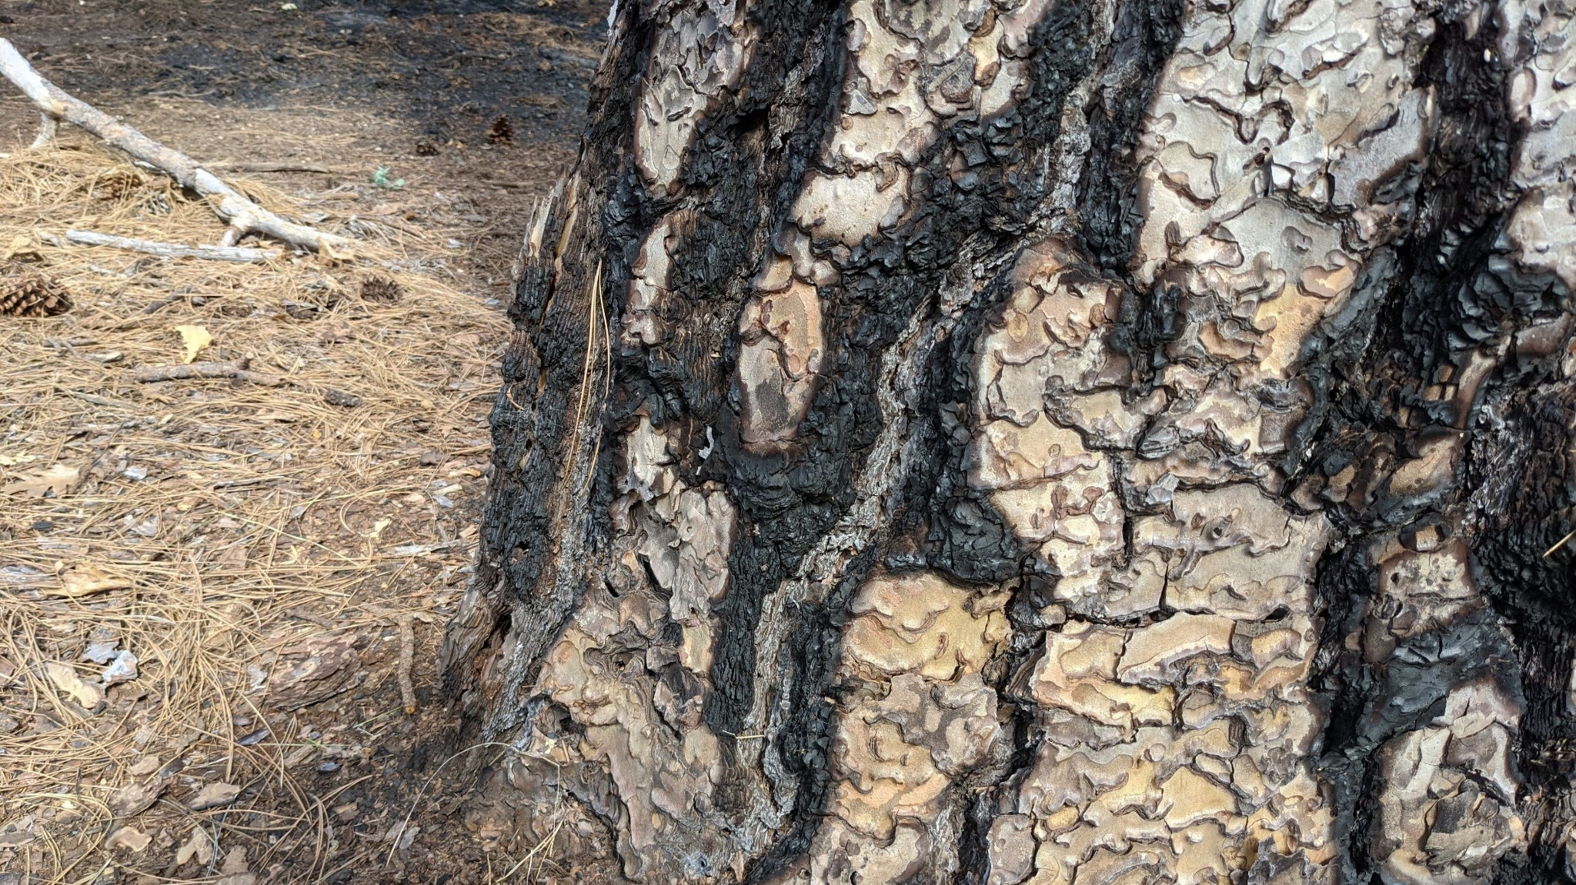
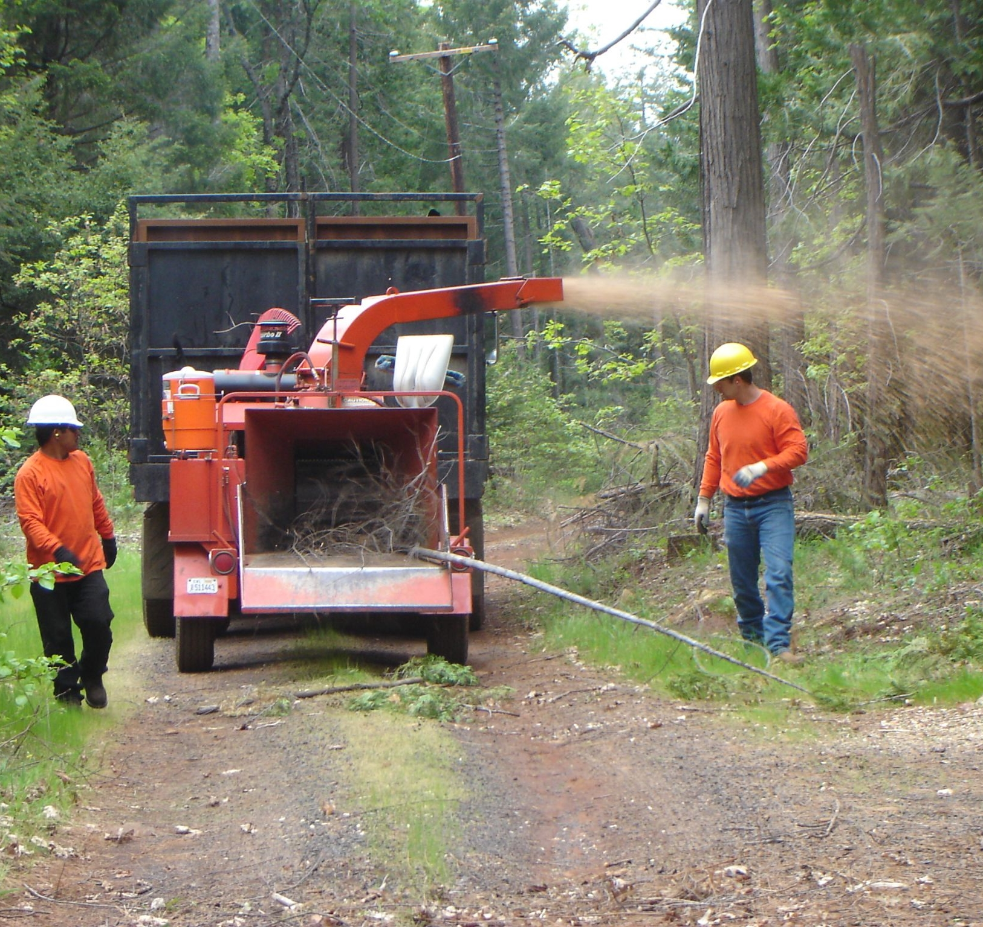
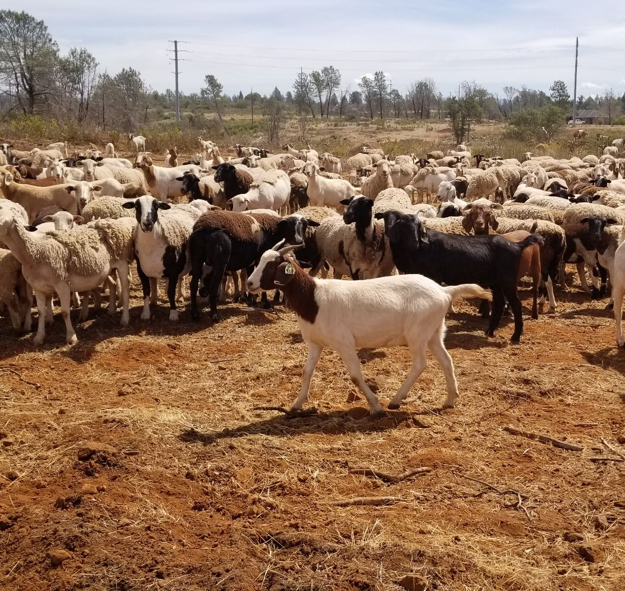
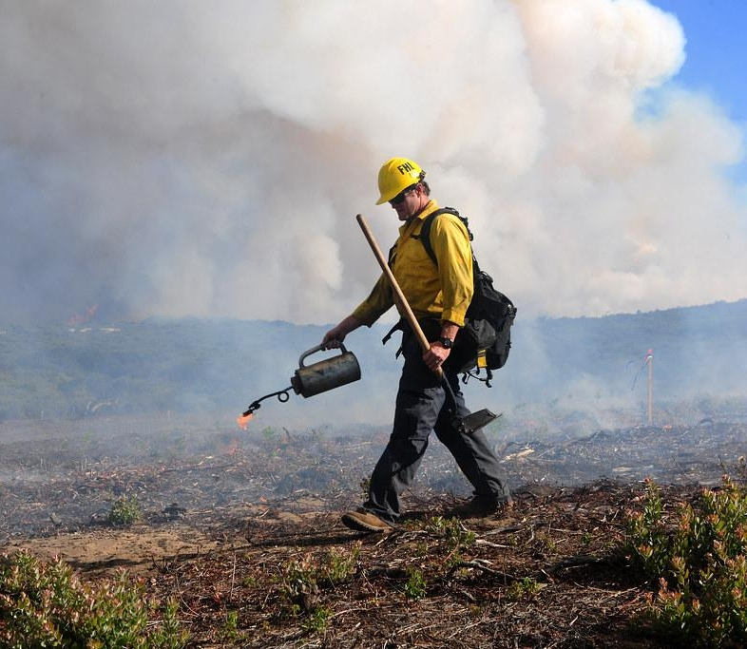
Fuels Management
Grazing
Prescribed Fire
Notes:
Featured mitigation strategies:
Fuels management through chipping, thinning, and grazing
Prescribed fire
Community education

Slide 12
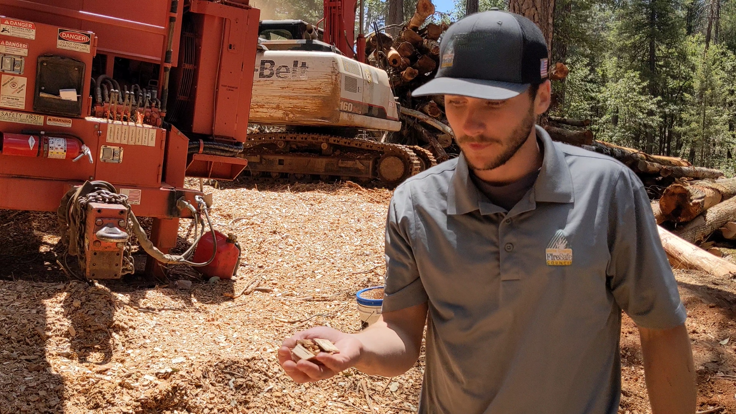
Fuels
Management
Video Link
Notes:
Video Link: https://youtu.be/LwyEjIkD8WI
Visit an active project in Magalia, with BCFSC assistant director Taylor Nilsson, to witness how mechanical thinning and chipping contributes to healthier and more fire-safe forests.
Video Length: 5:04

Slide 13
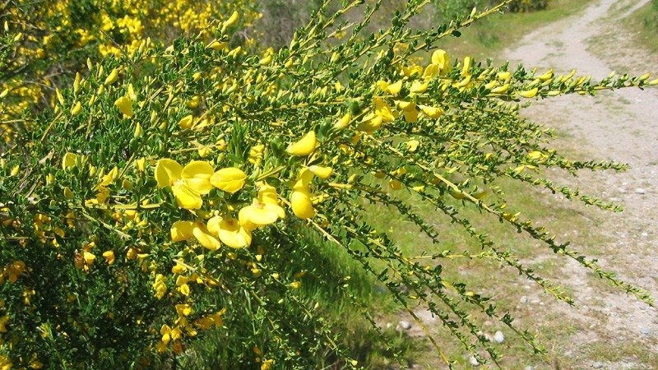
Grazing
“Taking out the highly invasive and flammable broom weed in the area is one of the major goals for the hungry animals.”
-Chico Enterprise-Record
Video Link
Notes:
Video Link: DWR Uses Goats to Help Prevent Wildfires
“A herd of 350 to 400 goats from Hanski Family Farms LLC were used to successfully reduce hazardous fuels in nearly five acres near Lake Oroville. The California Department of Water Resources partnered with the Butte County Fire Safe Council on this grazing project to reduce the fire risk from grasses, leaves, invasive and non-invasive plants, and other vegetation.”
This video was created by the Department of Water Resources and released in 2021.
Video Length: 2:45

Slide 14
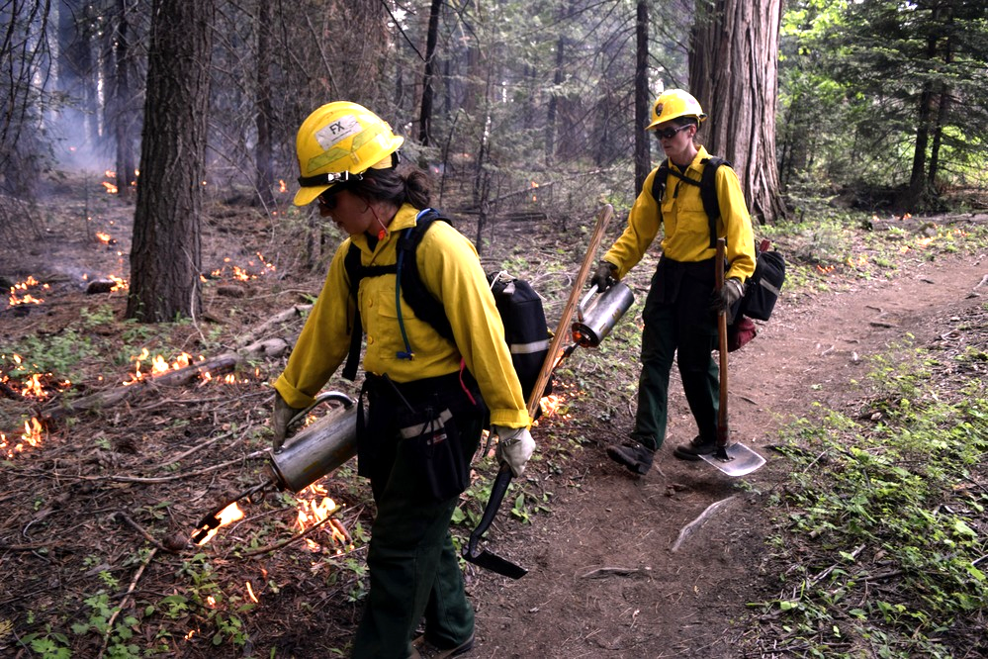
Notes:
1) What do you think is happening in this picture? What do you notice?
2) What do you wonder about the people in this picture?
Prescribed fire at Sequoia and Kings Canyon National Parks, June 2016.
Prescribed fire is an important management tool for the National Park Service.
Photo courtesy of National Park Service Photo Gallery (US National Park Service)

Slide 15
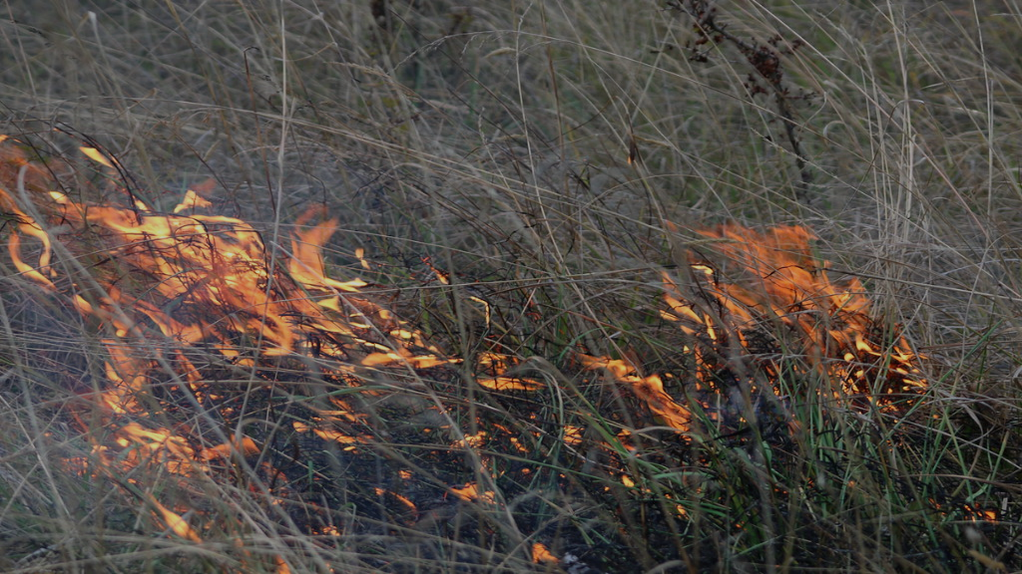
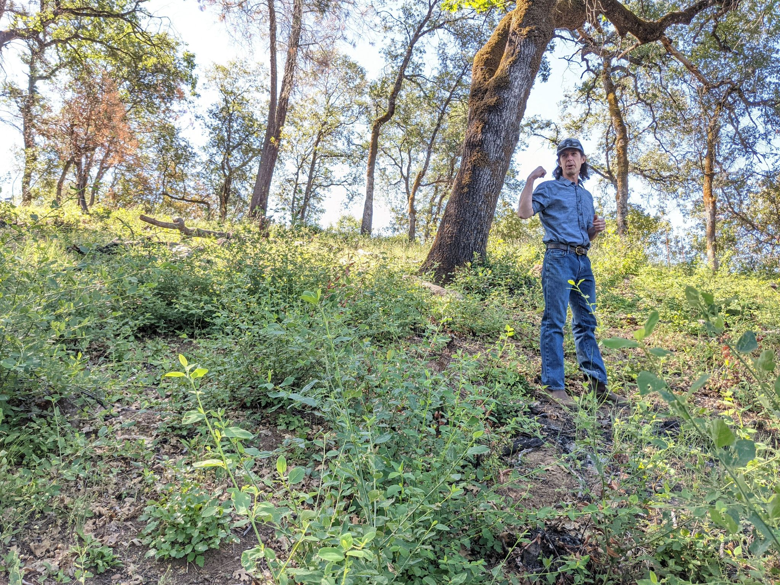
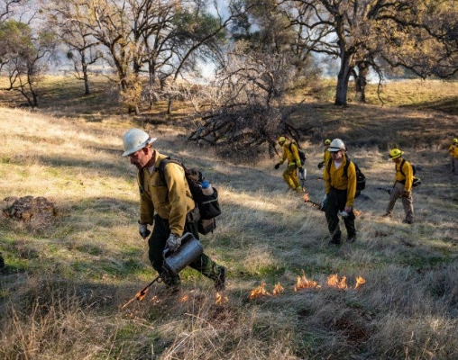
Prescribed Fire
Video Link
Notes:
Video Link: https://youtu.be/NcU_bAJW7jI
Learn about the ecological benefits and uses of prescribed fire with CSU Chico professor and fire practitioner, Dr. Don Hankins, at a recently burned area atop Doe Hill Ridge in Forest Ranch.
Video Length: 5:30
Photo: Chico State Today: PRESCRIBED FIRE SCHEDULED ON UNIVERSITY’S BIG CHICO CREEK ECOLOGICAL RESERVE
Jason Halley / University Photographer

Slide 16
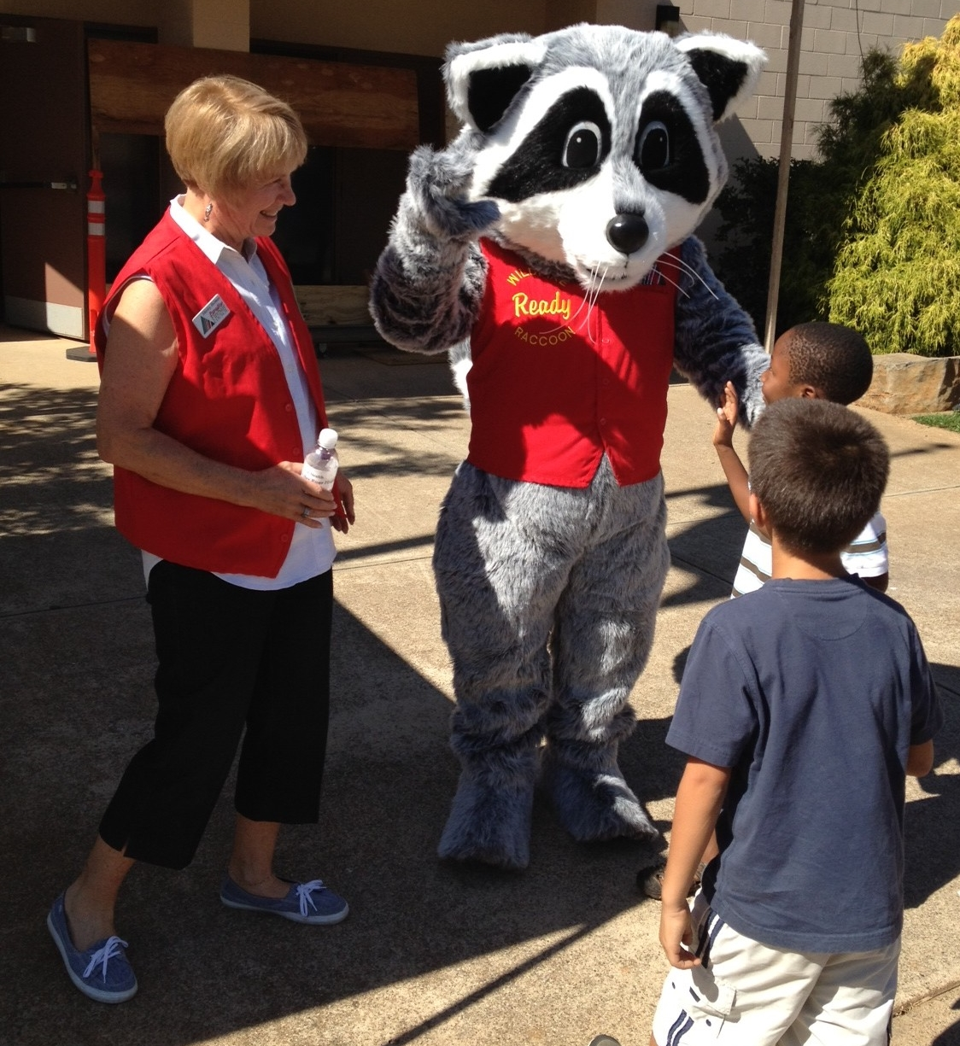
Wildfire Ready Raccoon
Sharing fire-safe messages and fun since 2008!
“I’m a raccoon livin’ in Paradise. I’m ready, are you ready?”
Watch here:
The Official Wildfire Ready Raccoon Rap
Notes:
Video Link: The Official Wildfire Ready Raccoon Rap
Wildfire Ready Raccoon, created by Phil John after the 2008 Humboldt fire, has been an important part of the community ever since. Ready spreads his message of wildfire preparedness through his book, at live events around the community, and now through music! Watch Ready Raccoon’s music video for important tips about how to be prepared for a wildfire. It looks like he has some support from youth in the community too!
Video Length: 3:41

Slide 17
What new ideas do you have?
Wildfire
Mitigation
Notes:
Students add new strategies to the mind map from their video learning charts.

Slide 18
START - STOP - CONTINUE
- What actions could more people START doing to strengthen the community to wildfires?
- What could lead to a wildfire that people should STOP doing?
- What mitigation actions are already happening that should CONTINUE?
Notes:
Small group or class discussion.
For the STOP category, have students reflect on Lesson 3 and review topics picked for the wildfire PSA activity.

Slide 19
TakeAction
Teen Program
Project Categories:
Risk reduction
Evacuation planning
Help community first responders
Educational outreach
Post-fire impacts
Notes:
Break into small groups. Have students access the pdf through the National Fire Protection Association’s website.
https://www.nfpa.org/Public-Education/Fire-causes-and-risks/Wildfire/TakeAction
7-page pdf: Community Service Project Ideas

Slide 20
Propose a class service project.
Read through the project ideas.
Decide in your small group which project you think would be the best choice for you class to work on.
Discuss, make notes in your journals, and be prepared to share with the class:
What is the specific problem?
What would your project work to accomplish?
Why is this service project a good fit for our class to participate in?
What skills, equipment, and time are needed to complete the project?
Notes:
Allow 10 minutes for group discussion and presentation planning that addresses the four questions on the slide. Each group has two or three minutes to present their project idea to the class and every person in the group should have a part in the presentation. Note student’s project suggestions for later reference. Some ideas that students present for a class project may be part of the next three lessons about personal and family preparedness, which is a great segue.

Slide 21
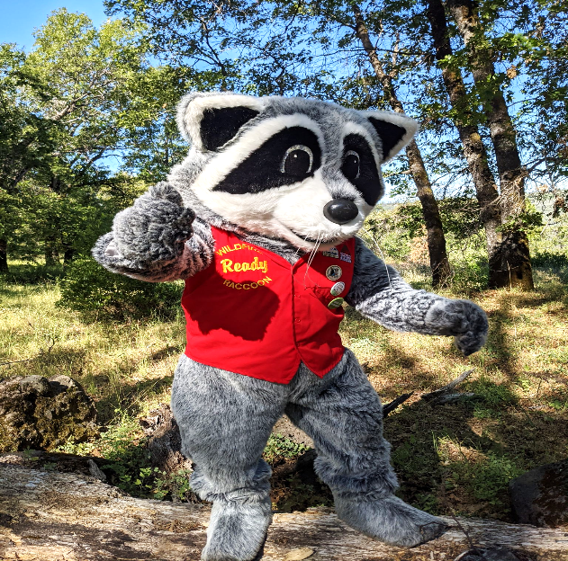
You have completed Lesson 4.

