Slide 1
Wildfire in the Foothills
Lesson 2: Cultural Fire

Slide 2
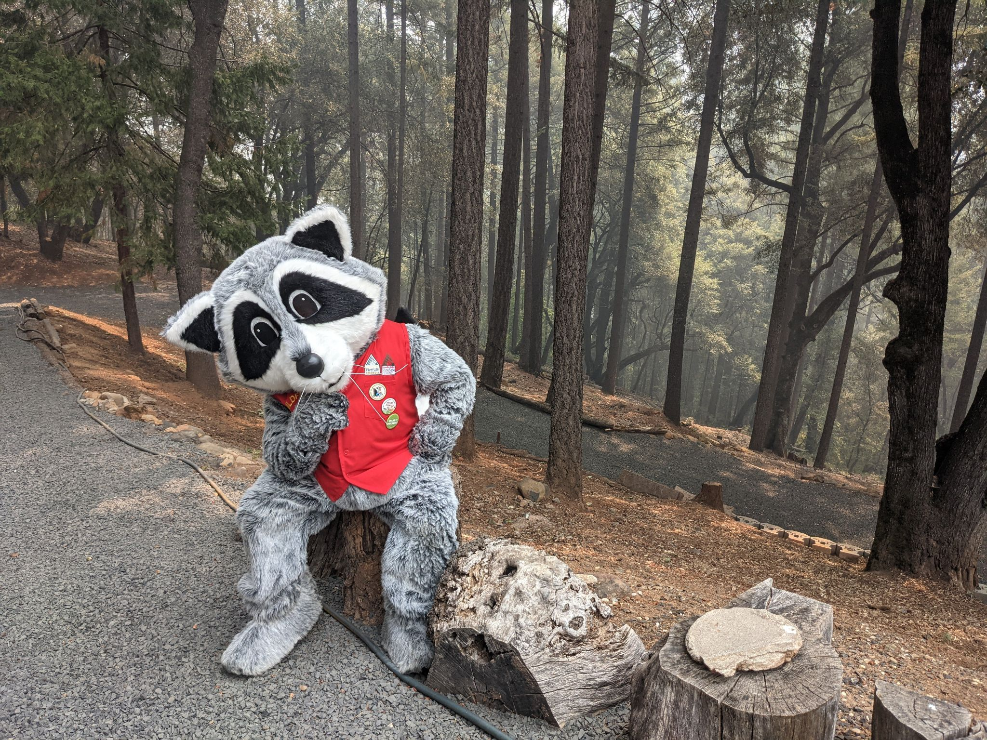
How do Indigenous Californians, past and present, use fire?

Slide 3
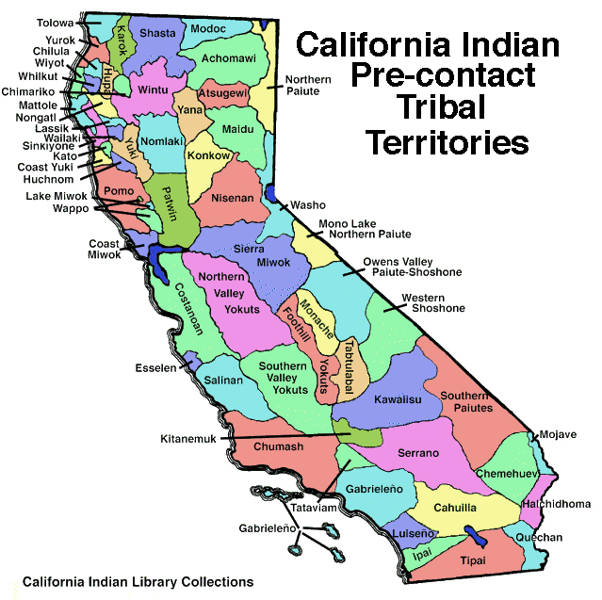
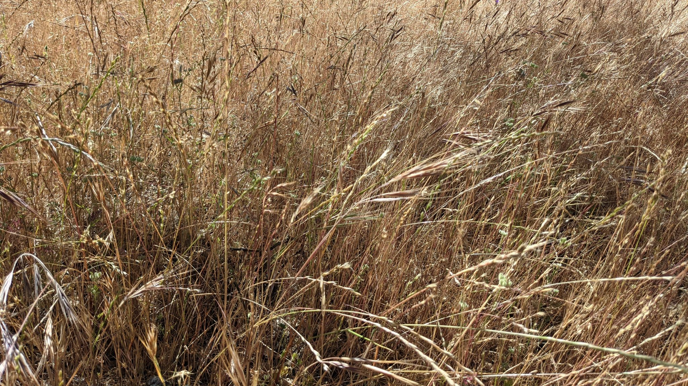
Which tribal territory do you live in?
Notes:
The Northwestern Maidu were the earliest known residents of what is today, Butte County. Their descendants include the Tribes of: Berry Creek Rancheria of Maidu Indians, Enterprise Rancheria of Maidu Indians of California, KonKow Valley Band of Maidu, Mechoopda Indian Tribe of the Chico Rancheria, and Mooretown Rancheria of Maidu.
Source: Northern California Indian Development Council
California Indian Library Collections
https://ncidc.org/CA_Tribal_Territories_and_Language_Maps

Slide 4
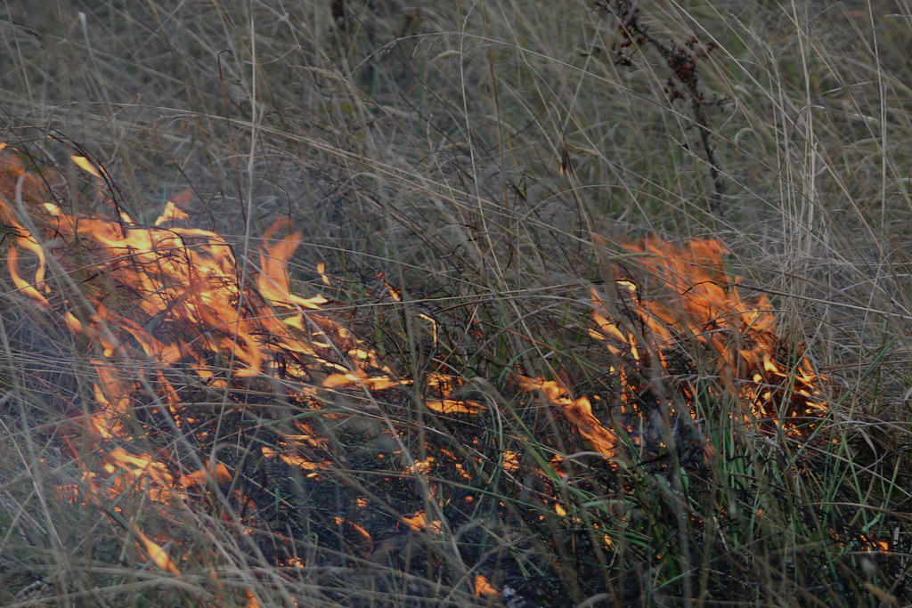
Indigenous Californians have used fire to maintain healthy ecosystems for over ten thousand years!
Tribes have unique burning practices to improve their environments. This supports both the people, and plants and animals who live here.
Notes:
How fire is applied and the desired outcomes, depend on factors like the area’s topography, climate, season, species present, the area’s fire history, and human needs. People and plant communities have co-evolved with fire in California.

Slide 5
A cultural burn is a fire started and managed by Indigenous people for specific outcomes. Cultural burns are typically low-intensity fires or “cool burns”.
An intentional fire for land management purposes today may also be called a prescribed fire. However, this may or may not include Indigenous people in the burn.
Notes:
Cultural burns have less heat, less plant die-off, and the fire stays within people’s control.

Slide 6
Notes:
What do you notice about this photo?
What do you wonder about the scene?
Does this picture reveal what might these people be thinking or feeling about fire?
Photo –Woodland-Cultural-Burn-3
Credit Alysha Beck/UC Davis
UC Davis professor of Native American studies Beth Rose Middleton Manning throws deergrass onto a burning pileas she and students in the “Keepers of the Flame”class take part in a cultural burn at the Tending and Gathering Garden at the Cache Creek Nature Preserve in Woodland.
Article: https://climatechange.ucdavis.edu/news/rethinking-wildfire/

Slide 7
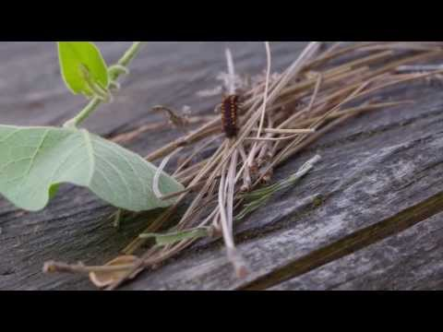
Notes:
Traditional Ecological Knowledge (TEK) describes Indigenous knowledge of local resources developed over thousands of years. The first seven minutes (of this 27-minute video) introduces Traditional Ecological Knowledge within a Chico area context and peoples’ personal connections with TEK. The video will automatically stop after seven minutes.
Link to video: Traditional Ecological Knowledge
Living Traditions- Living Lands

Slide 8
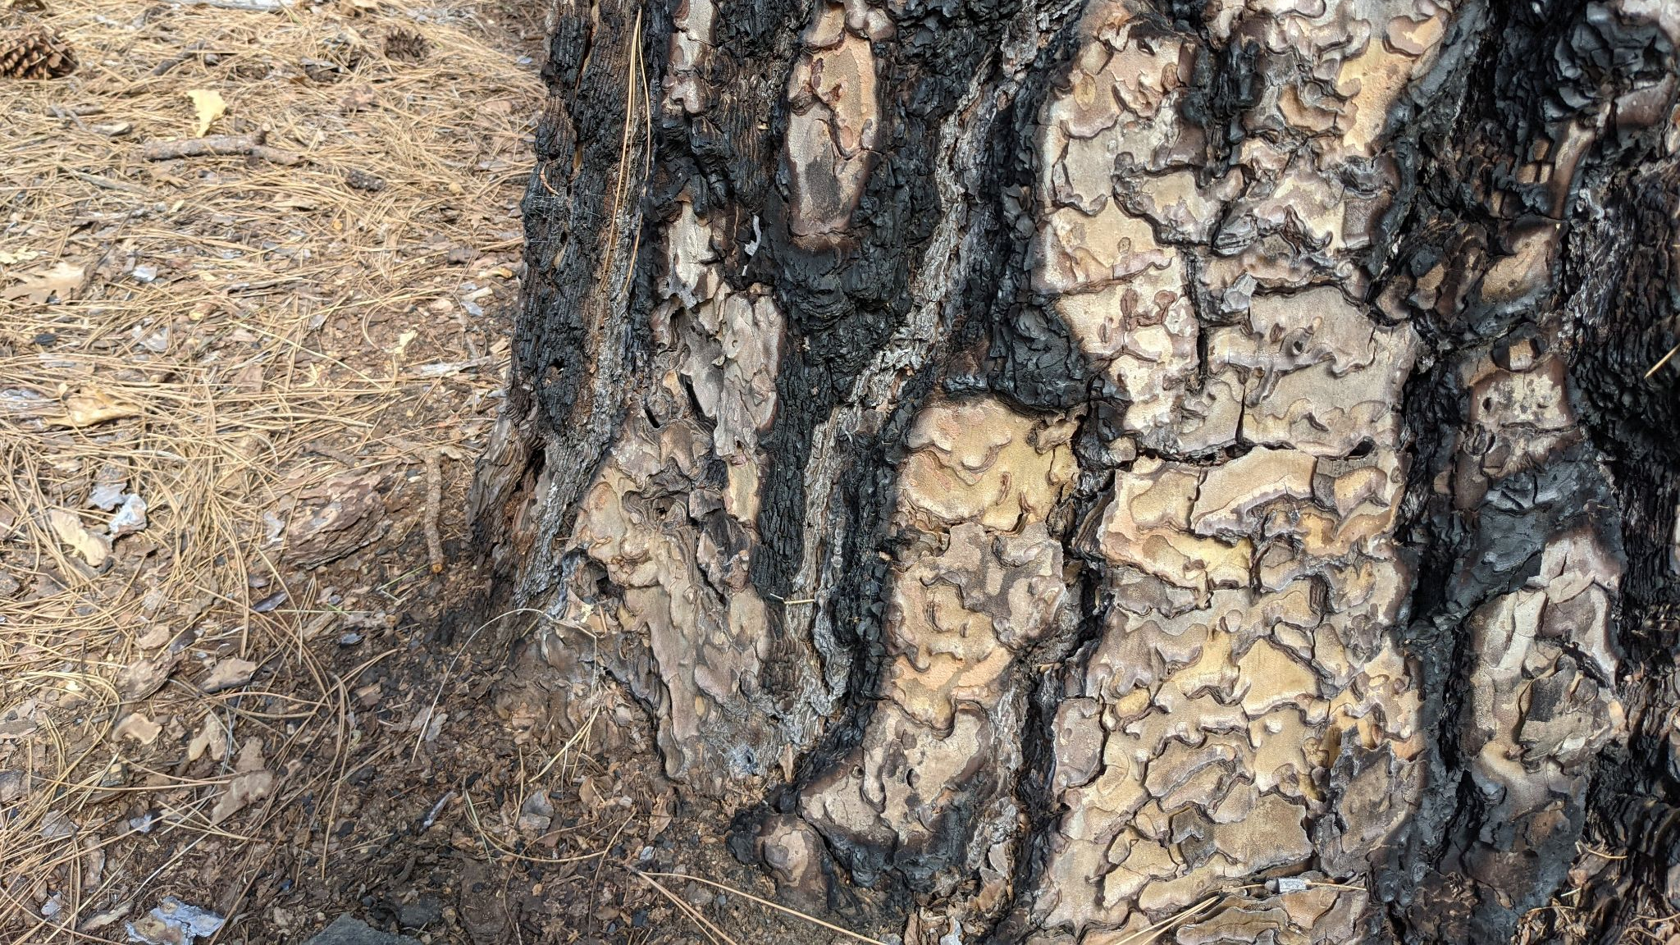
1) How would you explain Traditional Ecological Knowledge (TEK) to a classmate if they were not here today?
2) How was your knowledge of the area you live in developed?
3) Why do you think we are learning about TEK in a program about wildfire?
Notes:
Journal reflection.

Slide 9
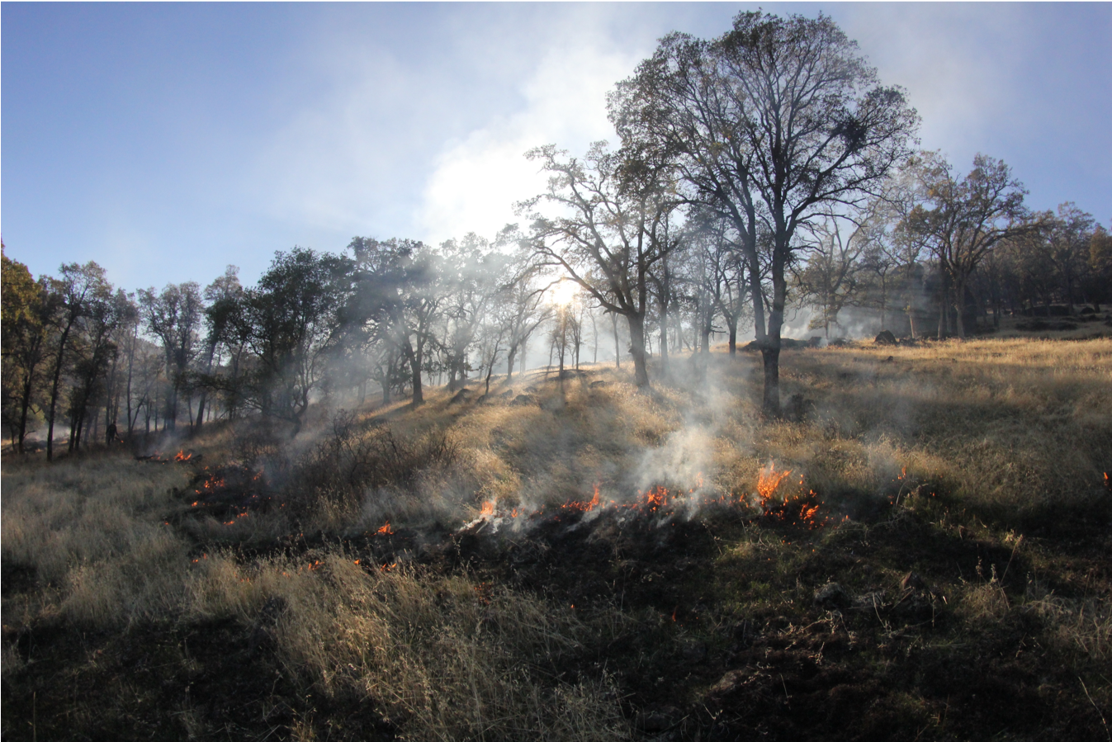
Some Uses of Cultural Fire:
Promote desired habitats and species.
Increase favored resources.
Alter plant structure for materials.
Improve safety and travel.

Slide 10
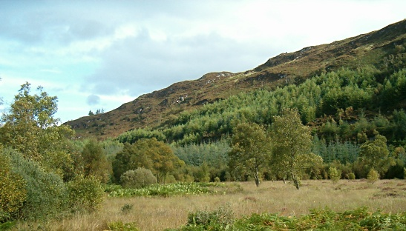
Promote desired habitats and species.
Frequent, low-intensity fire improves ecosystems by making patches of plants of different ages, sizes, and species. This creates a rich mixture of resources for food, clothing, tools, and medicine.

Slide 11
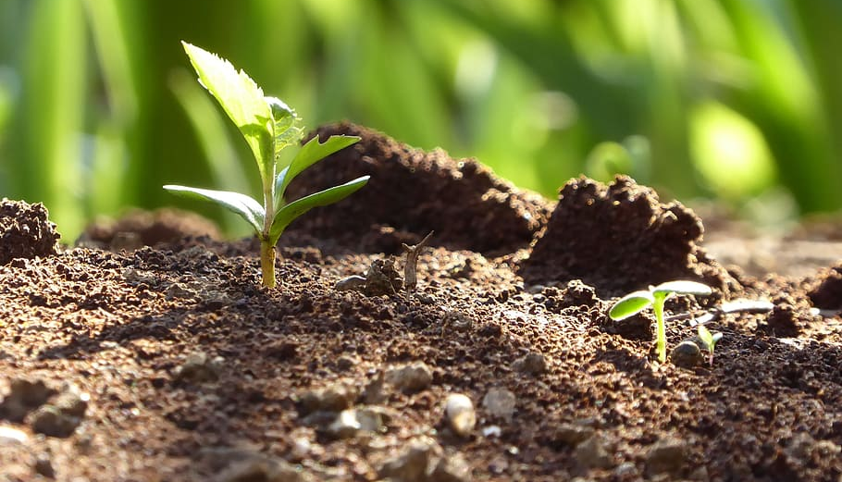
Increase favored resources.
Fire restores soil nutrients which increases the output of edible plants such as grass seeds, greens, bulbs, and corns. Straight, flexible shoots that grow from the base of a burned oak tree produces the best materials for making baskets and cradles.

Slide 12
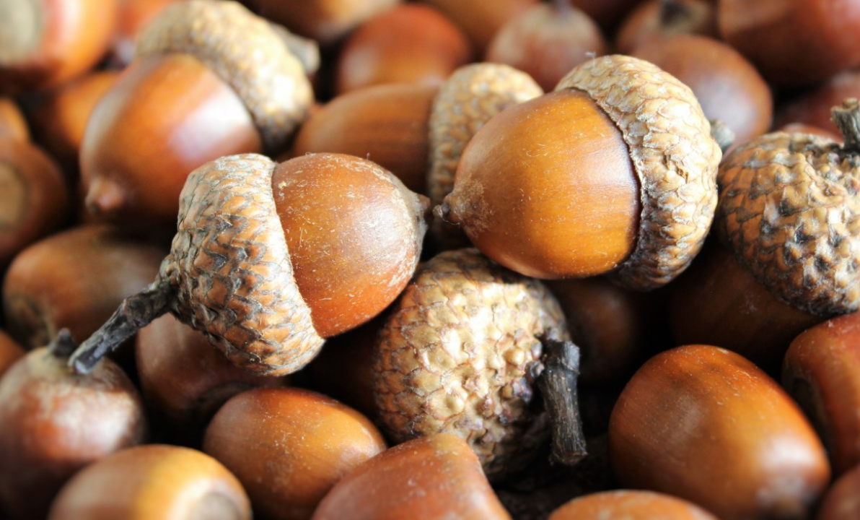
Increase Acorn Harvest
The black oak’s large, round acorns were a staple food source for the Maidu. Harvested acorns were dried, leached of tannins, ground into flour, and eaten as a mush or cooked into breads.
According to the Mechoopda Tribe, “an abundant annual crop of acorns might provide enough food for an entire year, and due to its hard shell, could often be stored for up to two years in time.”
Notes:
Using fire to remove understory shrubs made collecting acorns easier once they fell to the ground. This also reduces the trees’ competition for water. Burning helps oak trees by decreasing insect pests, disease, and undergrowth fuels that could carry damaging flames to the canopy. This gave trees the energy to produce a larger, and higher quality acorn batch.
Mechoopda Indian Tribe of the Chico Rancheria, Culture
https://www.mechoopda-nsn.gov/culture/

Slide 13
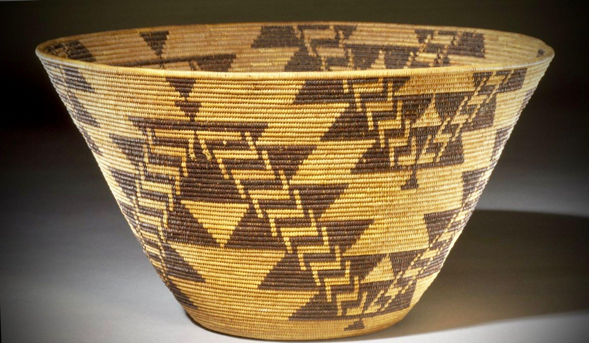
Improve Natural Materials
Fire alters the structure of grasses and plants to produce more useable shoots. Baskets woven with other native plant materials were made for collecting grass seeds, sifting acorn flour and cooking, storage, and carrying materials.
Notes:
Image: Finely coiled presentation bowl by Maidu weaver, Mary Kea’a’ala Azbill (1864-1932), made from sedge root, briar root, and willow shoots.
Background image: Basket tray, Maidu, before 1932 - Oakland Museum of California

Slide 14
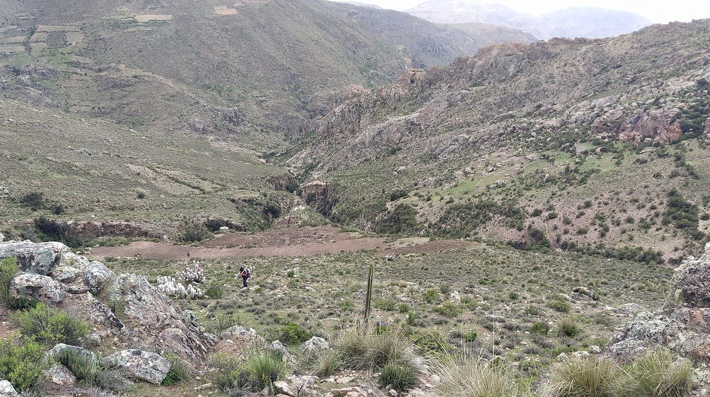
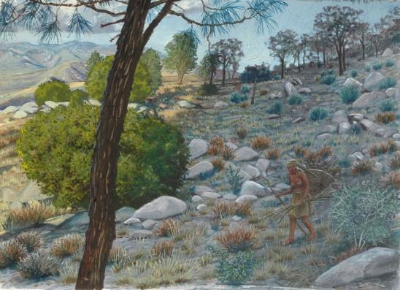
Improve Safety and Travel
Areas surrounding villages were burned frequently, even yearly. This protected the villages from fire danger by reducing the amount of fuel nearby. Fire opened the landscape to improve visibility and travel.
Notes:
Image: Miwok Woman Gathering from A State of Change: Forgotten Landscapes of California
-Laura Cunningham

Slide 15
Watch the following video about using cultural fire today and be prepared to answer the following questions:
1) What were some of the reasons given for why fire is important?
2) What were some ways they used fire in the video?
3) What is a consequence of removing fire from the landscape?

Slide 16
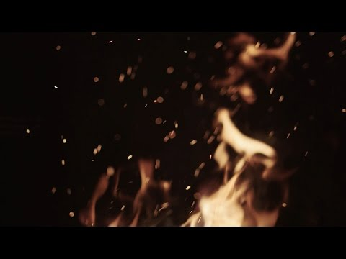
Notes:
“In this video, we explore how cultural burning is being practiced today and what lessons it holds for the future of the forest. We visit the area just south of Yosemite National Park where two tribes are working to bring fire back to the land, the North Fork Mono Tribe and the Cold Springs Rancheria of Mono Indians.”
Tending the Wild - 18-minute video from KCET-TV (2016)
E1: Cultural Burning - How Native American Peoples Use Fire to Rejuvenate the Land

Slide 17
1) What were some of the reasons given for why fire is important?
2) What were some ways they used fire in the video?
3) What is a consequence of removing fire from the land?
Notes:
Pair share or small group discussion.

Slide 18
Notes:
Cultural burns happen locally in Butte County. This photo is of a cultural burn in the oak woodlands at the
Big Chico Creek Ecological Reserve in 2015. Photo courtesy of Dr. Don Hankins.

Slide 19
What is the dominant view of fire today?
Notes:
Environmental Principal and Concept #5: Decisions affecting resources and natural systems are complex and involve many factors. The process of making decisions about resources and natural systems, and how the assessment of social, economic, political, and environmental factors has changed over time.
The table on the next four slides show contrasting views of fire. Possible discussion of each point. What themes from today’s lesson do students see represented in these views?

Slide 20
War on fire. | Work with the flow of natural processes.
Wildfire is destructive. | Wildfire is a necessary natural process.
Control wildfire on the landscape. | Learn to live with fire on fire-adapted landscapes.
Prevent and suppress fires. | Create fire-resilient human and natural communities.
Notes:
Chart adapted from (Olson & Bengston, 2015)
Olson, Robert L.; Bengston, David N.; DeVaney, Leif A.; Thompson, Trevor A.C. 2015.
Wildland fire management futures: insights from a foresight panel. Gen. Tech.
Rep. NRS-152. Newtown Square, PA: U.S. Department of Agriculture, Forest Service,
Northern Research Station. 44 p.

Slide 21
War on fire. | Work with the flow of natural processes.
Wildfire is destructive. | Wildfire is a necessary natural process.
Control wildfire on the landscape. | Learn to live with fire on fire-adapted landscapes.
Prevent and suppress fires. | Create fire-resilient human and natural communities.

Slide 22
War on fire. | Work with the flow of natural processes.
Wildfire is destructive. | Wildfire is a necessary natural process.
Control wildfire on the landscape. | Learn to live with fire on fire-adapted landscapes.
Prevent and suppress fires. | Create fire-resilient human and natural communities.

Slide 23
War on fire. | Work with the flow of natural processes.
Wildfire is destructive. | Wildfire is a necessary natural process.
Control wildfire on the landscape | Learn to live with fire on fire-adapted landscapes.
Prevent and suppress fires. | Create fire-resilient human and natural communities.
Notes:
Fire suppression is the act of putting out and stopping wildfire.

Slide 24
WARNING:
Intentional and accidental wildfires are extremely dangerous. Cultural and prescribed burns are practiced by people with years of experience and training with fire. These fires are set under the right conditions, with permission, and with the proper training and equipment.
NEVER intentionally start a wildfire or attempt a prescribed burn.
Notes:
Fire Safety Clarification: Do NOT start wildfires.
*NEVER is referring to them as a young student. If they go on to be fire practitioners and go through the proper training, great!
Make sure this safety point is very clear with students before moving on. Some definitions to help with the distinctions:
A wildfire is an unplanned, unwanted, uncontrolled fire.
Arson is the criminal act of deliberately setting fire to property.
Prescribed fire is the controlled application of fire to the land for management purposes.
A cultural burn is fire set and managed by Indigenous People for ecological or cultural outcomes.

Slide 25
Key Word Review
Cultural Burn
Prescribed Fire
Traditional Ecological Knowledge (TEK)
Fire Suppression

Slide 26
I still have questions about...
I used to think...
Now I think...
Notes:
Final discussion. Do students have new thoughts about fire after the lesson? If not, do they recall any new thoughts after the first lesson about healthy forests?

Slide 27
Assessment Activity
Create two Google Slides to summarize your learning about cultural fire. You can use photos, art, and information from the internet. Include three or more ideas from the presentation slides, the videos, or the Forest Health Guidebook.
Notes:
Students can also use PowerPoint or another presentation program you are familiar with.
15-20 minute in-class activity. When finished, submit slides.

Slide 28
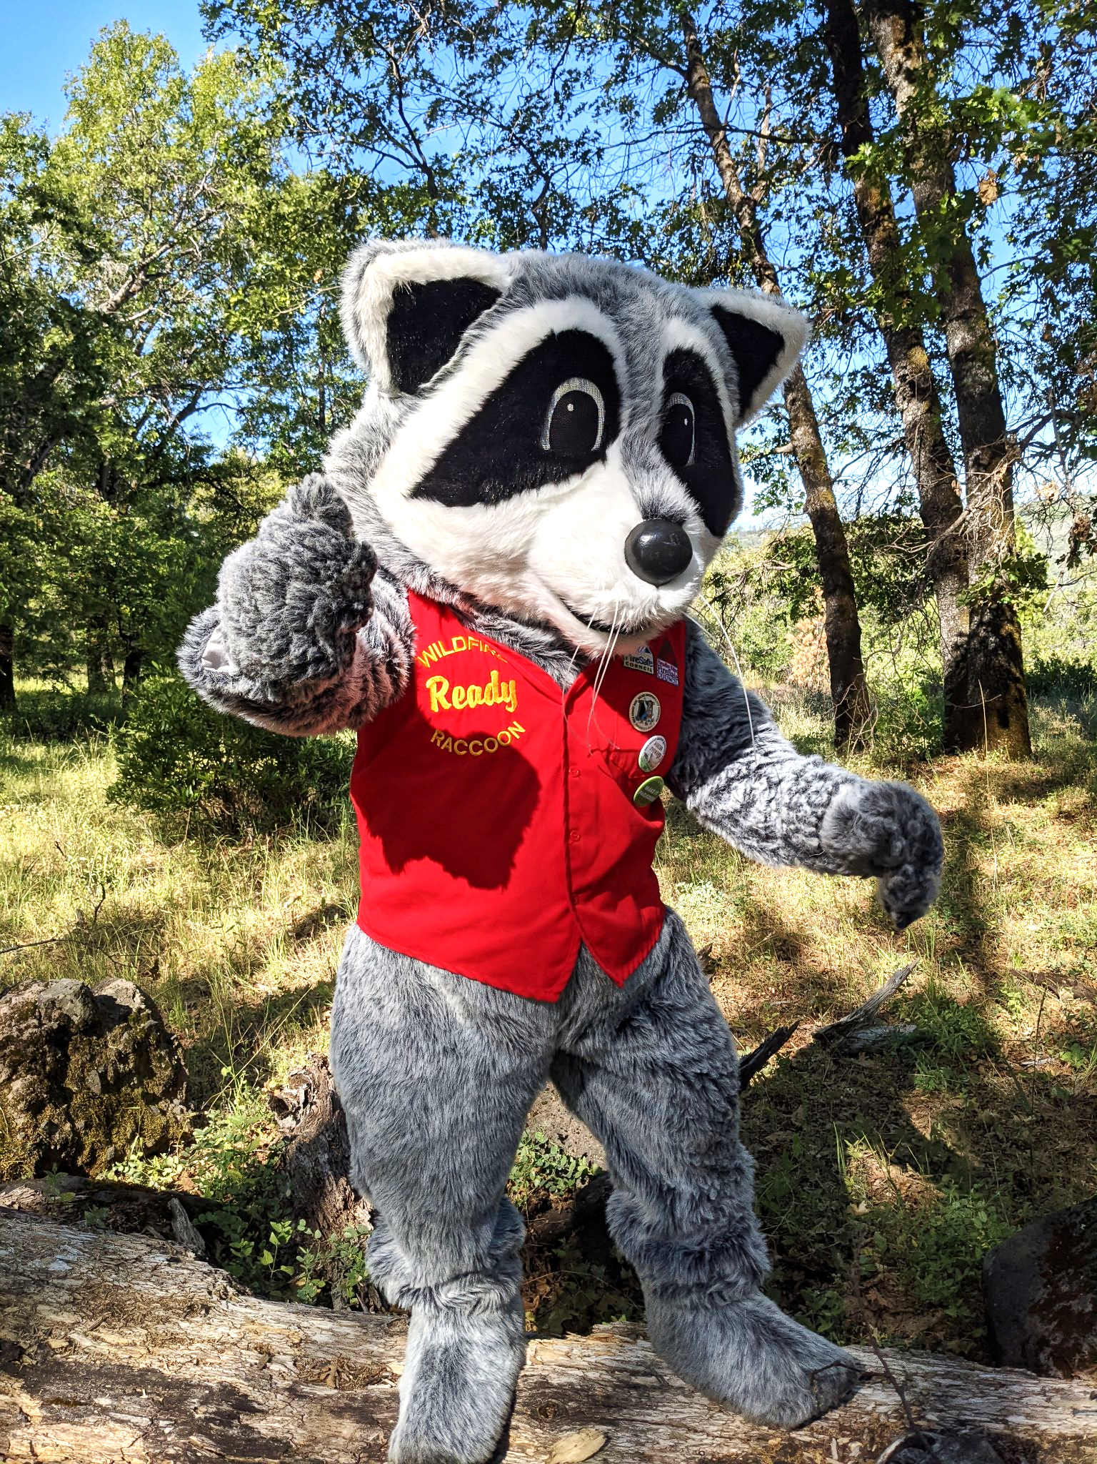
You have completed Lesson 2.

