Slide 1
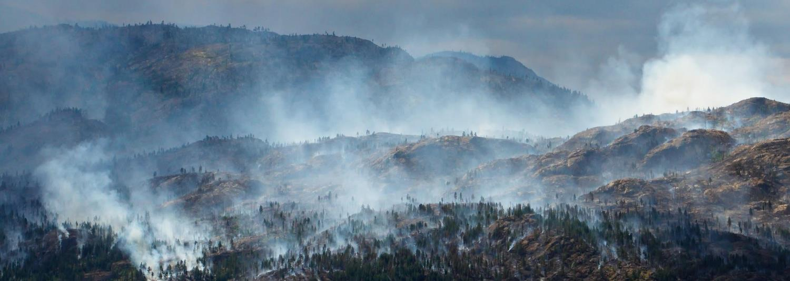
Wildfire in the Foothills
Lesson 1: Fire on our Landscapes

Slide 2
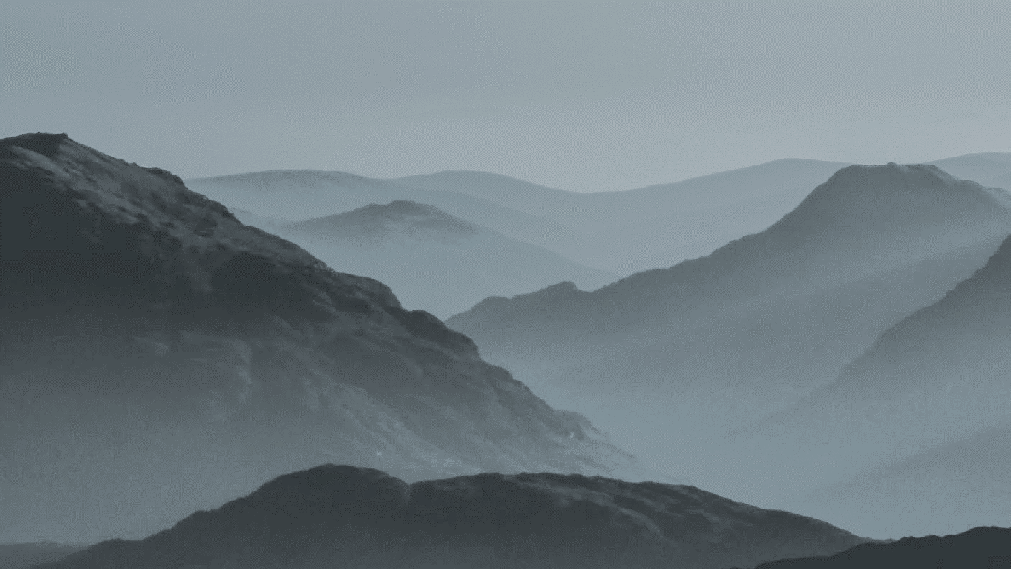
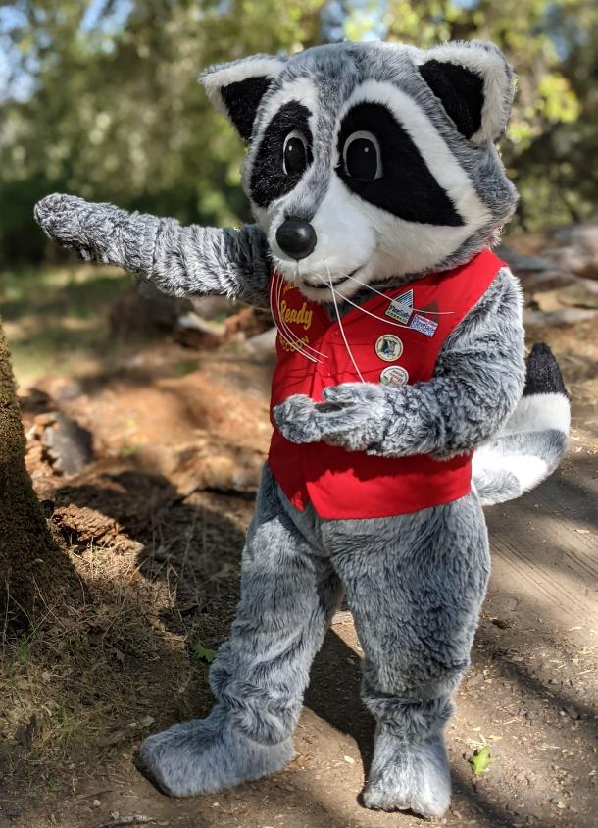
This program is for sixth-grade students in Butte County.
YOU are part of creating a fire adapted community!
The knowledge you gain in this program will help you, your family, and your community to be more wildfire-ready.
Notes:
In the foothills, it is not a matter of IF a fire will occur, but WHEN a fire will occur. What can we do now to be ready?
Pictured: Wildfire Ready Raccoon, the Butte County Fire Safe Council mascot.

Slide 3
Make your Wildfire in the Foothills journal! You will need:
A cover page.
10 pieces of lined paper.
5 pieces of blank paper.
Notes:
Every lesson gives the opportunity to use journals for quick-write reflections, activity brainstorming and outlines, or assessments. Option to include a decorated cover page, table of contents, and a vocabulary page.
Staple together a blank cover page, ten pieces of lined paper, and five blank pages for drawing and diagrams.

Slide 4
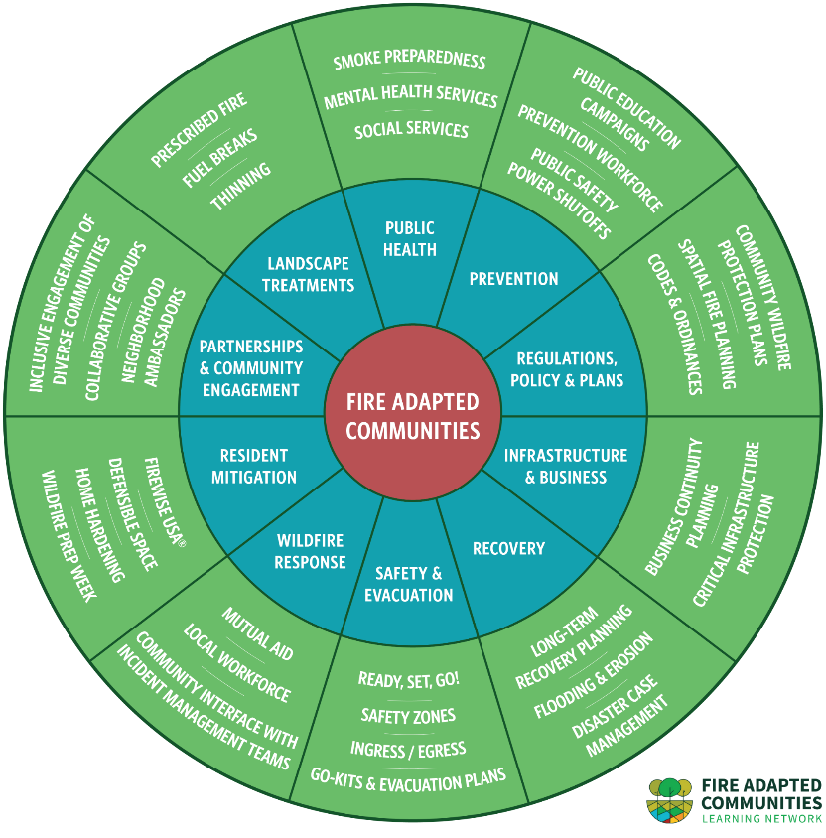
What does it mean to be a “fire adapted” community?
Notes:
The National Wildfire Coordinating Group defines a fire adapted community as “A human community consisting of informed and prepared citizens collaboratively planning and taking action to safely coexist with wildland fire.”
It takes many people working together across many fields to live as a fire adapted community. Wildfire in the Foothills will introduce many of these topics over seven lessons. Of the topics shown in the middle ring, this program focuses on Safety & Evacuation, Resident Mitigation, and Landscape Treatments. Youth education is a key part of community preparedness and living better with fire. Students can spread important messages to their peers, families, and to a wider community audience. They can also become contributing adults if they continue residing in Butte County as they get older.
This graphic was created by the Fire Adapted Communities Learning Network. FAC is not a one-size-fits-all approach; every community’s journey to living better with fire is unique.
Fire Adapted Communities Graphic and Facilitator's Guide

Slide 5
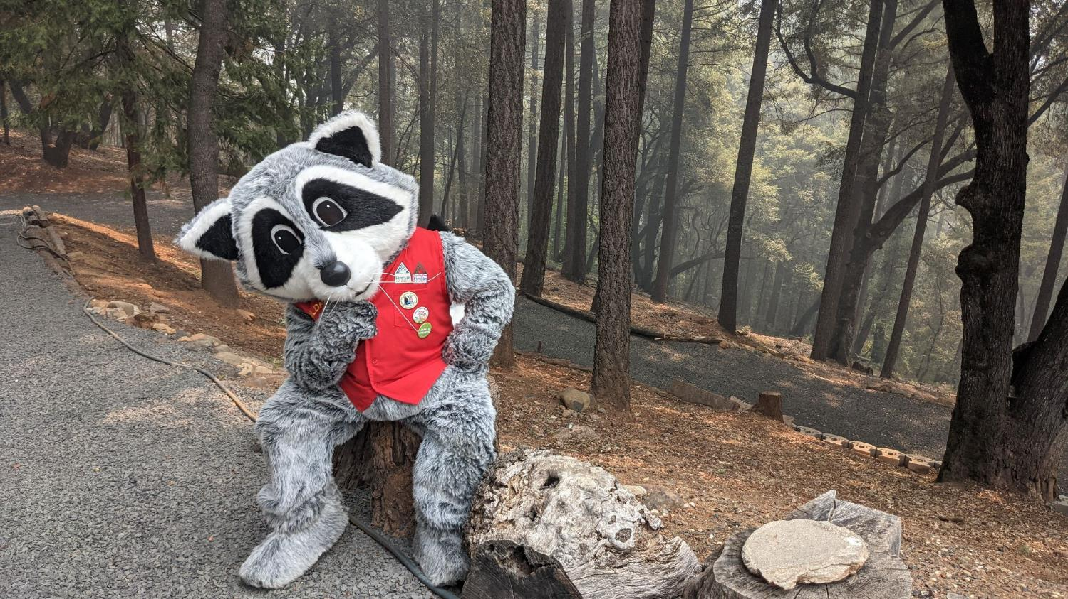
How does wildfire impact the landscapes we live in?
Notes:
Guiding Question: How does wildfire impact the landscapes we live in?
Make a T-chart on the whiteboard or butcher paper and brainstorm possible positive and negative effects of wildfire. Students’ reactions may start out exclusively negative, pointing out the dangers to people and destruction of houses. However, some students may know about some ecosystems or species that benefit from or depend on fire. Keep the T-chart visible as you continue with the lesson and add new ideas as they arise.

Slide 6
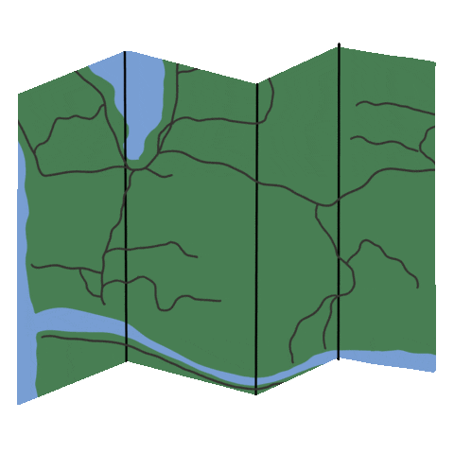
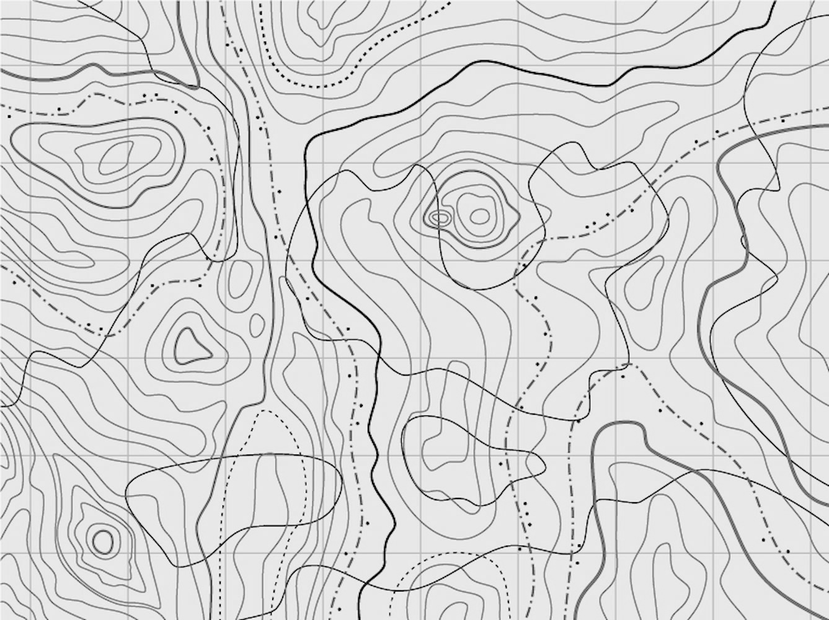
When was the last time you used a map?
Notes:
Group share:
What did you use it for? Was it a paper map? Google maps? A posted sign at a hiking trail?

Slide 7
What types of information can maps tell us?
What features should be included on a useful map?
Notes:
Pair share discussion.

Slide 8
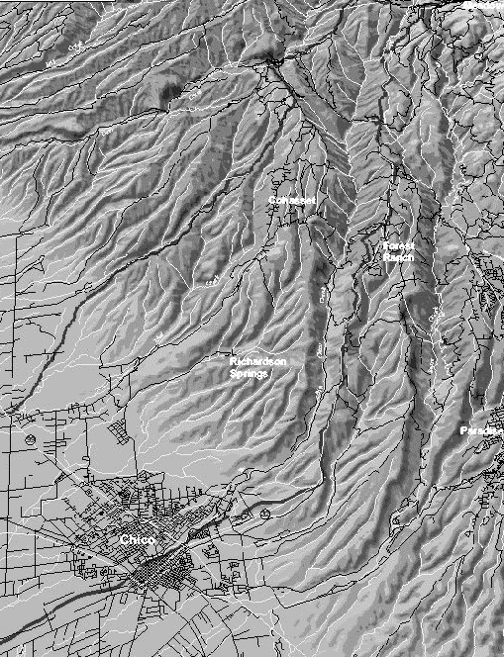
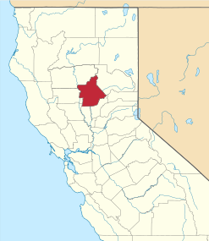
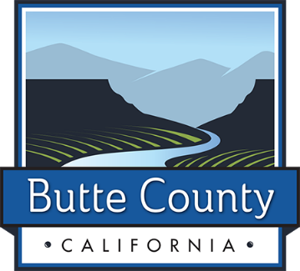
"The Land of Natural Wealth and Beauty"
Population 220,000
Notes:
To be more complete, what features would you add to this map that shows Butte County’s location?

Slide 9
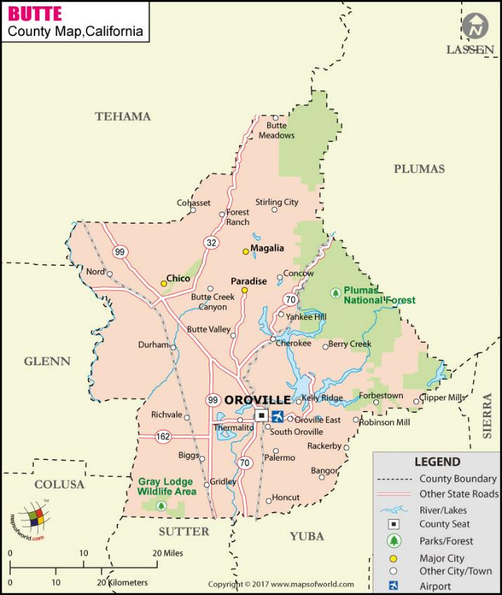
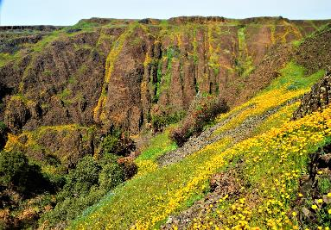
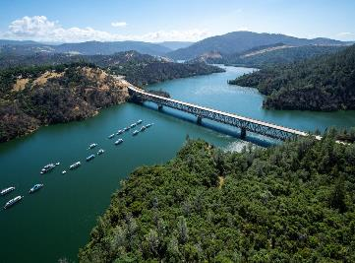
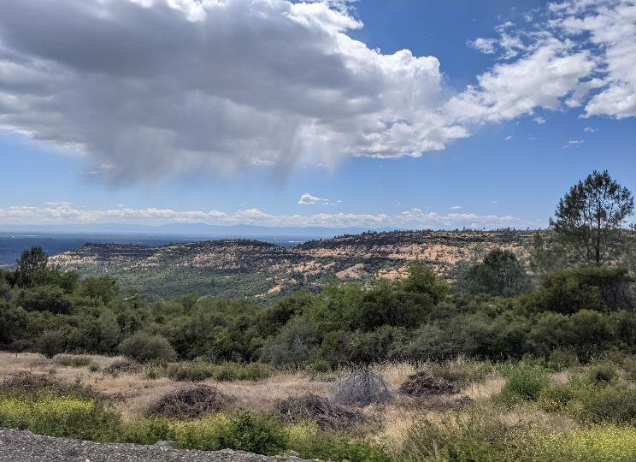
Notes:
This map includes a title, legend, scale, north arrow, and labels, giving us lots more information.
Take a moment to find your approximate location on the map and make some observations about your area.
How many counties border Butte County? (6)
What is your nearest town? Approximate distance from Chico to Paradise? (10 miles, as the crow flies)
Map from: Butte County Map, Map of Butte County, California

Slide 10
Topography: The physical features on Earth’s surface or the technique of representing surface areas of land on maps.
Topography includes mountains, ridges, valleys, plateaus, or water features on the land.

Slide 11
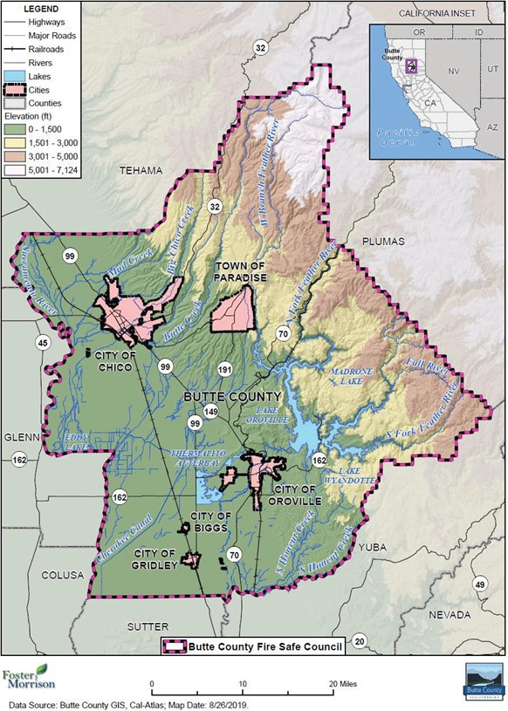
What new information does this map give?
Notes:
County Elevation
What percent of the county would you estimate is between 60-1,500 feet in elevation?
What is the highest point in Butte County? (7,124 feet on the Robert Jenkins mountain ridge)
Have you been to an area with a higher elevation than where we live? Can you remember some differences between that place and here?

Slide 12
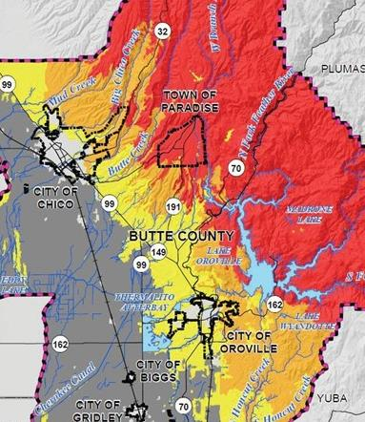
The colors on this CAL FIRE map represent Fire Hazard Severity Zones.
Red is very high and yellow is moderate.
Notes:
CAL FIRE uses various types of data to map wildfire risk and categorizes areas into Fire Hazard Severity Zones. This represents not just the likelihood of a wildfire, but also how much harm it could cause to people and structures. Dark gray areas are non-wildland/non-urban, and light gray around the City of Chico and City of Oroville represents urban areas.
Note: These maps are created at a general scale and do not take into account mitigation activities that may have taken place locally to reduce wildfire risk.
Cropped from: Figure K-2 Butte County Fire Safe Council – Fire Hazard Severity Zones
Annex K Butte County Fire Safe Council

Slide 13
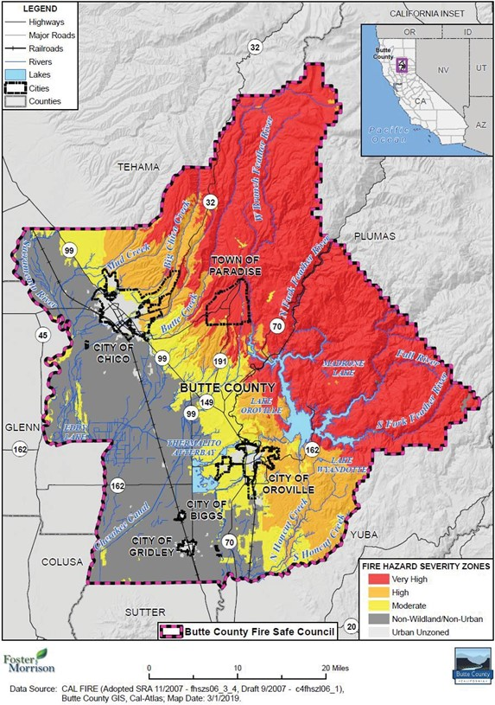
Notes:
What similarities do you notice between these two maps?
What connection could you make between elevation and fire hazard severity?
Other than elevation, can you think of other factors that could affect the fire hazard severity of an area?
Maps from Butte County Local Hazard Mitigation Plan Update, 2019
Data source Butte County GIS and Cal Fire
Annex K Butte County Fire Safe Council

Slide 14
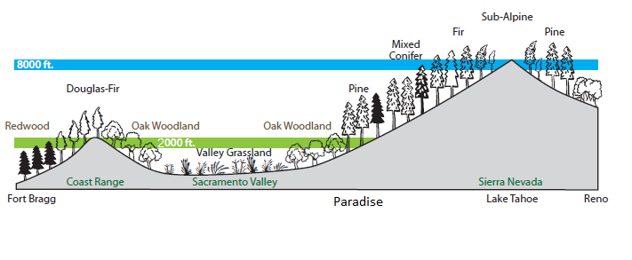
Notes:
This cross-section of California shows what plant communities are present, and at what elevation.
Take a moment to review California’s basic topography with a quick demonstration. Invite students to make a cup shape with one hand, like they are trying to hold water in their palm. Compare their hand shape to the high and low points on the graphic.
Coastal Range (heel of hand), Sacramento Valley (palm), and Sierra Nevada Mountains (four fingers).
Where do you live in relation to the model you made with your hand?
Based on the graphic, which plant communities are found in your area?
What are some basic differences in plant structure you notice on the graphic? (Short and fine structured plants in the valley, leafy trees at or below 2,000 feet, and tall, needled trees at higher elevations)
Graphic from: Paradise Forest Management Plan
https://storymaps.arcgis.com/stories/58c51c60d2ab477b8f957478b95cf2fb

Slide 15
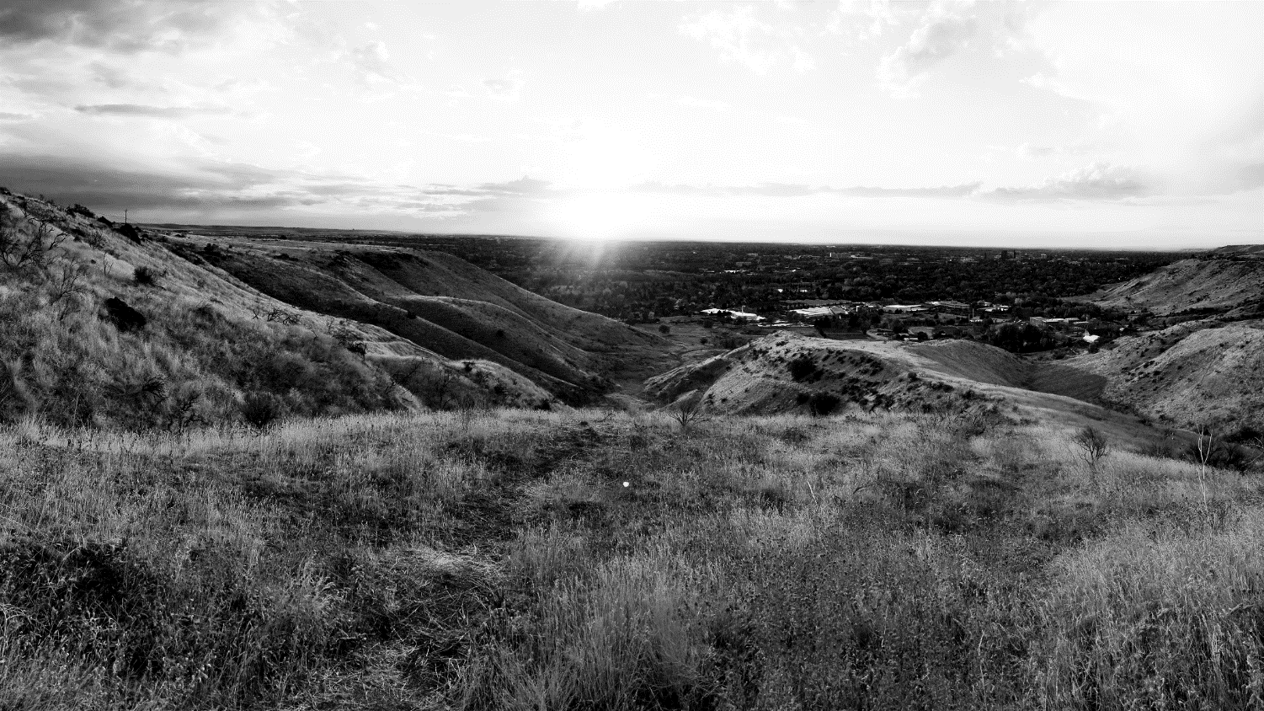
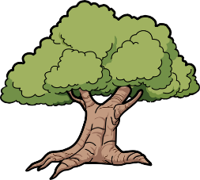
Elevation, climate, light, water, soil, and temperature all contribute to where plants can survive and how plant communities are formed on a landscape.
Every landscape has its own history and relationship with fire, which is heavily influenced by humans.

Slide 16
Weather vs. Climate
What’s the difference?
Notes:
Quick pair share.

Slide 17
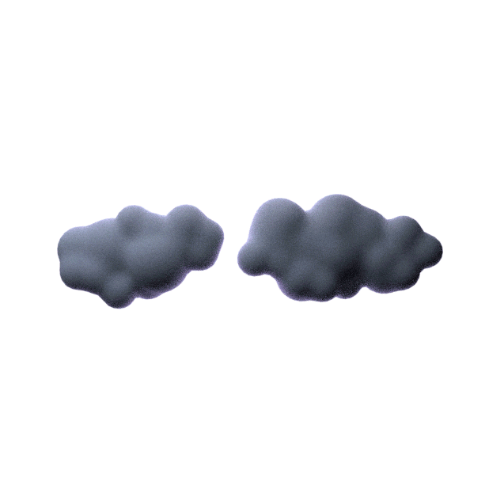
Weather reflects short-term conditions of the atmosphere.
Climate is the long-term average of weather, typically averaged over a period of 30 years.
California has a Mediterranean climate with warm to hot, dry summers and mild, wet winters.

Slide 18
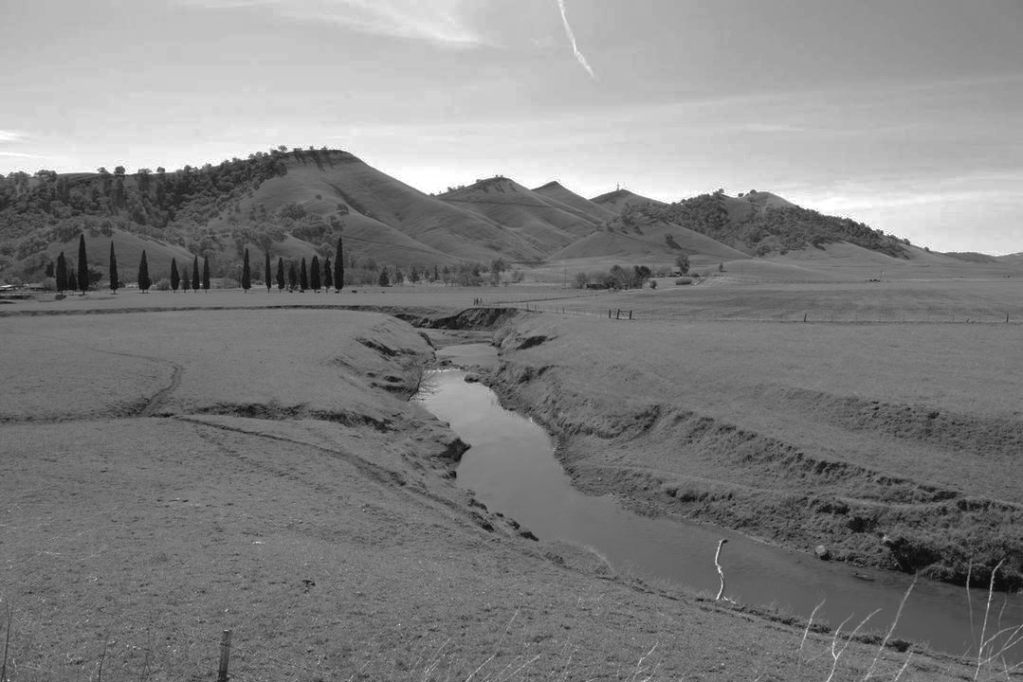
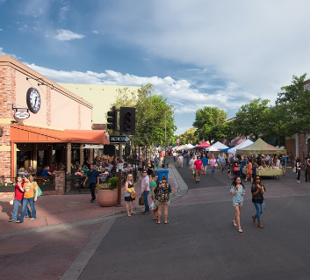
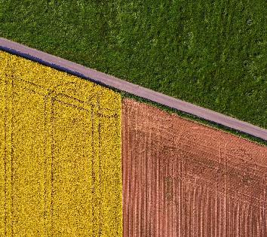
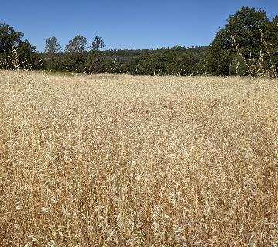
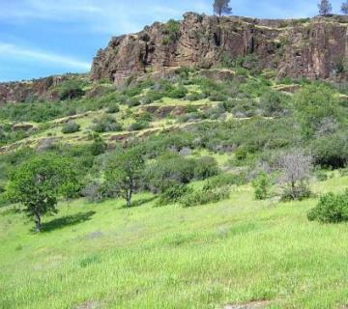
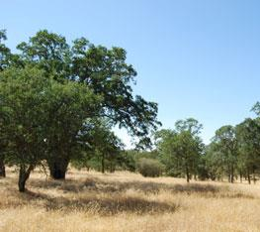
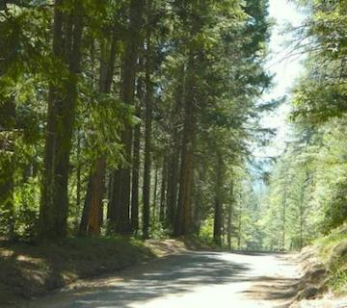
Urban
Agriculture
Grassland
Shrubland/ Chaparral
Oak Woodland
Mixed Conifer
Notes:
Butte County is made up of these six landscapes.
Which landscape best describes where you live?
Note: These are general categories. The more specific plant community you may live in or near, including blue oak woodland, Sierran mixed hardwood, or mixed conifer woodland, will be explored during the activity at the end of the presentation slides.

Slide 19
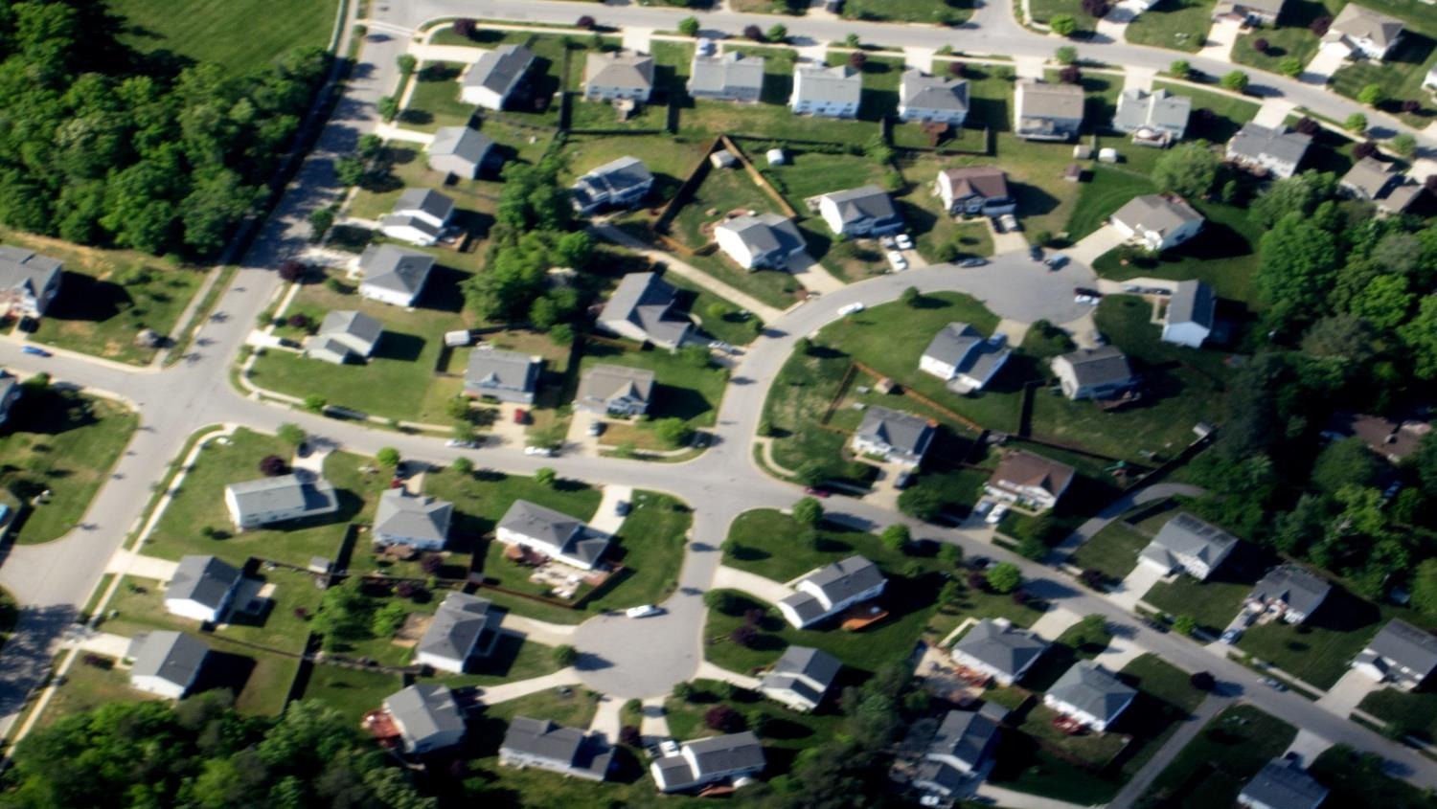
Urban
Features: Most concentrated development and housing.
Cities include Chico, Oroville, Gridley, and Biggs.
Elevation: 90-240 ft
Common species: Humans and plant species planted and maintained for landscaping.
Fire Factors: Less vegetation. Lower risk from wildfires. Impacted by wildfire smoke, evacuations,
and relocations after a fire.
Notes:
Although urban areas have lower wildfire risk, developments in or near wildland areas are at risk. Residents in urban areas such as Chico and Oroville that border on wildland areas should be prepared for wildfire.

Slide 20
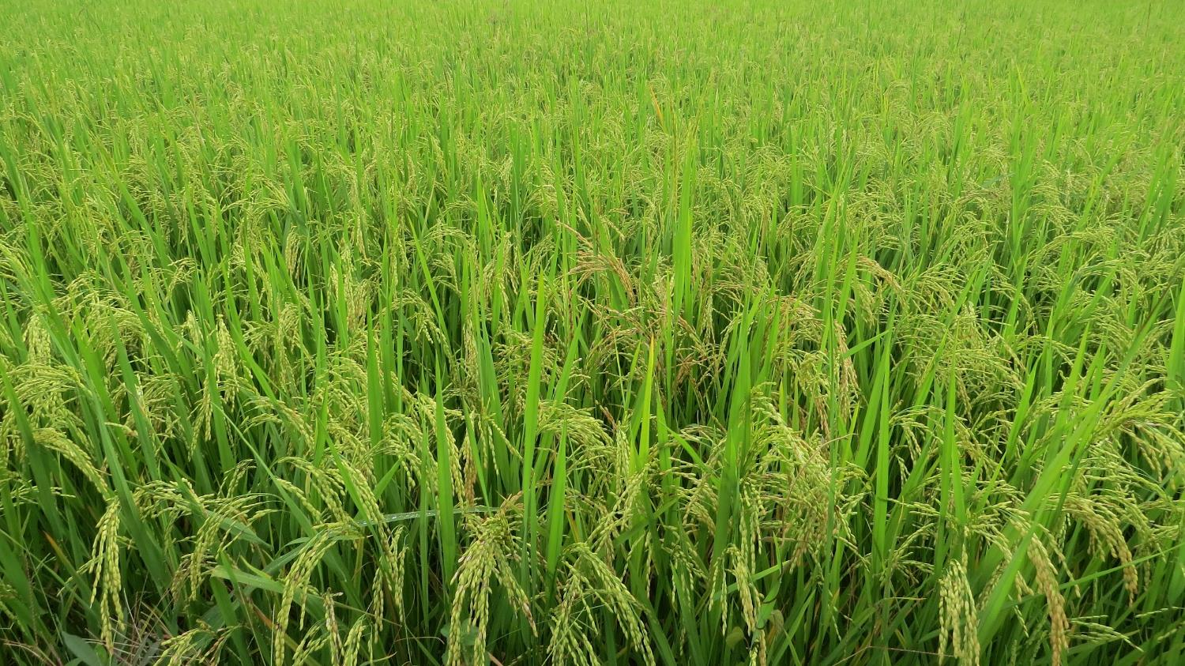
Agriculture
Features: Western third of the county. Highly managed land for crop and livestock production.
Elevation: Approximately 60 ft
Common species: Walnuts, rice, almonds, prunes, livestock, peaches, olives, and lots more!
Fire Factors- Lower risk from wildfires. Cattle ranchers use fire to clear seasonal grass and improve grass regrowth to feed livestock.
Notes:
Are there any agricultural products grown near you? If not crops, is any livestock ranged near you?
Butte County Crop Report, 2019

Slide 21
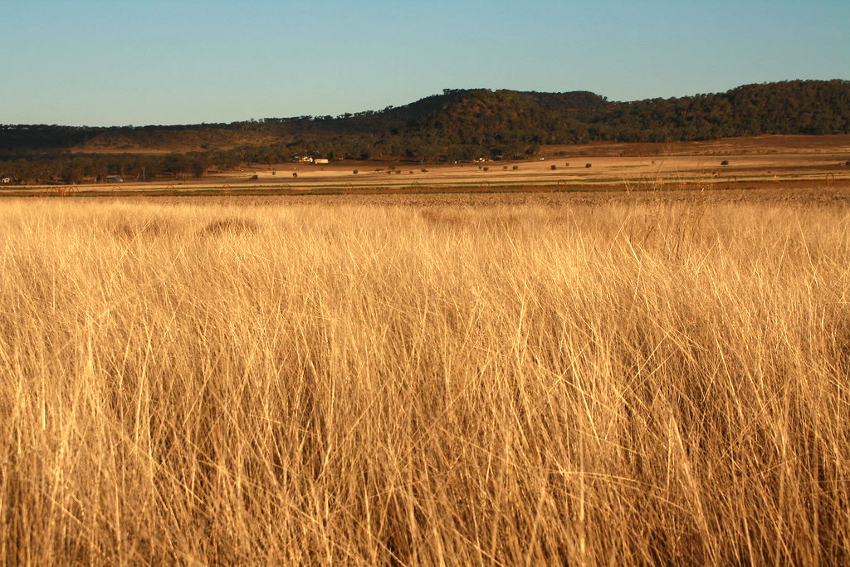
Grassland
Features: Few trees, lots of direct sunlight, and dominated by non-native, annual grasses.
Elevation: Up to 1,000 ft
Common species: Oat grass, cheatgrass, ripgut brome, yellow star-thistle, and medusahead.
Fire Factors: Seasonal grasses dry out and die annually. Grass fuels burns quickly and easily.
Notes:
Non-native Mediterranean grasses spread through the grasslands and woodlands starting in the 1800’s from European immigrant introduction. Many seeds were introduced accidentally through animal feed. These grasses are seasonally dry and highly flammable. Grass forms continuous, horizontal fuel.

Slide 22
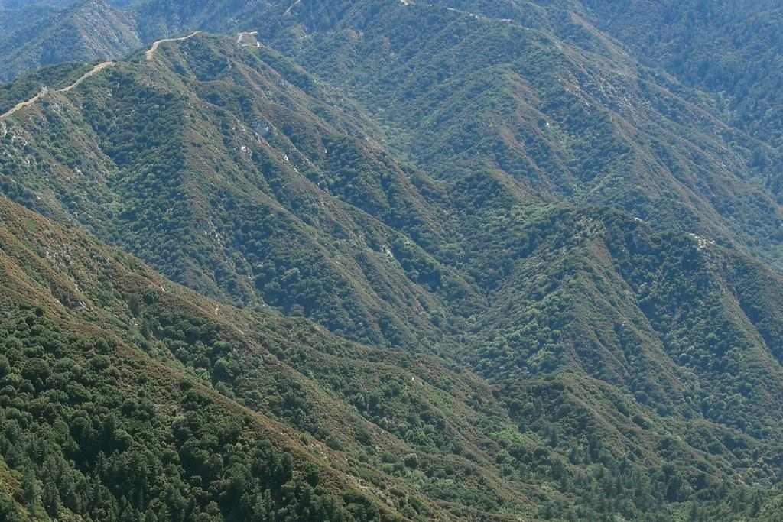
Shrubland/ Chaparral
Features: Low-growing brush and shrub species that are densely packed together when mature. Drought tolerant. Lots of sunlight.
Elevation: 1,000-2,000 ft
Common species: Manzanita, evergreen oaks, chamise, ceanothus, deer brush, scotch broom and poison oak.
Fire Factors: Highly flammable vegetation which often contain oils and waxes. Highest temperature fires.
Notes:
Fire Factors continued: Chaparral is evergreen vegetation common at middle elevations, covering 8.5 million acres of California. It is often uniform fuel, where the plants are the same species mix, height, and spacing. Fire can pass very quickly and burn hot through these landscapes. When a fire passes through a chaparral area, fire spreads through the shrub canopy burning the whole area. Chaparral vegetation is well adapted to fire and regenerates readily after fire, either through sprouting from stem bases or from soil-stored seed. Fire that is too frequent is harmful to this ecosystem, causing it to convert to grassland.
U.S. Forest Service: Restoration of Fire-adapted Ecosystems
Fire Science | Research topics | PSW

Slide 23
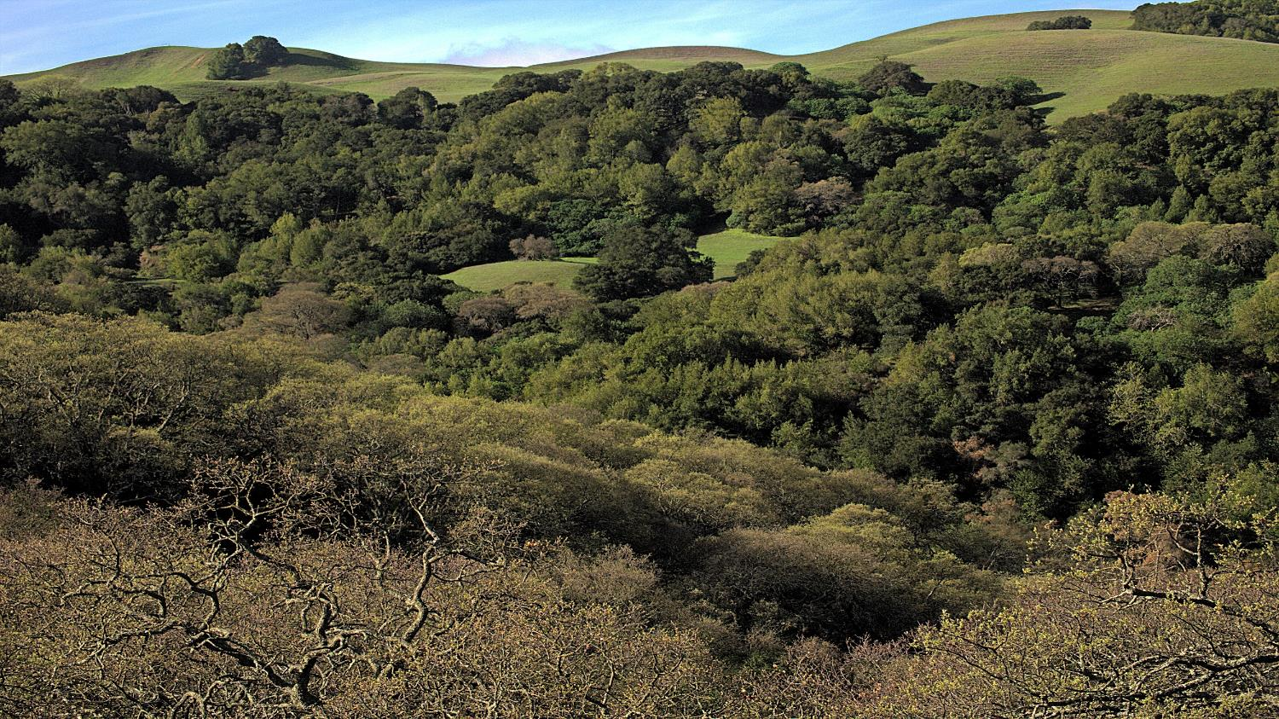
Oak Woodland
Features: Spaced out oak trees in rolling hills. Open canopy with lots of sunlight to the grassy understory.
Elevation: 1,000-2,000 feet
Common species: Live oak, valley oak, blue oak, gray pine, and annual grasses.
Fire Factors: Traditionally, lower intensity fires occur here. Low-intensity fire can benefit oak trees in multiple ways.
Notes:
Blue oaks are the most heat and drought-tolerant oaks. Frequent, low-intensity fire helps to remove insect pests, reduces competition for light and water, and improves acorn output.

Slide 24
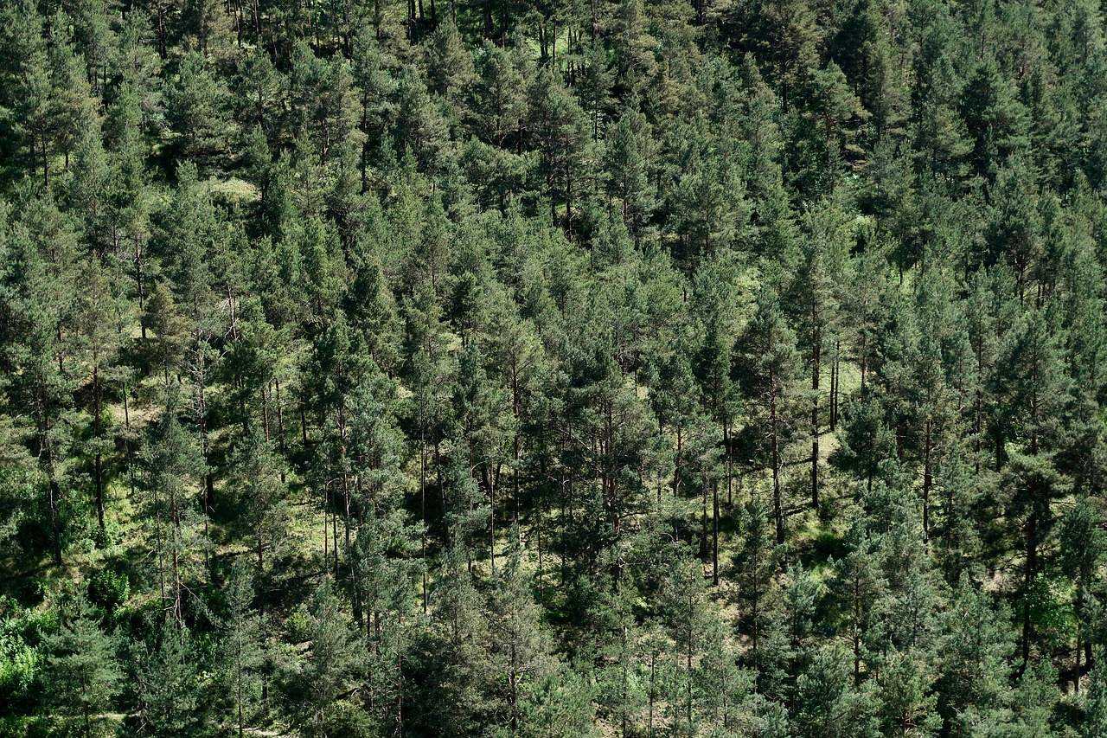
Mixed Conifer
Features: Many evergreen, cone-bearing trees. Dense forest structure in areas without recent fire.
Elevation: Approx. 2,000 ft +
Common species: Ponderosa pine, white fir, Douglas fir, sugar pine, incense cedar, and California black oak.
Fire Factors: Thick insulating bark and self-pruning limbs are adaptations to keep low-severity fires on the ground and out of the tree canopy.
Notes:
Fire Factors continued: Tree species that are most tolerant of fire are the ponderosa pine, incense cedar, and sugar pine.
Drought stress and pests, such as bark beetles and disease, put pines at risk of die-off. Stands of dead ponderosa pine trees fill the middle and lower Sierra Nevada mountains. Thick conifer forests are at risk from high-severity fires.

Slide 25
Not every area fits neatly into just one of these landscapes. The area where one plant community meets and changes into the next is an ecological transition zone.
Notes:
Paradise, located at approximately 1,800 feet, is in a transition zone between the lower elevation grassy woodlands, the upper elevation conifers, and the live oak-chaparral dominant canyons.
Paradise Forest Management Plan: https://storymaps.arcgis.com/stories/58c51c60d2ab477b8f957478b95cf2fb

Slide 26
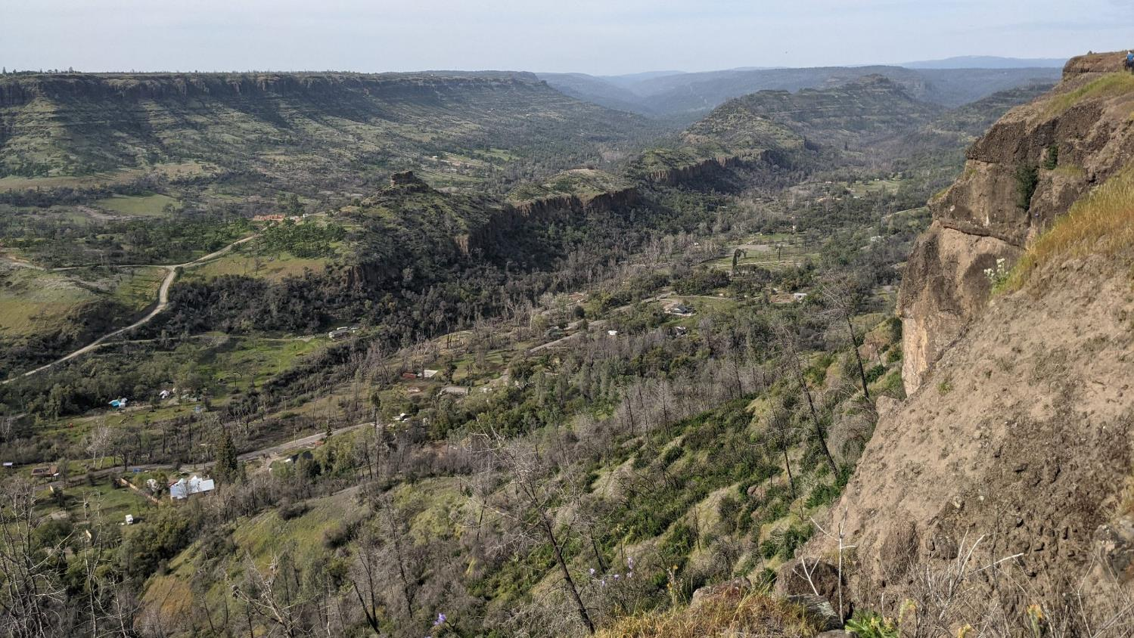
What can we learn from our landscapes?
Notes:
Forest health, structure, and the presence of certain plants in a landscape gives us clues about that ecosystem’s relationship with fire. These clues could tell you, for example, how recently a fire has burned there, which species benefit from or are sensitive to fire, or if a lack of fire has made the forest unhealthy. Knowing how our landscapes have been shaped by fire in the past, helps us to live more sustainably and safely with fire in the future.
Picture: Taken from the Paradise lookout along Skyway Road.

Slide 27
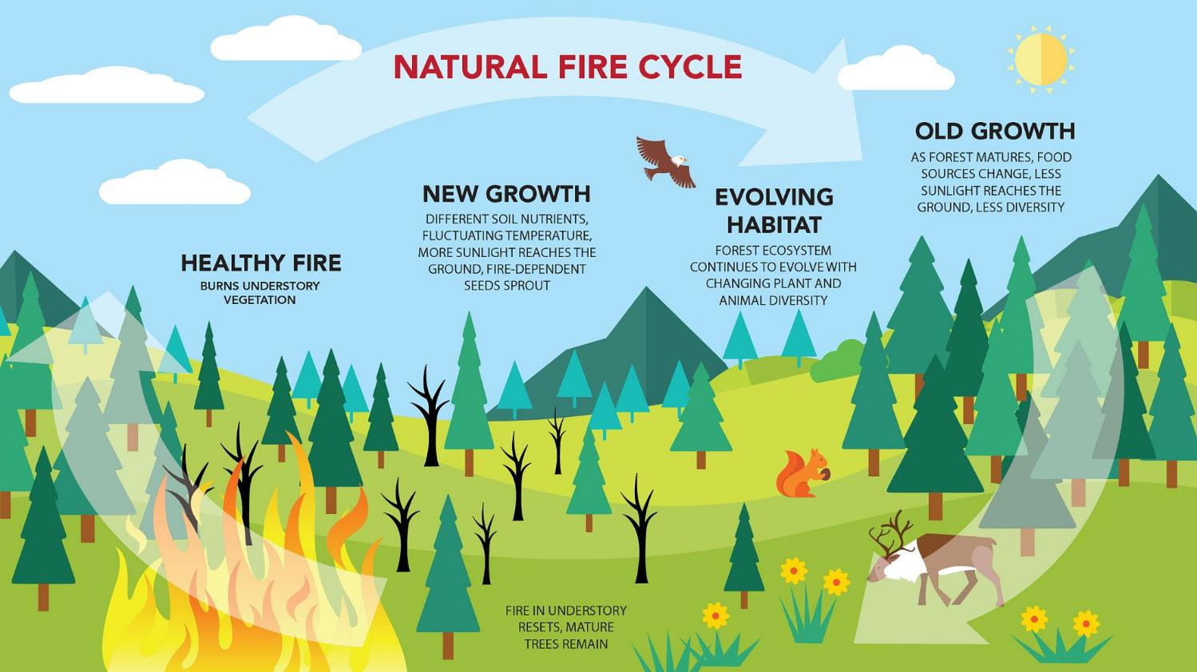
Notes:
Fire is a natural and critical process for maintaining healthy and resilient forests. How are humans a part of this natural process? We will learn about this by using the Forest Health Guidebook for the lesson activity.
Graphic: Open Space Authority
https://www.openspaceauthority.org/system/user_files/Images/OSA-infographic-fire-cycle.jpg

Slide 28
Key Word Review
Elevation
Fire Adapted Community
Fire Hazard Severity
Topography
Weather
Climate
Ecological Transition Zone
Notes:
Review key words from the lesson and check for understanding.

Slide 29
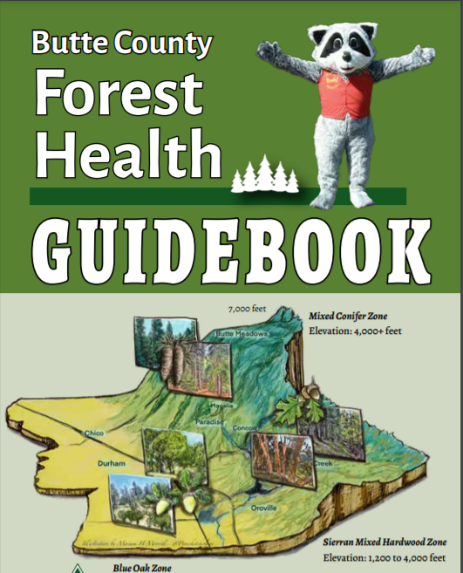
What makes a healthy forest?
Notes:
Access the Forest Health Guidebook online: https://buttefiresafe.net/forest-health-guidebook/
Contact the Butte County Fire Safe Council for a physical copy for your students.

Slide 30
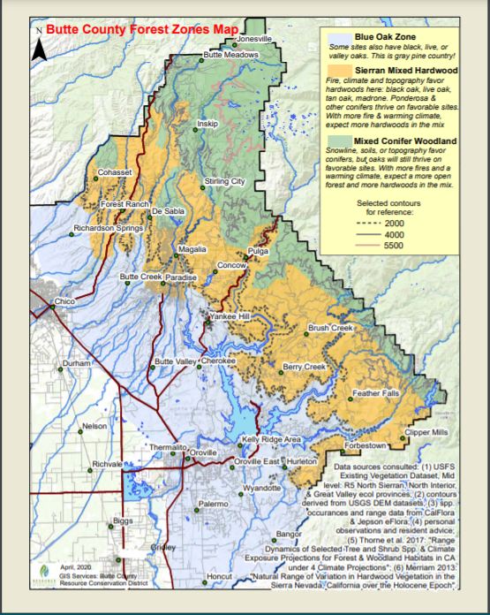
Which Forest Zone do you live in?
Blue Oak Zone,
Sierran Mixed Hardwood, or
Mixed Conifer Woodland

Slide 31
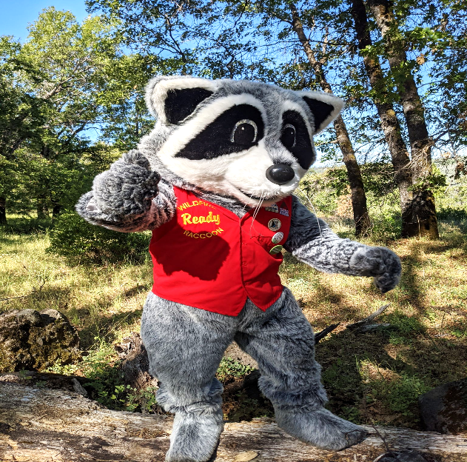
You have completed Lesson 1.

