Slide 1
2020 Butte County Fire Safe Council Annual Summit
December 2nd, 2020
Zoom: https://zoom.us/j/9981904778
10am-11:30am

Slide 3
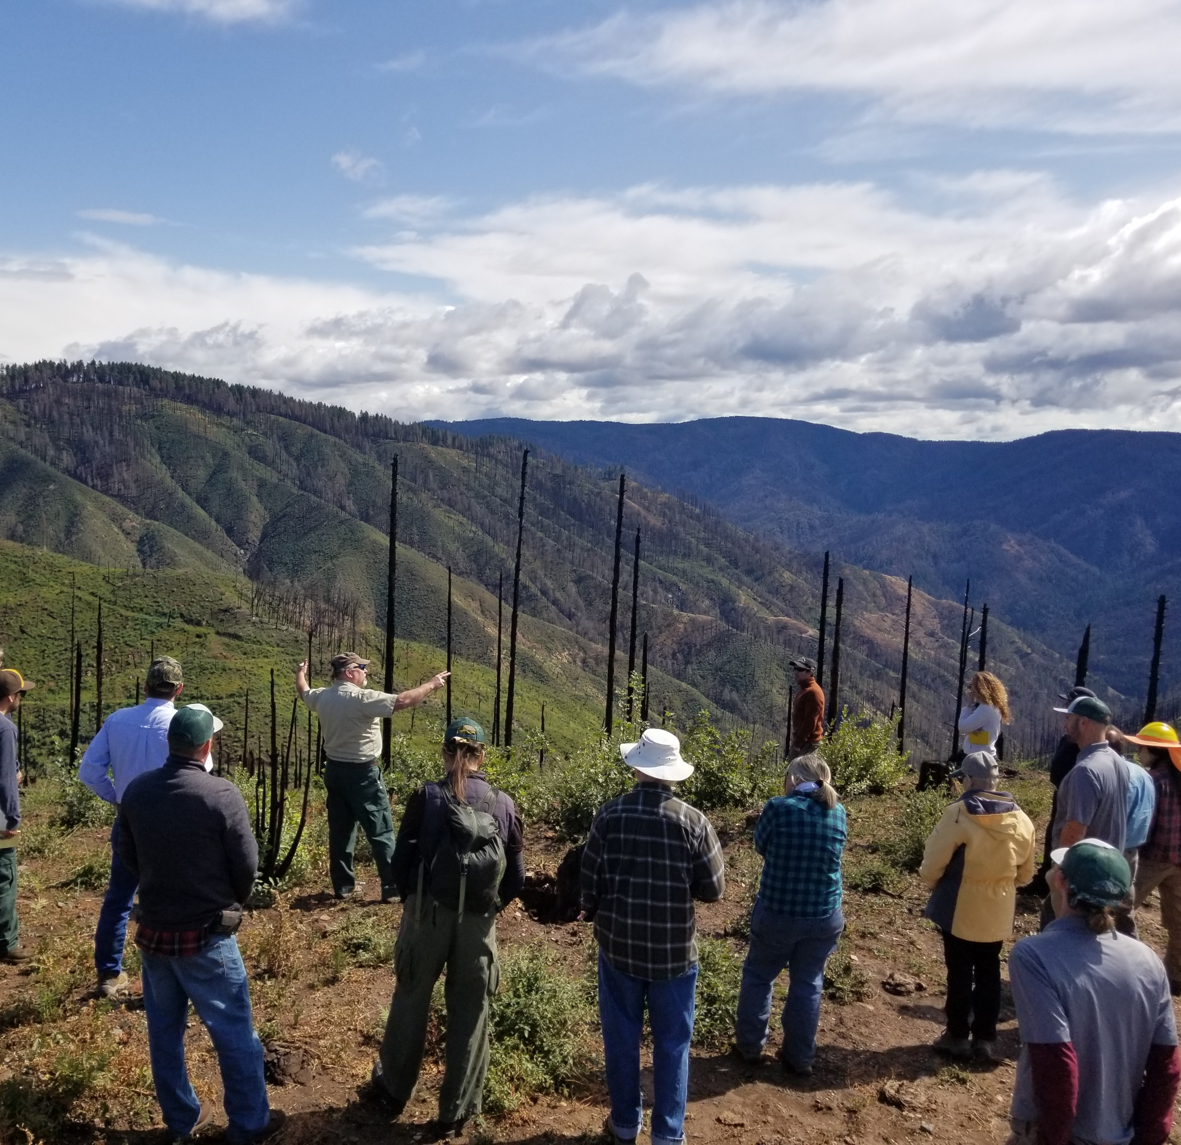
Introduction
Who we are
Board, staff, and volunteers
Partners
Mission
Award Recipients

Slide 4
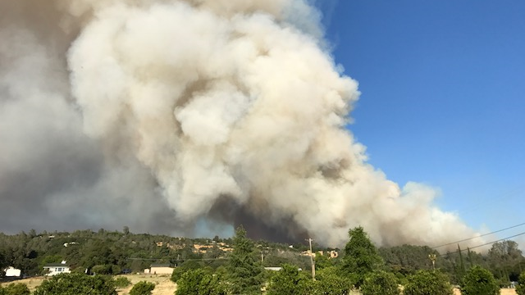
Our Mission To provide safety in Butte County through wildfire hazard education, mitigation and wildfire recovery.

Slide 5
Wildfire Safety Recognition Awards Given 2020
January – Deborah Mathews
February – Joe & Carrie Cardoza
March – Denise Bethune
April – Scott Shaw
May – Pete Samuels & Lynn Costa
June – Officer Kevin Tuck
July – DJ Gomes & Gary Warner
August – Kiernan O’Leary
September – P31 Enterprises
October - Reed Rankin
November – William Cotter
December – Art Colyer

Slide 6
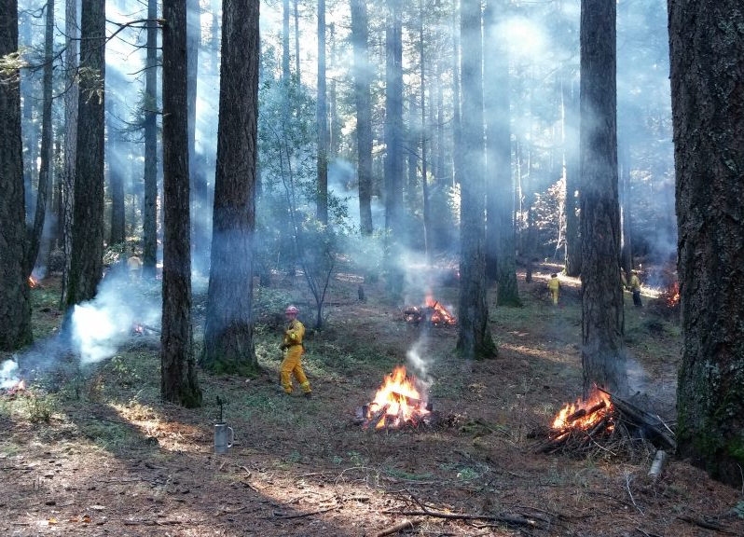
Pre- and Post-Fire WUI Action Plan
In the past 20 years there have been 400,000 acres burned and 20,000 structures destroyed due to wildfire in Butte County…
How do we solve the problem?
A collaborative approach
Treatment (acres/home hardening)
Education

Slide 7
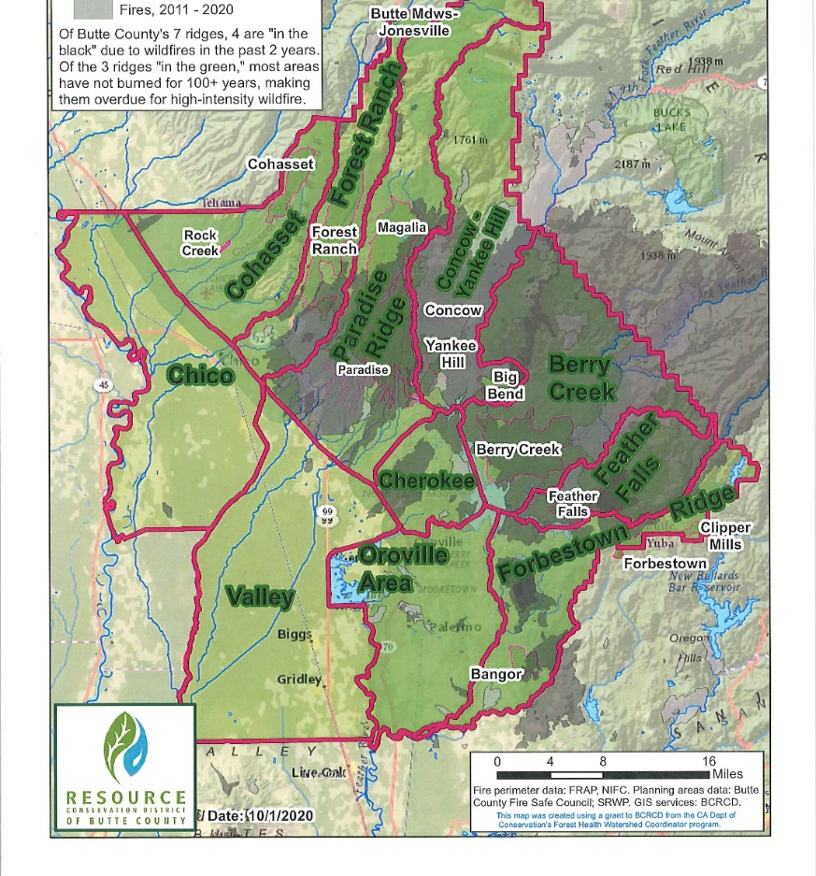
Pre- and Post-Fire WUI Action Plan
How are project goals set in the Action Plan?
Based on Fire Return Interval
Organized by planning area/unit
Projects past and Future

Slide 8
My Sierra Woods

Slide 9
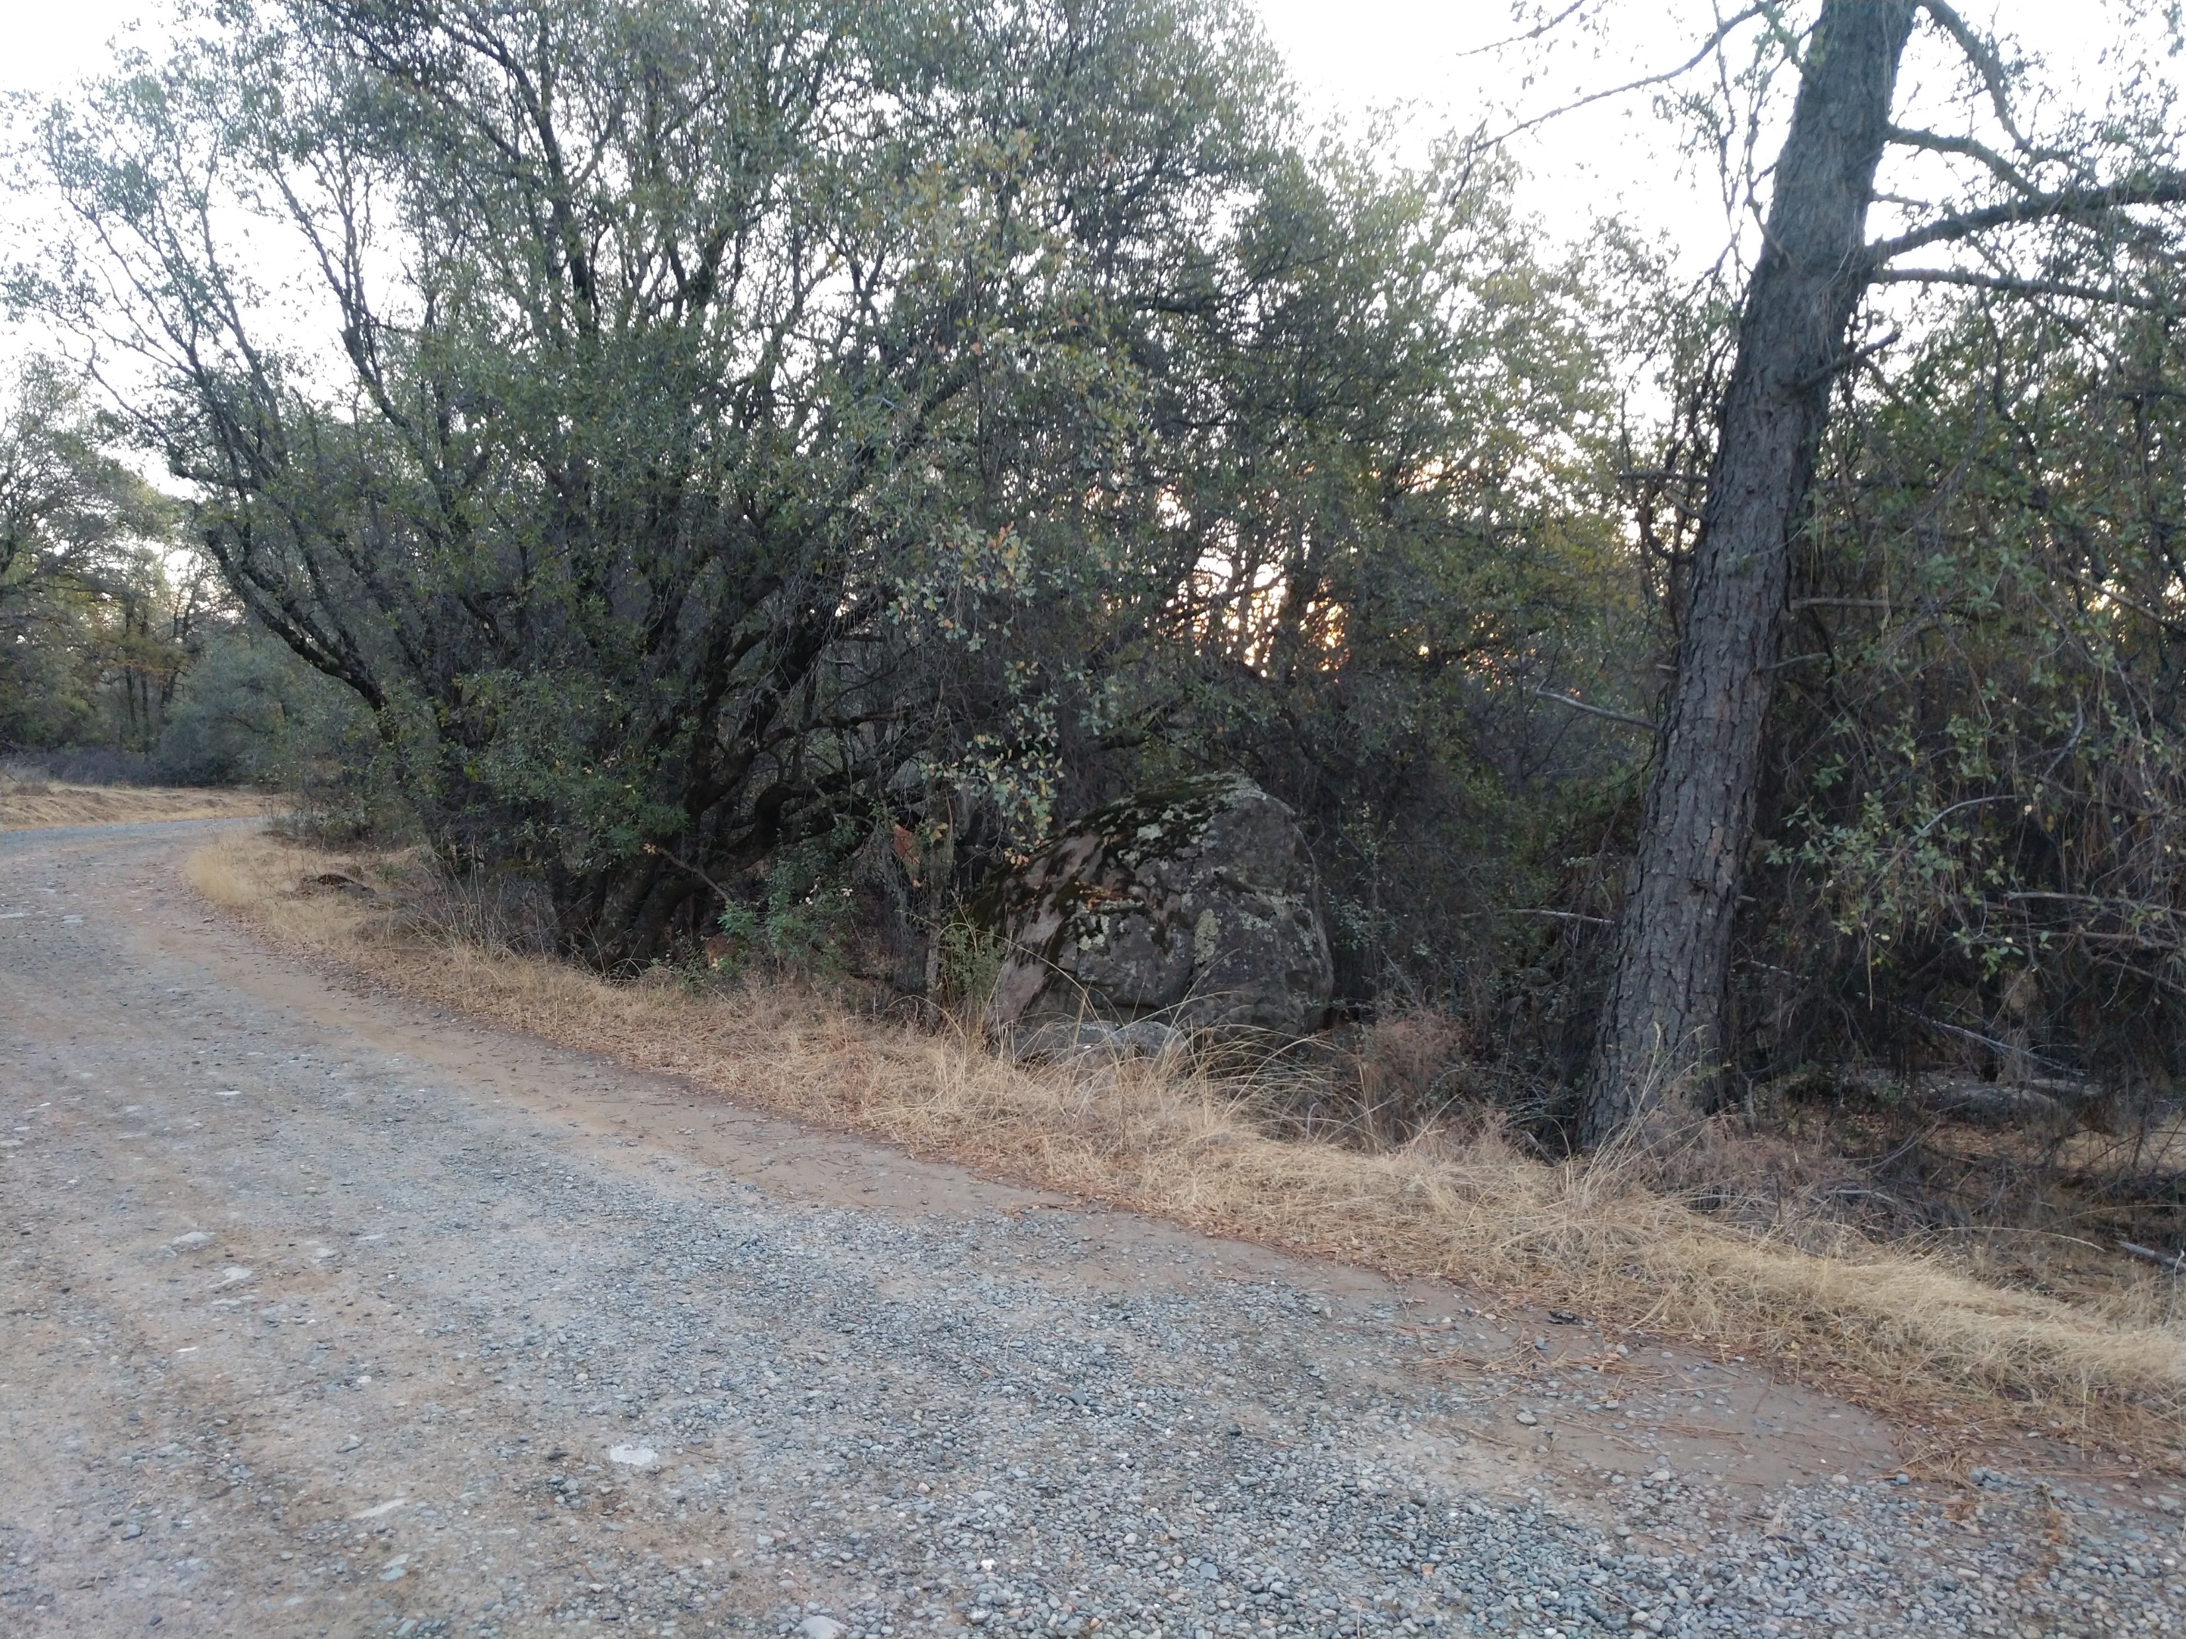
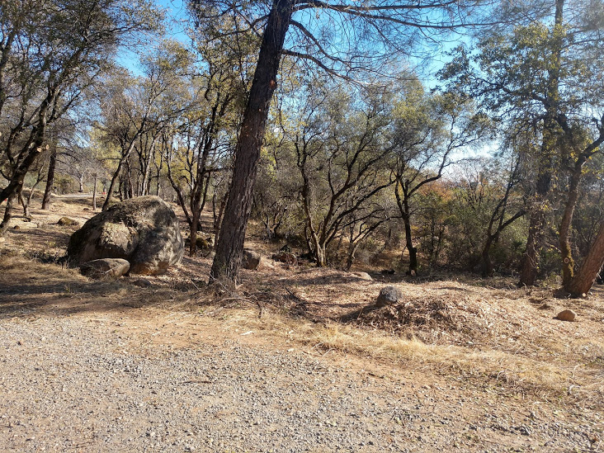
Successes
Before
After
Forbestown

Slide 10
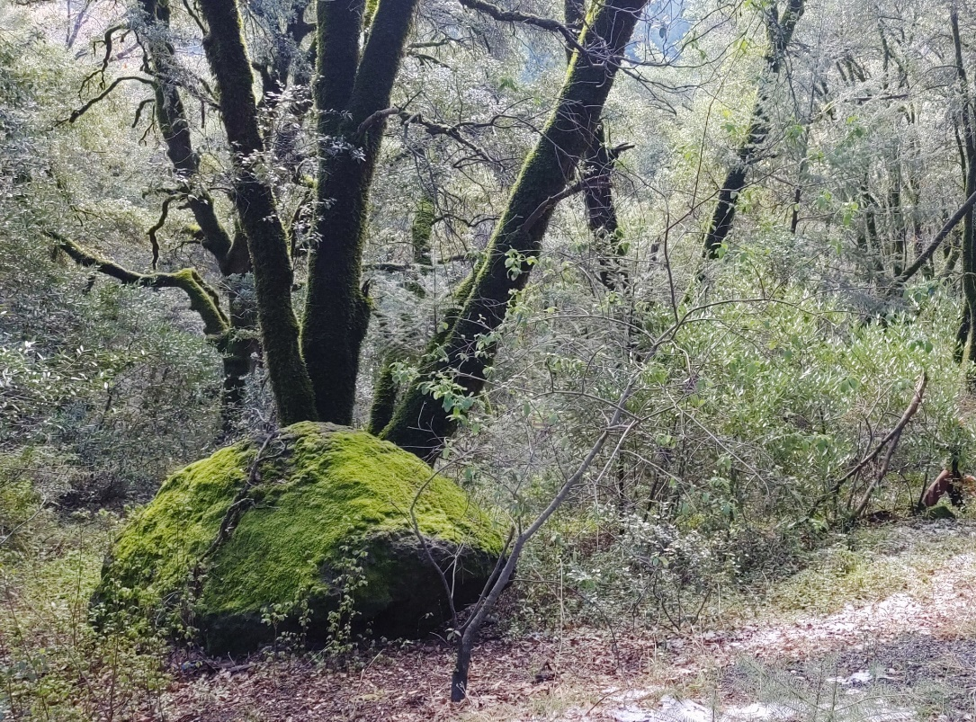
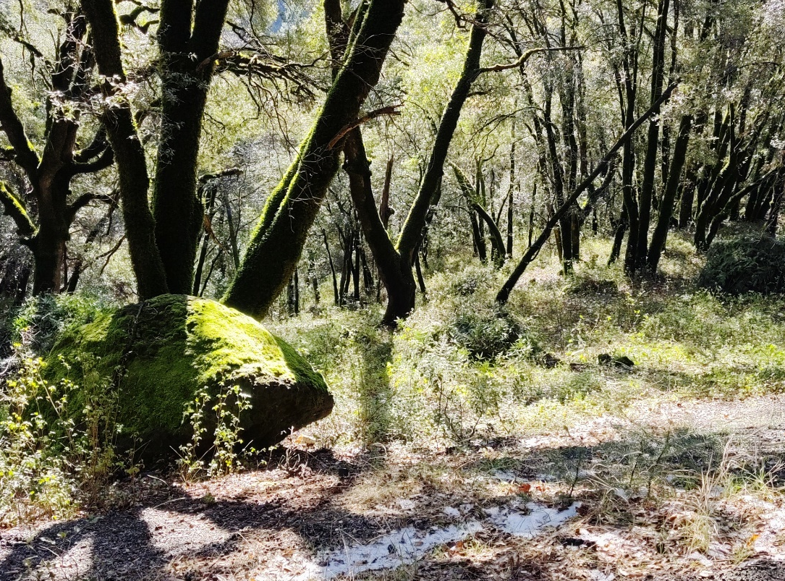
Successes
Before
After
Forest Ranch

Slide 11
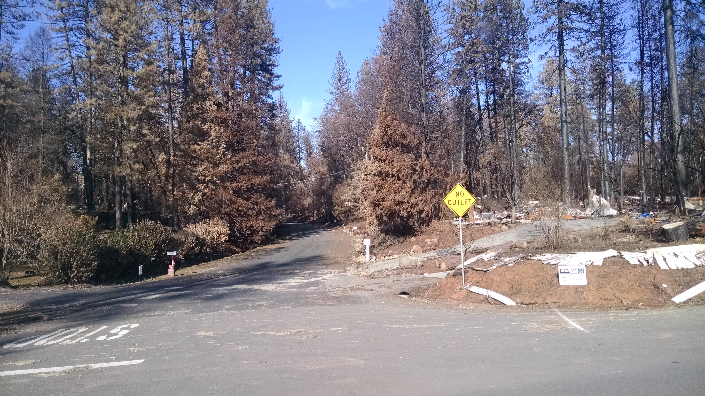
Pre and Post Fire Areas
Post Fire Areas | Pre-Fire Areas
Paradise | Cohasset
Yankee Hill | Rock Creek
Concow | Forbestown
Berry Creek | Clipper Mills
Feather Falls | Forest Ranch
 | Magalia
 | Butte Meadows/Jonestown
Total Structures Remaining (estimate) = 631 | Total Structures = 5,194

Slide 12
Post Fire Areas Berry Creek – Bear Fire

Slide 13
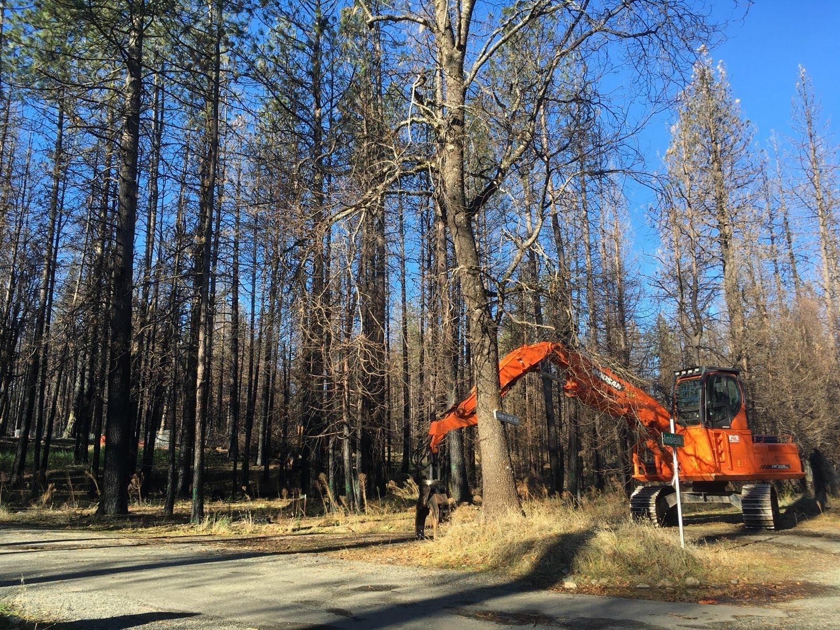
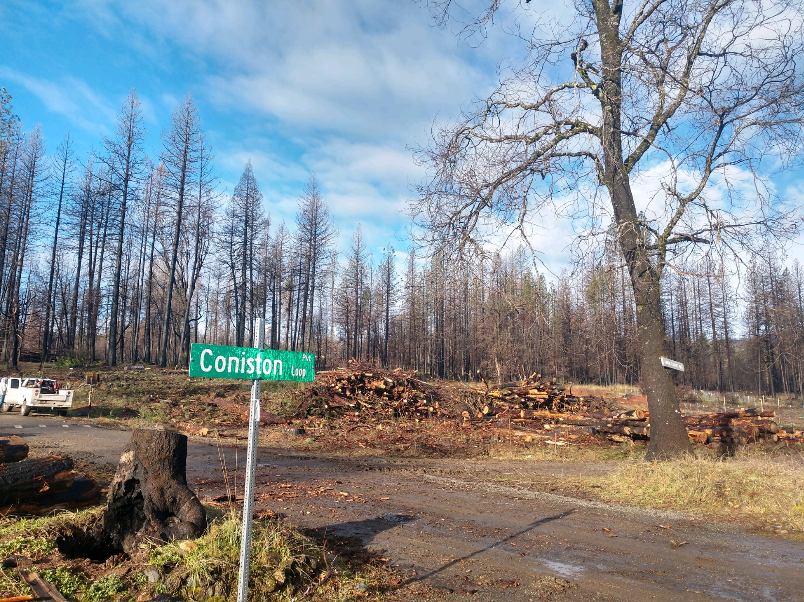
Post Fire Restoration Successes
Concow & Yankee Hill
Tree Removal Completed on 148 properties assisting 12 landowners rebuilding
Biochar!
Collaborations and Partnerships

Slide 14
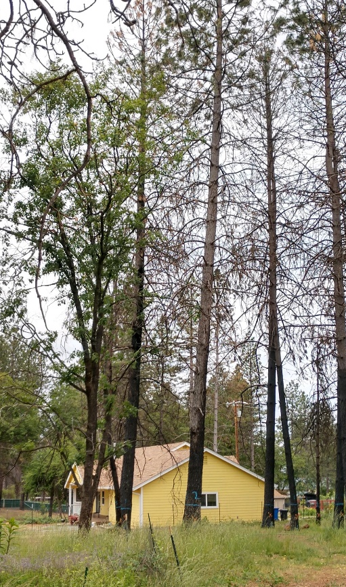
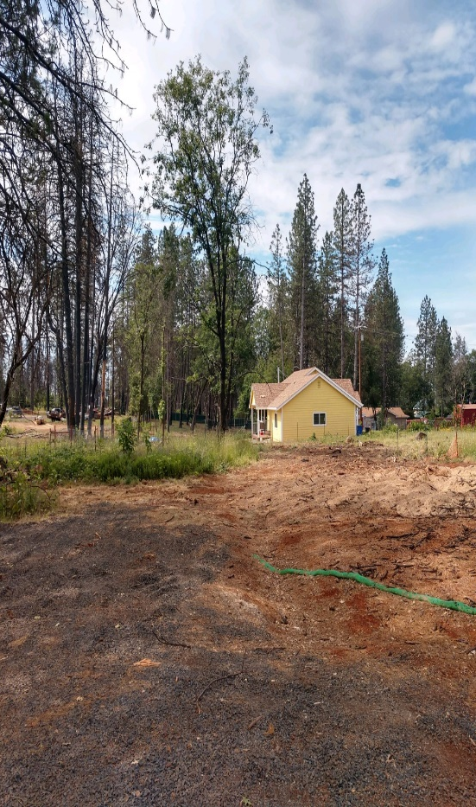
Post Fire Restoration Successes
Paradise
Tree Removal – Completed removal of 1,186 trees threatening new construction on 65 sites
Partnerships – FRAP
Firewise Communities
Planned treatments
West Branch Fuels Reduction
Tree Removal
Before
After

Slide 15
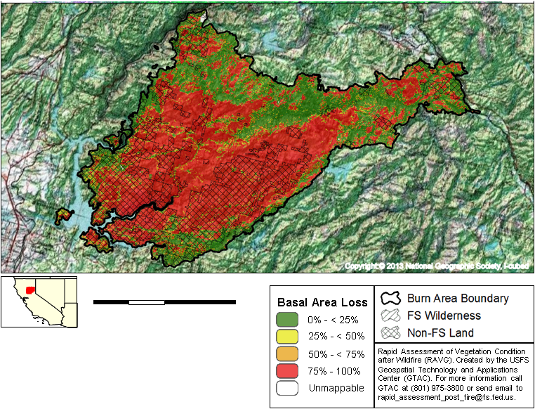
Post Fire Restoration
Berry Creek
Evacuation Routes – Bald Rock Road and Rockerfeller Rd.
TRA around Pioneer School and Berry Creek Park Site.
300’ around existing standing structures.
Continue with Fuel Break and assist with fuel reduction around Lake Madrone.

Slide 16
Pre Fire Areas

Slide 17
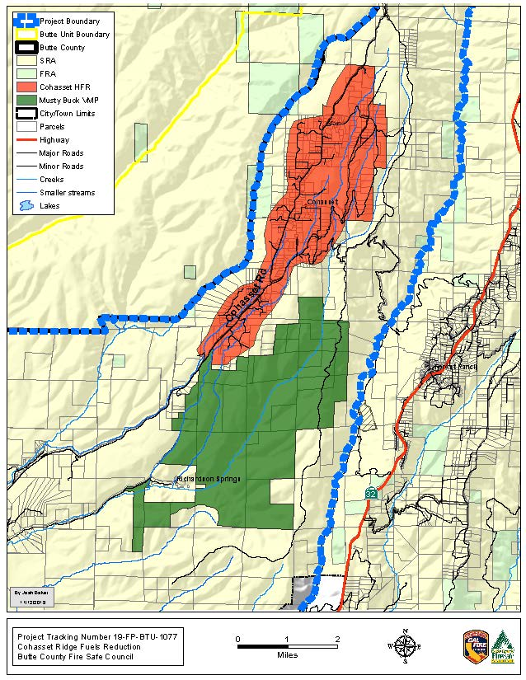
Successes and Upcoming Projects
Cohasset
Cohasset CCI Grant – Sign-up Landowners and Award Contract – RFP for CEQA (500 A) – Evacuation Routes and Defensible Space - Up to 205 Acres
Cohasset Forest Management Plan – SNC – RFP for CEQA & FMP
PG&E – Defensible Space and increased safety of the Temporary Refuge Area around Cohasset Elementary School

Slide 18
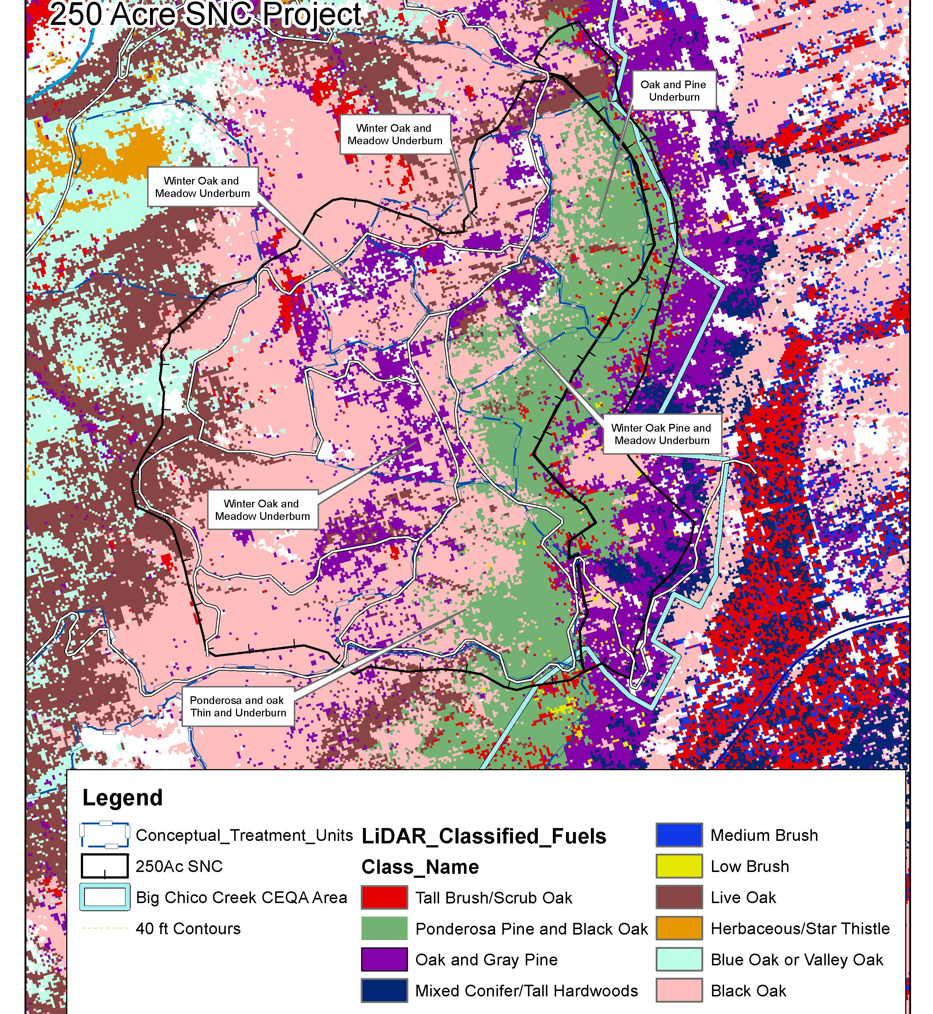
Big Chico Creek
Successes and Upcoming Projects
Forest Management Plan
Work currently being completed on 250 acres
SNC Grants – CEQA – BCCER

Slide 19
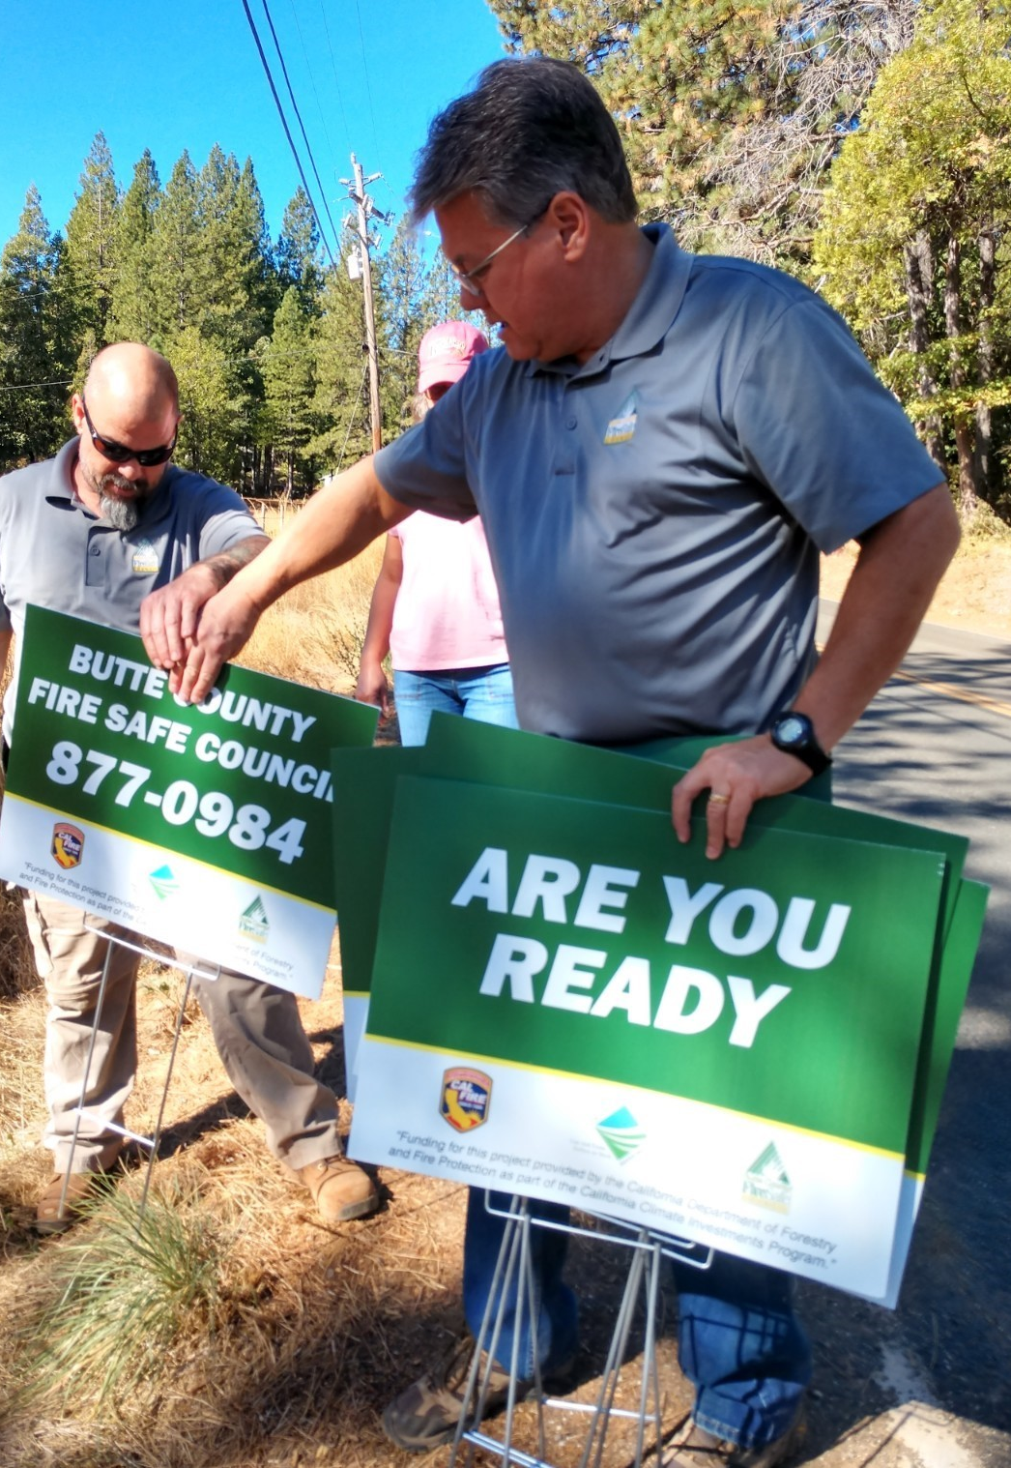
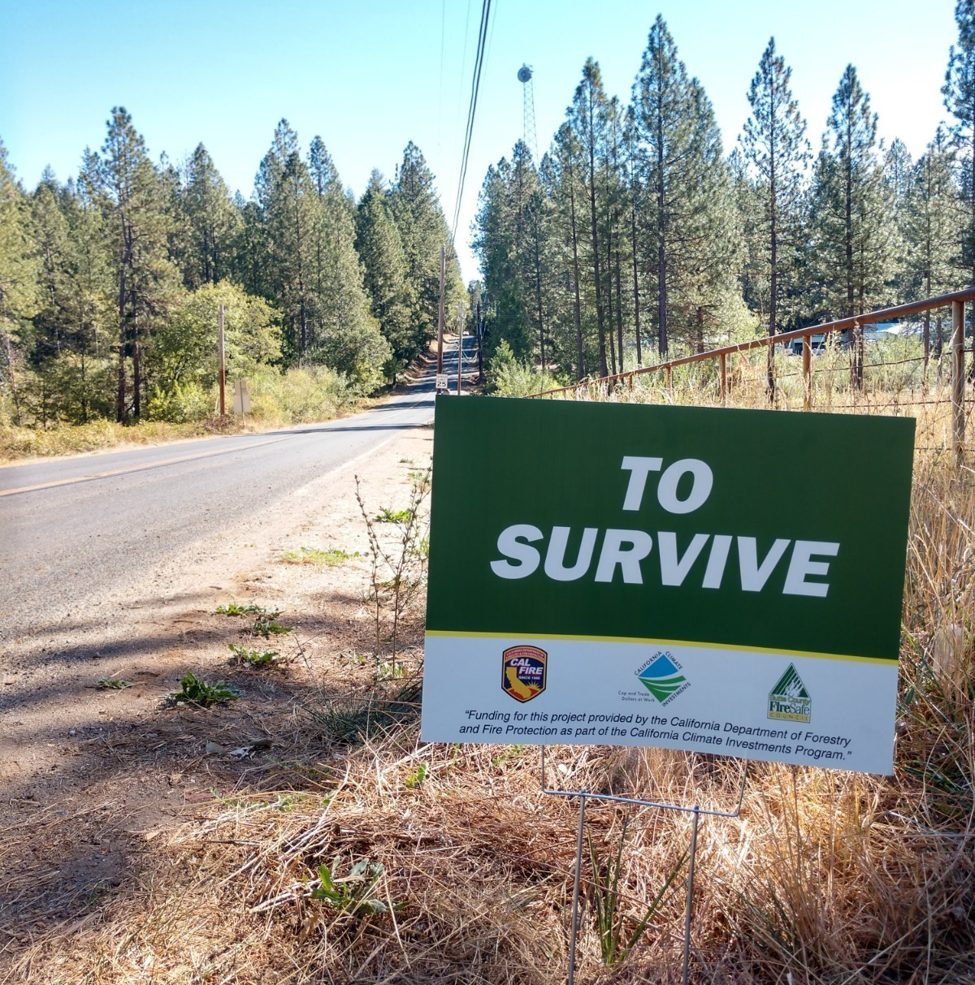
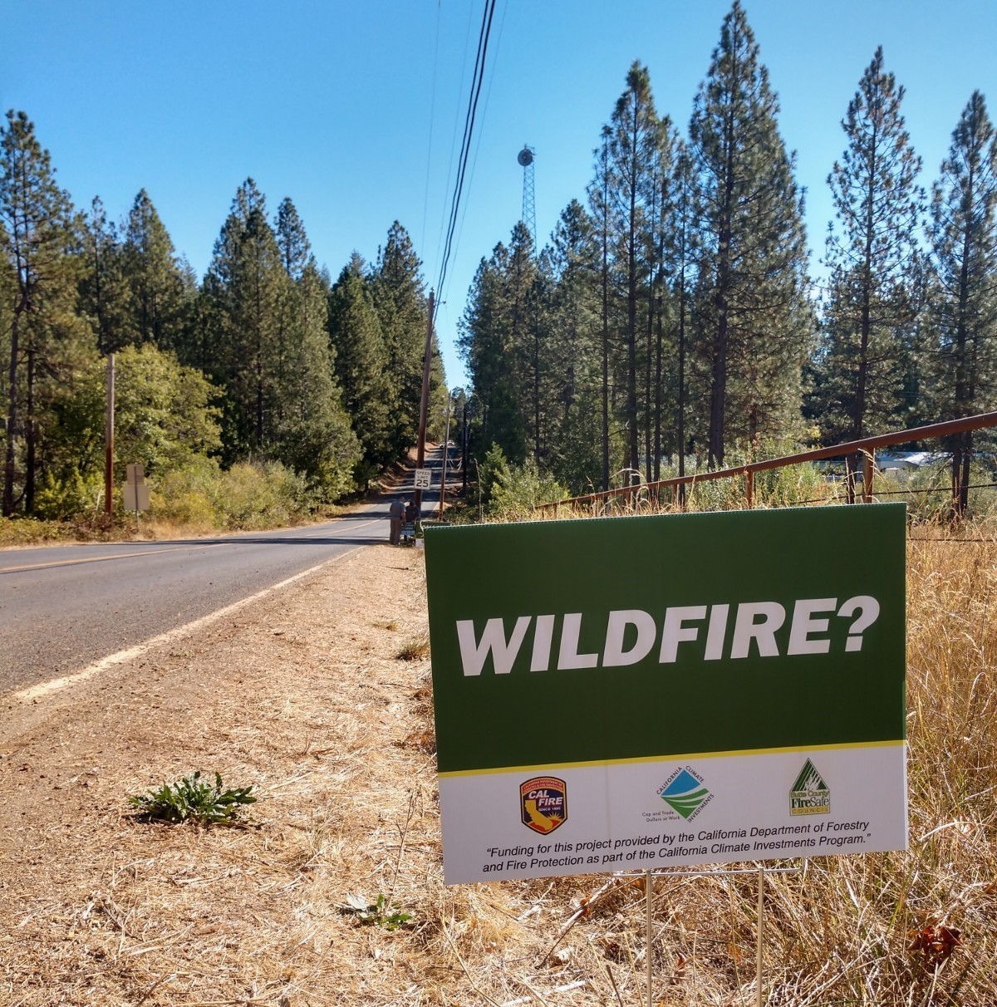
Successes and Upcoming Projects
Forbestown
Completion of the Merry Mountain / Clipper Mills Shaded Fuel Break Dec 2020 – 90 acres
Beginning the Forbestown Ridge Shaded Fuel Break – Nov 2020 – 129 Acres – Forbestown Rd/Hurleton Rd/ Hurleton Swedes Flat Rd/ Black Bart Rd.
PG&E Grant – 12 Homes completed RAP/100’ Defensible Space

Slide 20
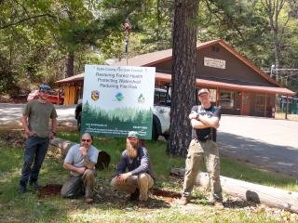
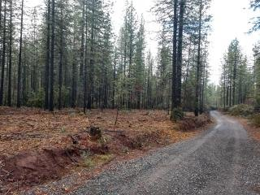
Forest Ranch
Successes and Upcoming Projects
CCI Grant - Completion of Shaded Fuel Break of 170 Acres consisting of Hand Cut and Chip, Hand Cut and Pile and Mastication on:
Crown Point Rd
Doe Mill Rd
Schott Rd
Currently scheduled pile burning.
Firewood Distribution
BEEP Program

Slide 21
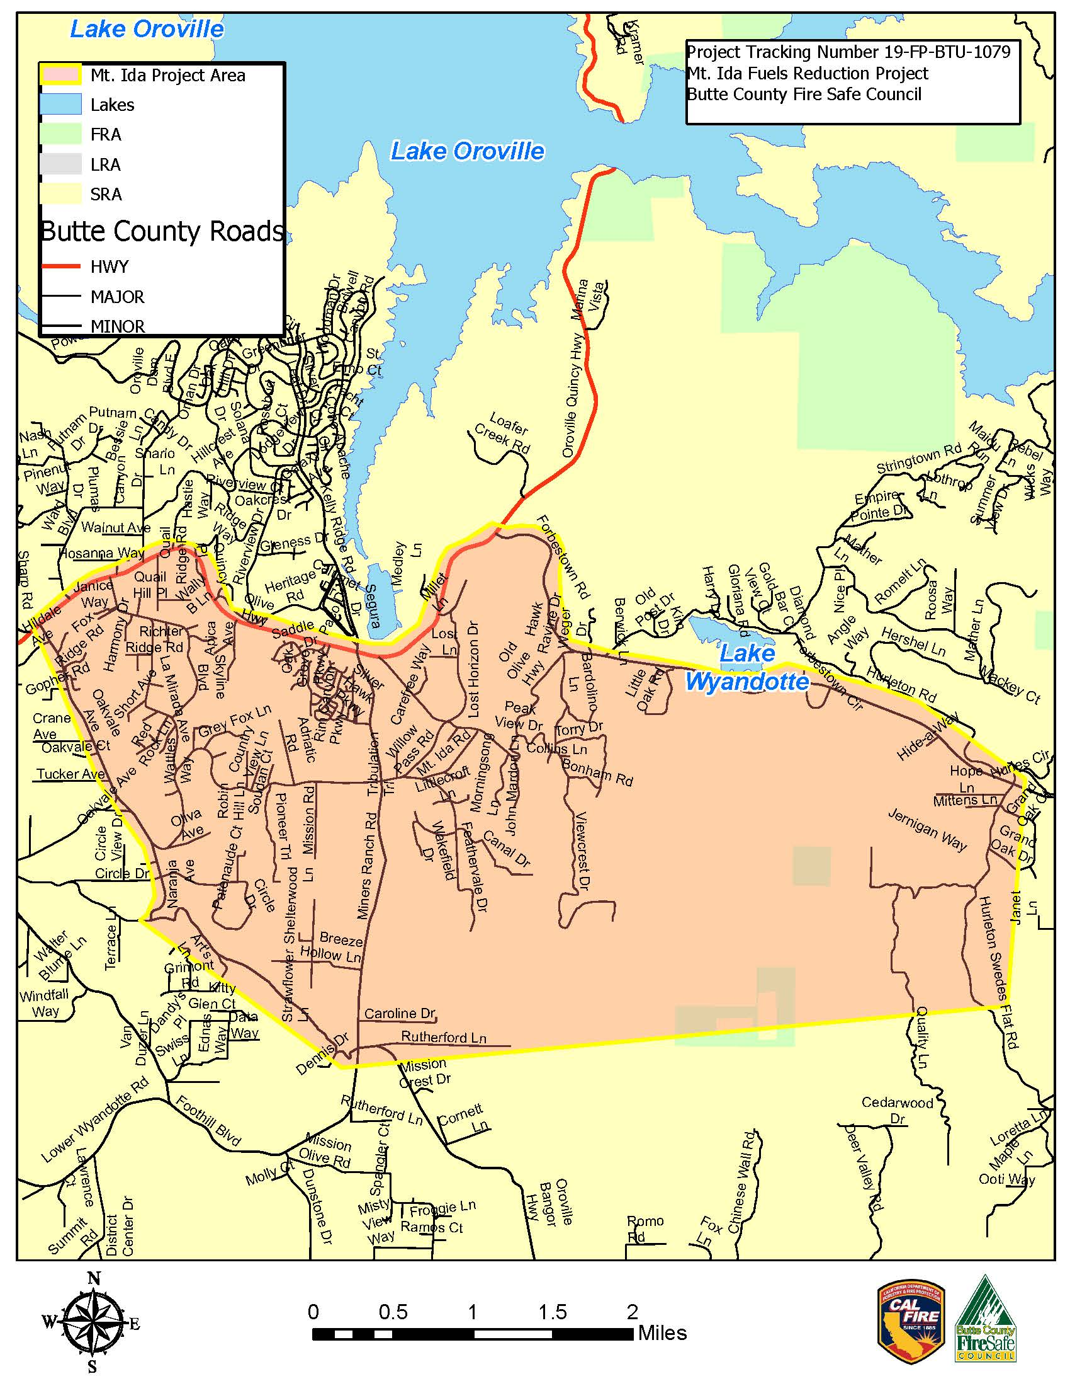
Successes and Upcoming Projects
East Foothills - Mt. Ida
CEQA – 500 Acres
Fuel Reduction up to 205 Acres
RFP for CEQA
Fuel Reduction Project to focus on current project area, evacuation routes and 100’ defensible space.

Slide 22
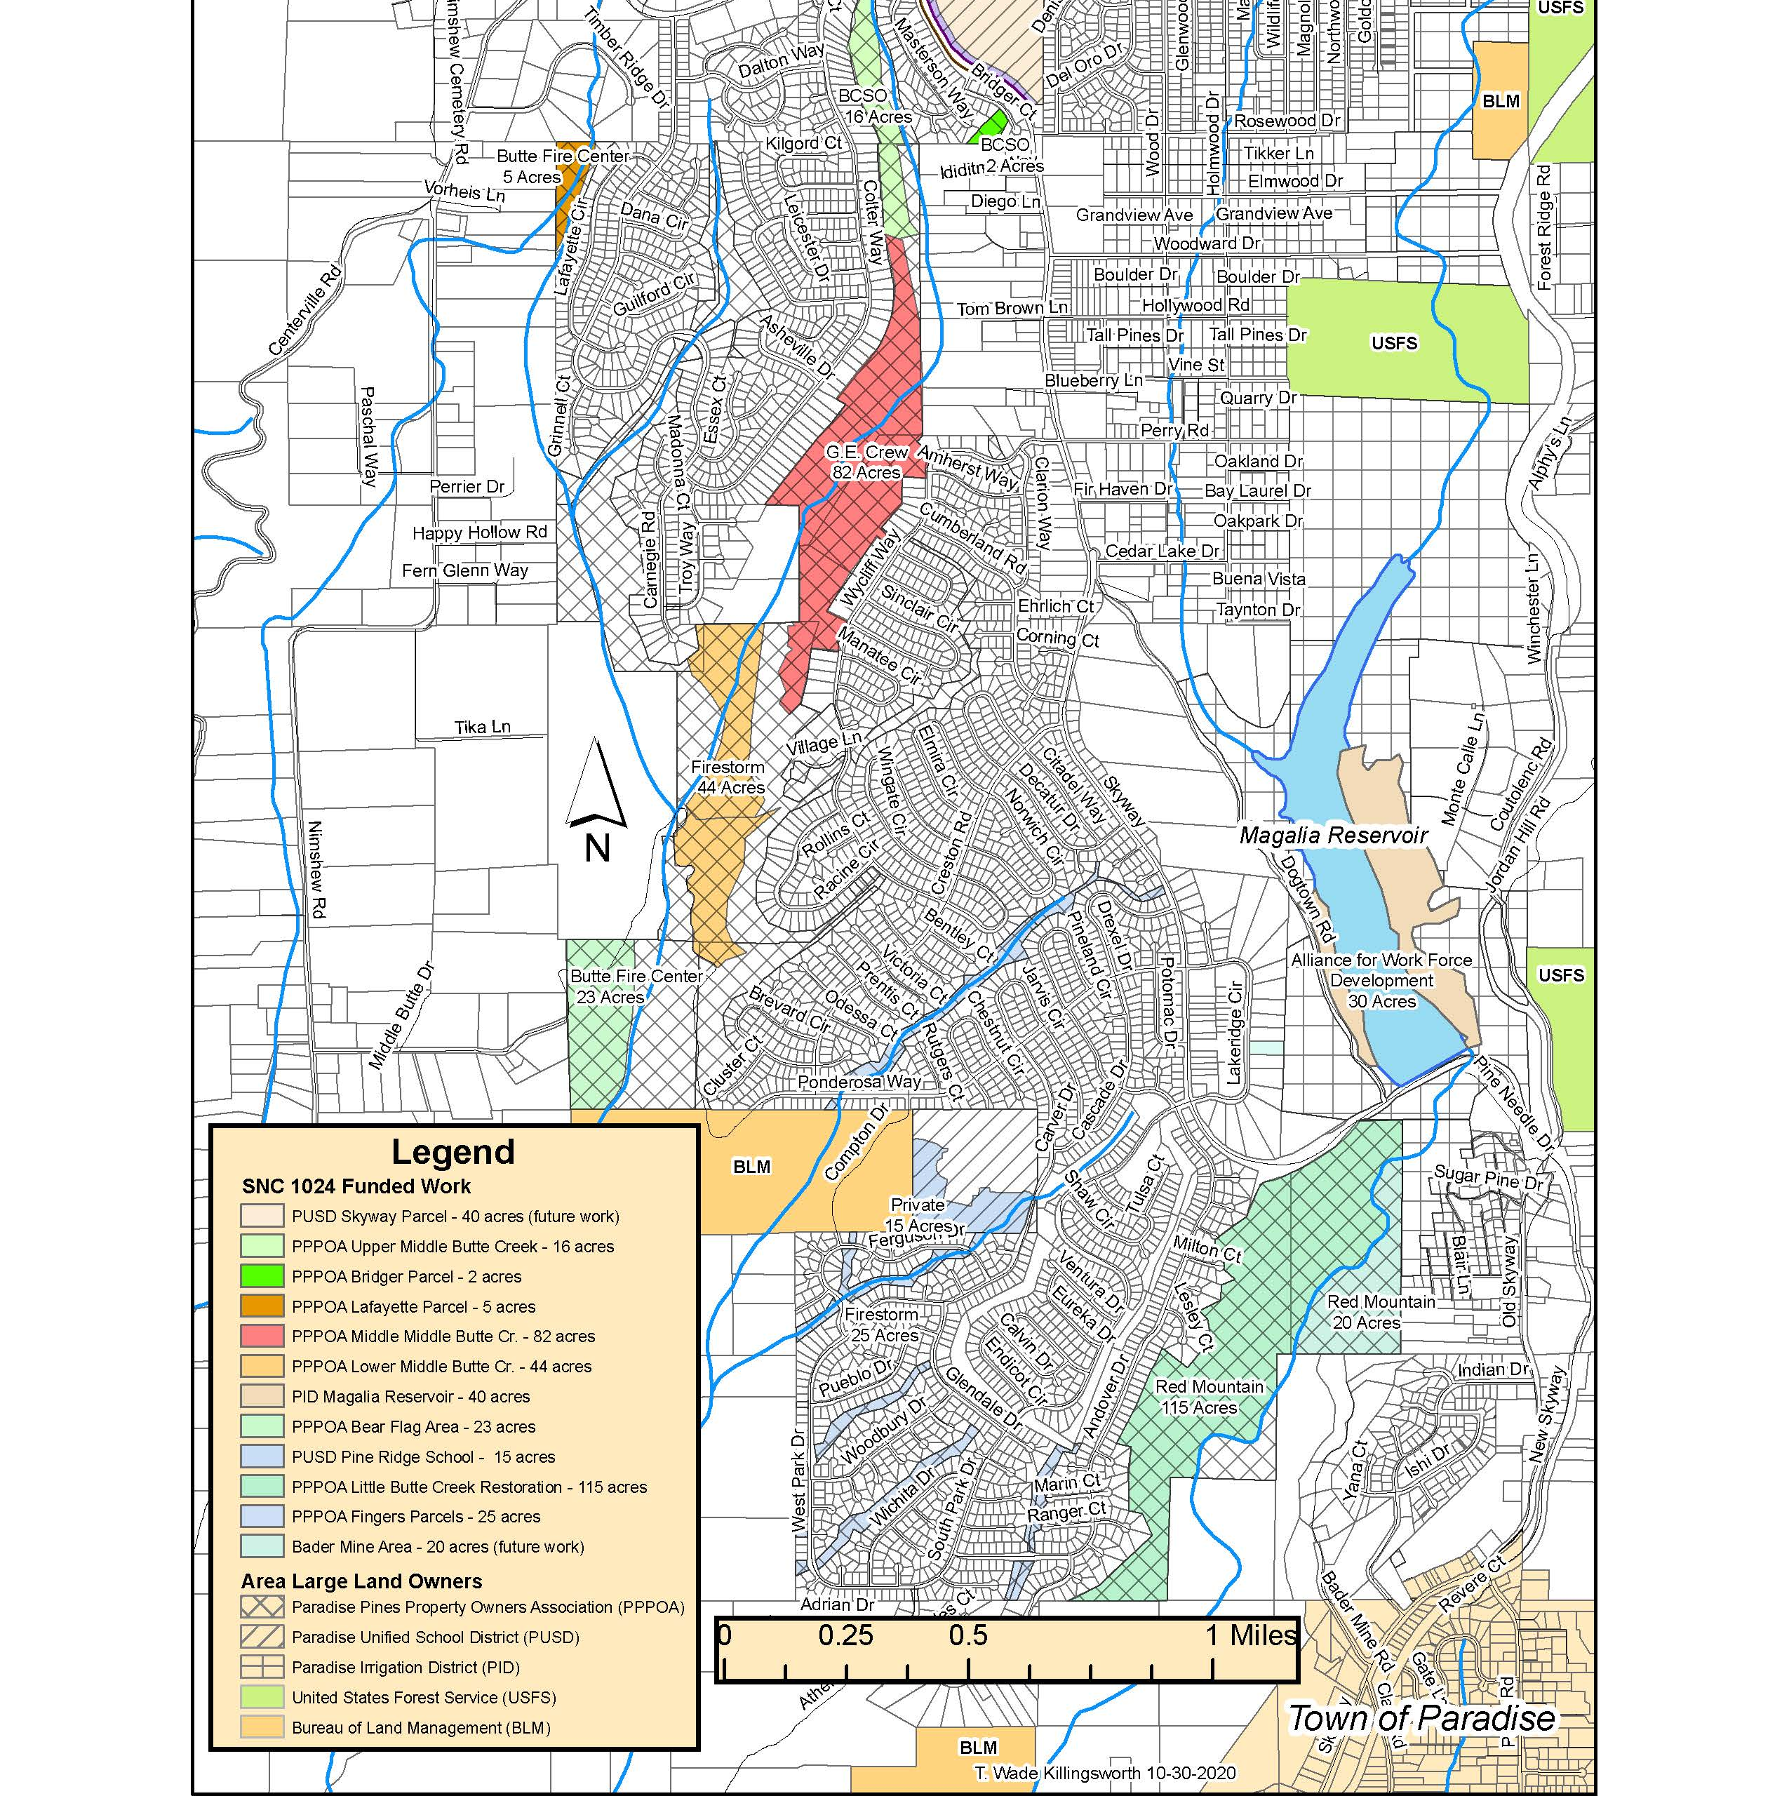
Successes and Upcoming Projects
Magalia
SNC 1024 Fuels Reduction Projects - FMP
My Sierra Woods treatment of roughly 700 acres
CCI Fuels Reduction along Coutolenc/Hupp Coutolenc
Grazing!

Slide 23
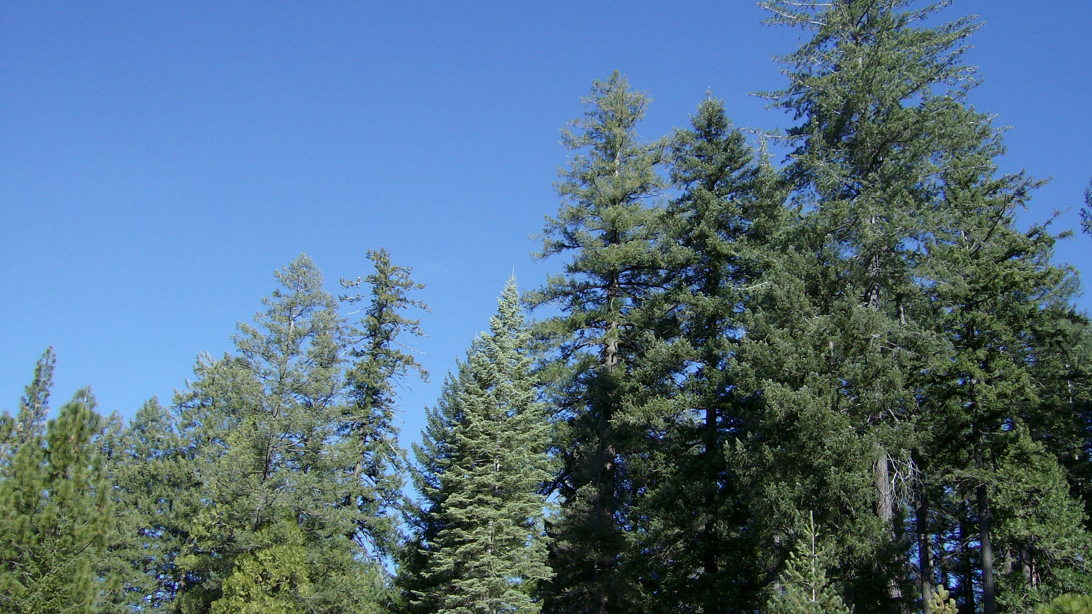
Camp Fire Forest Management Plan
What is it?
Who is it for?
Decision Makers and Landowners
We will be announcing a public comment period on February 1st, 2021. In the meantime you can access the Forest Management Plan here https://arcg.is/X819D
Notes:
What is it?
A FMP allows us to clearly outline the plans, goals, and objectives for the land and its resources within our community.
Online document told in a story format
This FMP in particular, is a document that can be used to inform and assist residents of Paradise with their roles and responsibilities in community forest management.
The FMP takes into account both the past, current and future conditions of Paradise landscape to help guide landowners post Camp Fire.
Important:
Who is the FMP for?
Unique in that it is for both the general public an those that are guiding the policy and practices of our community, the decision makers.
General Public – highlighted components, checklist, home hardening & defensible space, reforesting a town, emergency action plan
Public Comment –
Currently in initial phases of public comment
General public commenting period opening on February 1st, 2021
For now available for viewing on the website.

Slide 24
Camp Fire Forest Management Plan

Slide 25
Fire Hazard Abatement Ordinance
John Messina, Fire Chief, Butte County/Cal Fire
Paula Daneluk, Butte County Development Services Director

Slide 26
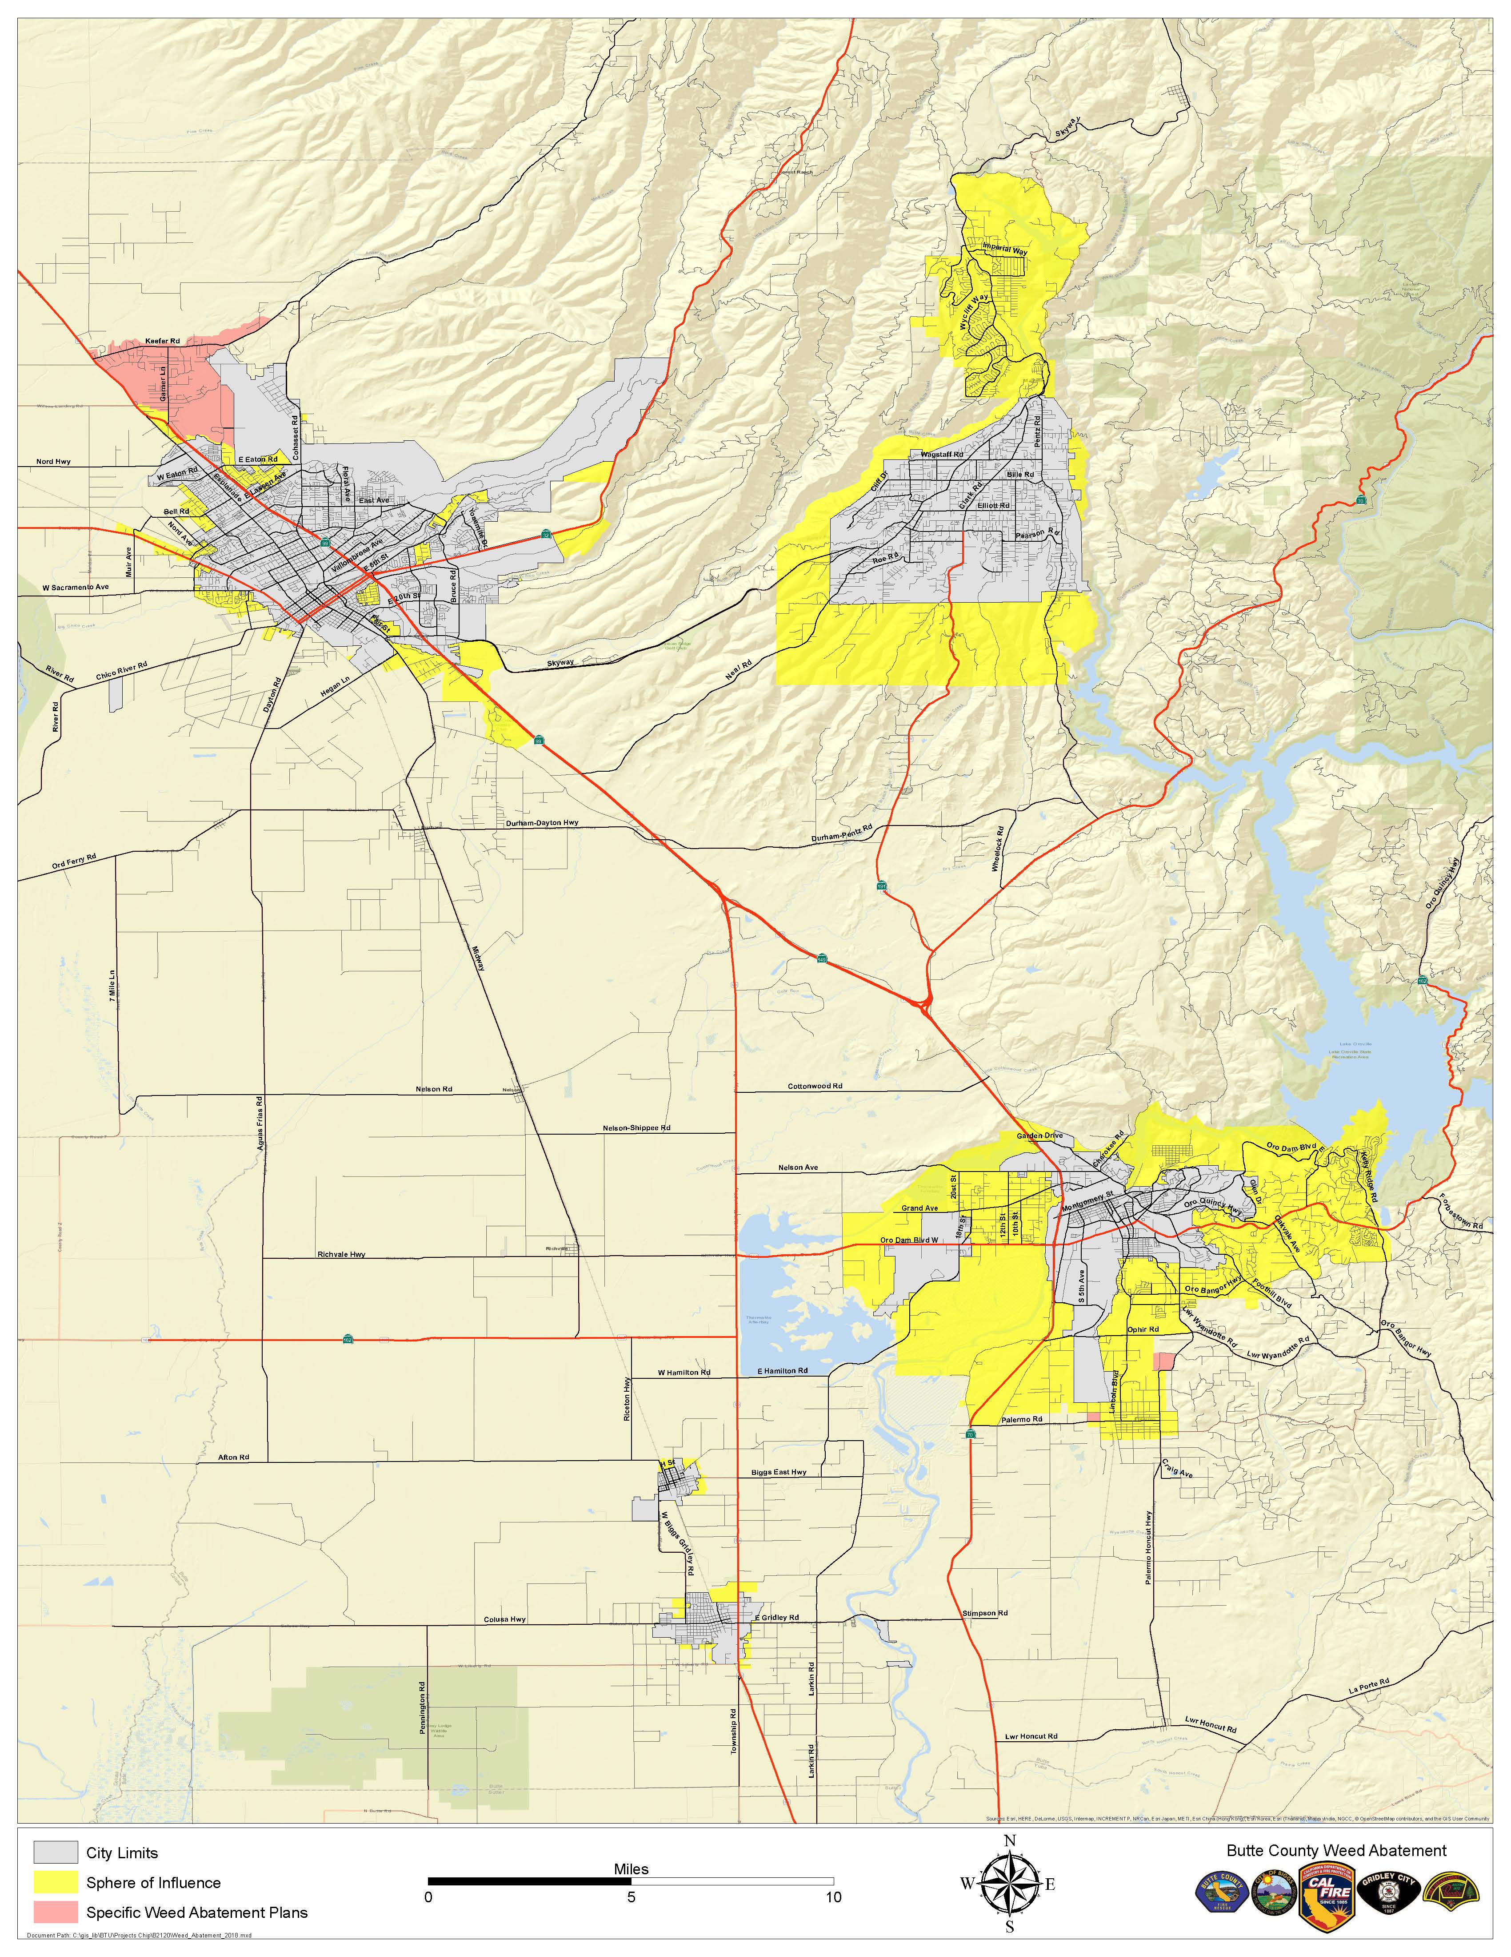
Fire Hazard Abatement Ordinance
History of Weed Abatement in Butte County
PRC 4291
Chapter 38A of the County Municipals Code
Current ordinance only covers sphere of influences around urban areas
Enhancements first brought forward in November 2019
Board directed the FD to provide more information at a follow up meeting

Slide 27
Fire Hazard Abatement Ordinance
Current Chapter 38A requirements
Defensible space around structure in the SOI
Properties 1.25 or greater need a 30ft fuel break around property
Properties 1.25 or smaller must complete fuel reduction on entire property
Fuel breaks around utilities – generators, power poles

Slide 28
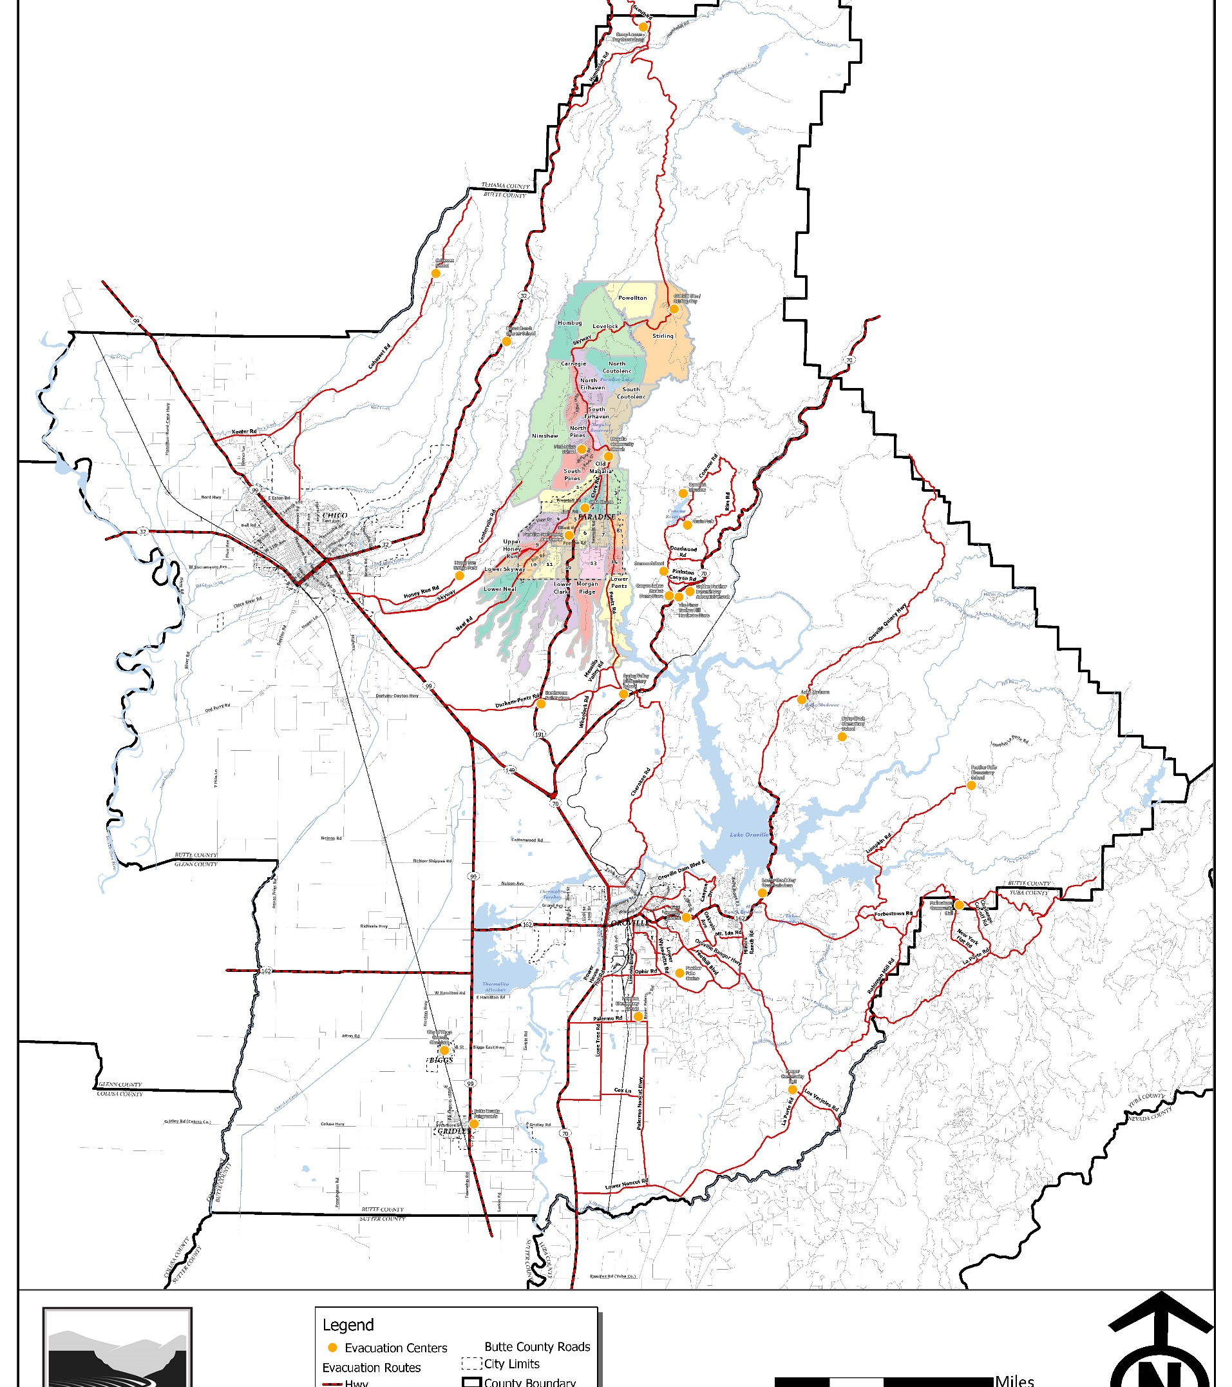
Fire Hazard Abatement Ordinance
Enhancements to existing ordinance
County wide implementation
True defensible space. Neighboring property may be required to provide fuel reduction
10 ft fuel reduction along means of ingress and egress
20 ft Fuel reduction along evacuation routes

Slide 29
Fire Hazard Abatement Ordinance
Enforcement/Abatement
Working with Development Service Director on the enforcement and abatement of non-compliance properties
Butte County FD received a 2-year grant for inspectors
After 2 years, BOS will need to approve additional funding to keep the program

Slide 30
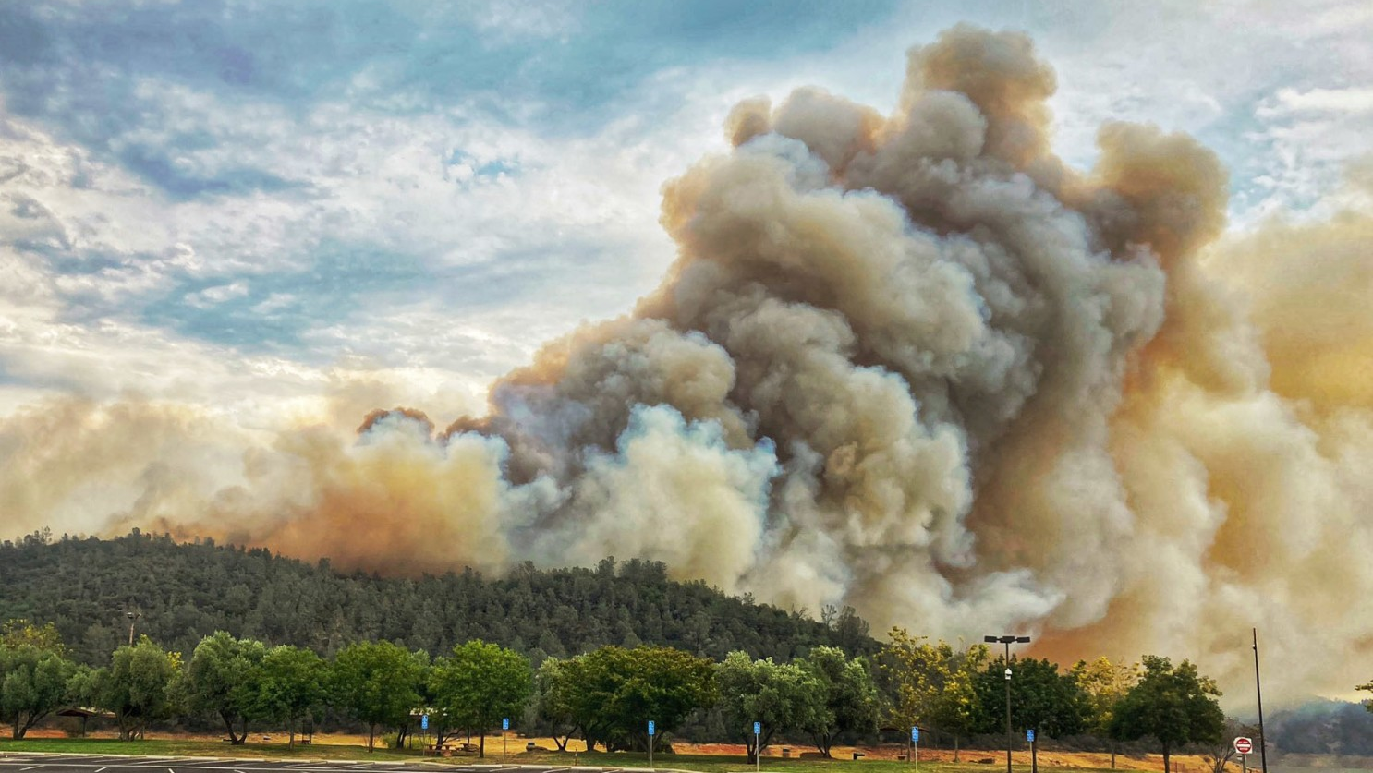
Fire Hazard Abatement Ordinance
In Conclusion
Must have voluntary compliance to be successful
We will need a strong public/private relationship
Education over enforcement
It will take time to see results

Slide 31
Biomass Needs and Opportunities

Slide 32
Biomass Processing
Co-generation
Pellets
Syngas
HYDROGEN
300 BDT/Day
11,000 K/Day
3500-5000 Acres of forest thinned for feedstock per year

Slide 33
Ways to Make a Difference and Get Involved
Committees & Groups
Grazing Committee
Biomass and Forest Health Working Group
Firewise and FireSafe Committee
Bear Fire Recovery Meetings
Youth Education Committee
Become a Butte County Fire Safe Council member by clicking the link below! https://buttefiresafe.net/membership/

Slide 34
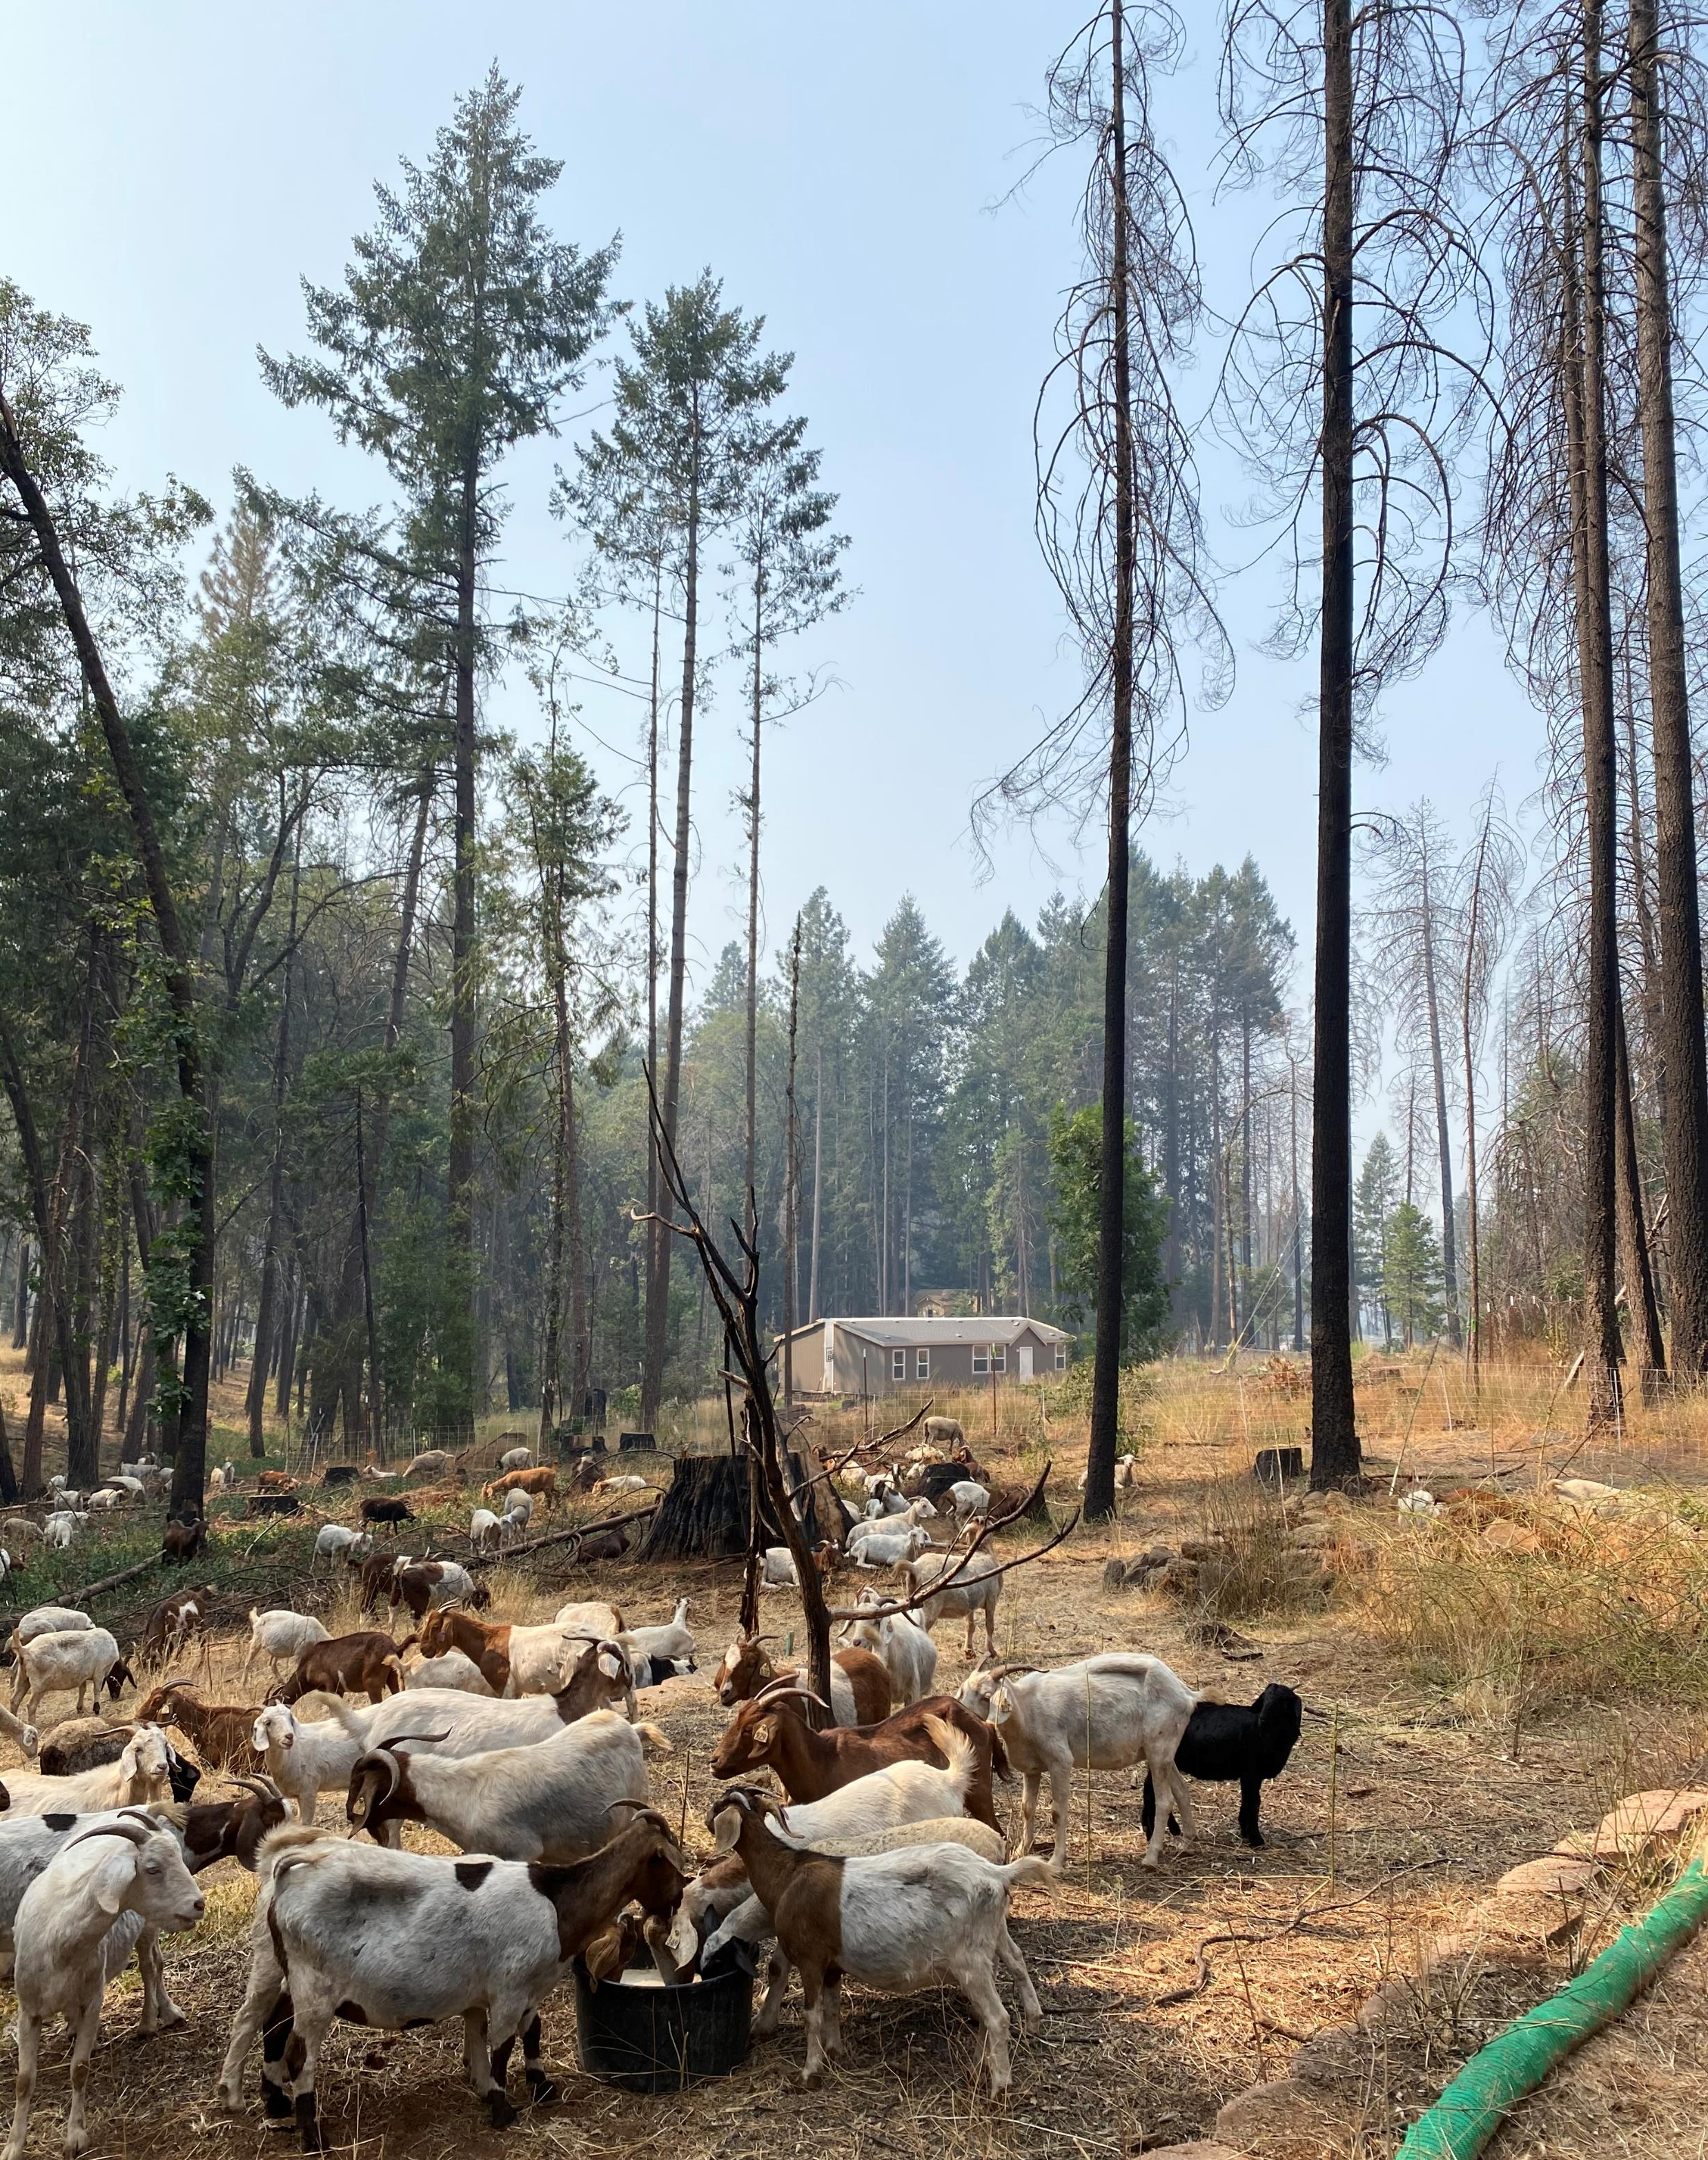
Grazing Committee
Meetings held monthly
Zoom
Next Meeting
January 6th, 2021
10am-11am
Click the link if you’re interested in participating! https://bit.ly/BCFSCCommittees

Slide 35
Biomass and Forest Health Working Group
Meetings held monthly
By Zoom
Next Meeting
January 14th, 2021
1pm-2pm
Click the link if you’re interested in participating! https://bit.ly/BCFSCCommittees

Slide 36
Firewise and Firesafe Committee
Meetings held monthly
By Zoom
Next Meeting
December 18th, 2020
10am-11am
Click the link if you’re interested in participating! https://bit.ly/BCFSCCommittees

Slide 37
Bear Fire Recovery Meetings
Meetings held twice monthly
By Zoom
Upcoming Meetings
December 3rd, 2020, 10am-11am
December 17th, 2020, 11am-12pm
Click the link if you’re interested in participating! https://bit.ly/BCFSCCommittees

Slide 38
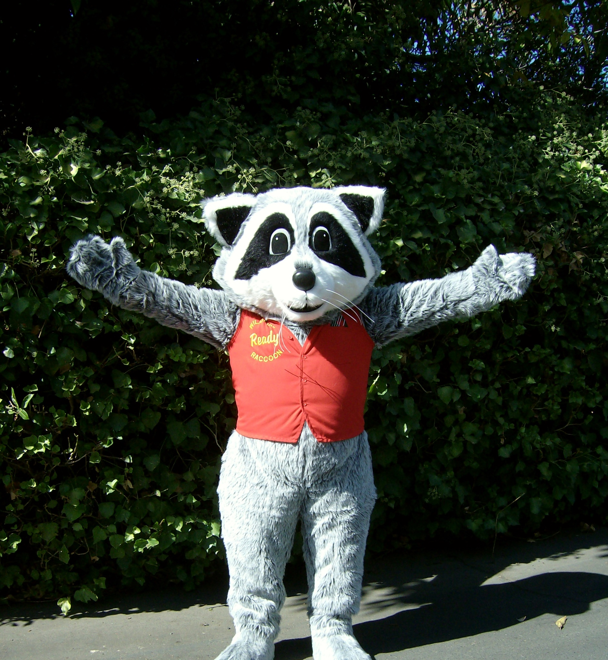
Youth Education Committee
Meetings held twice monthly
By Zoom
Next Meeting
January 21st, 2021
10am-11am
Click the link if you’re interested in participating! https://bit.ly/BCFSCCommittees

Slide 39
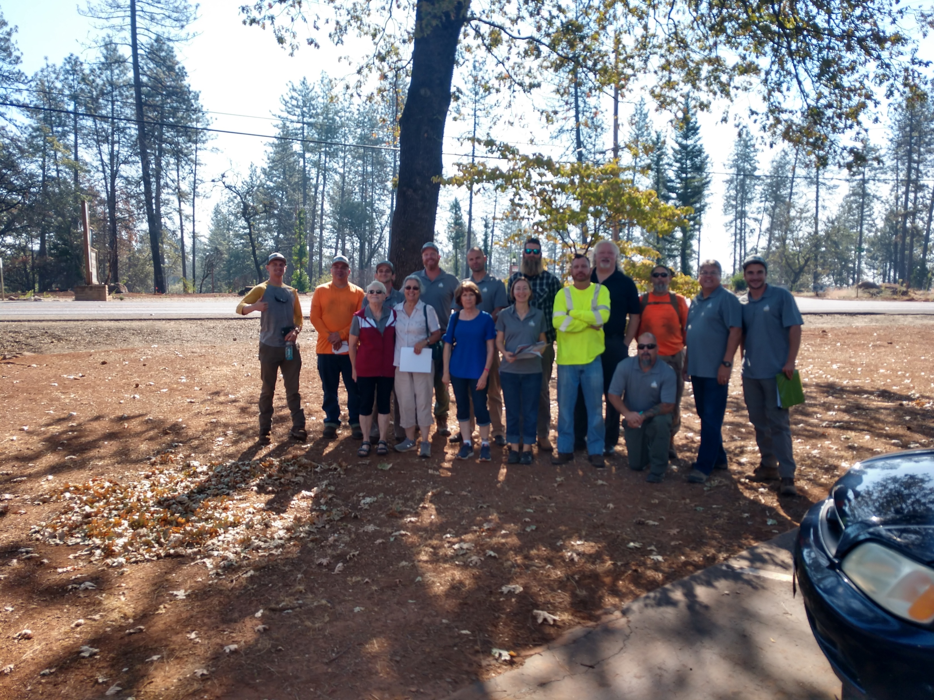
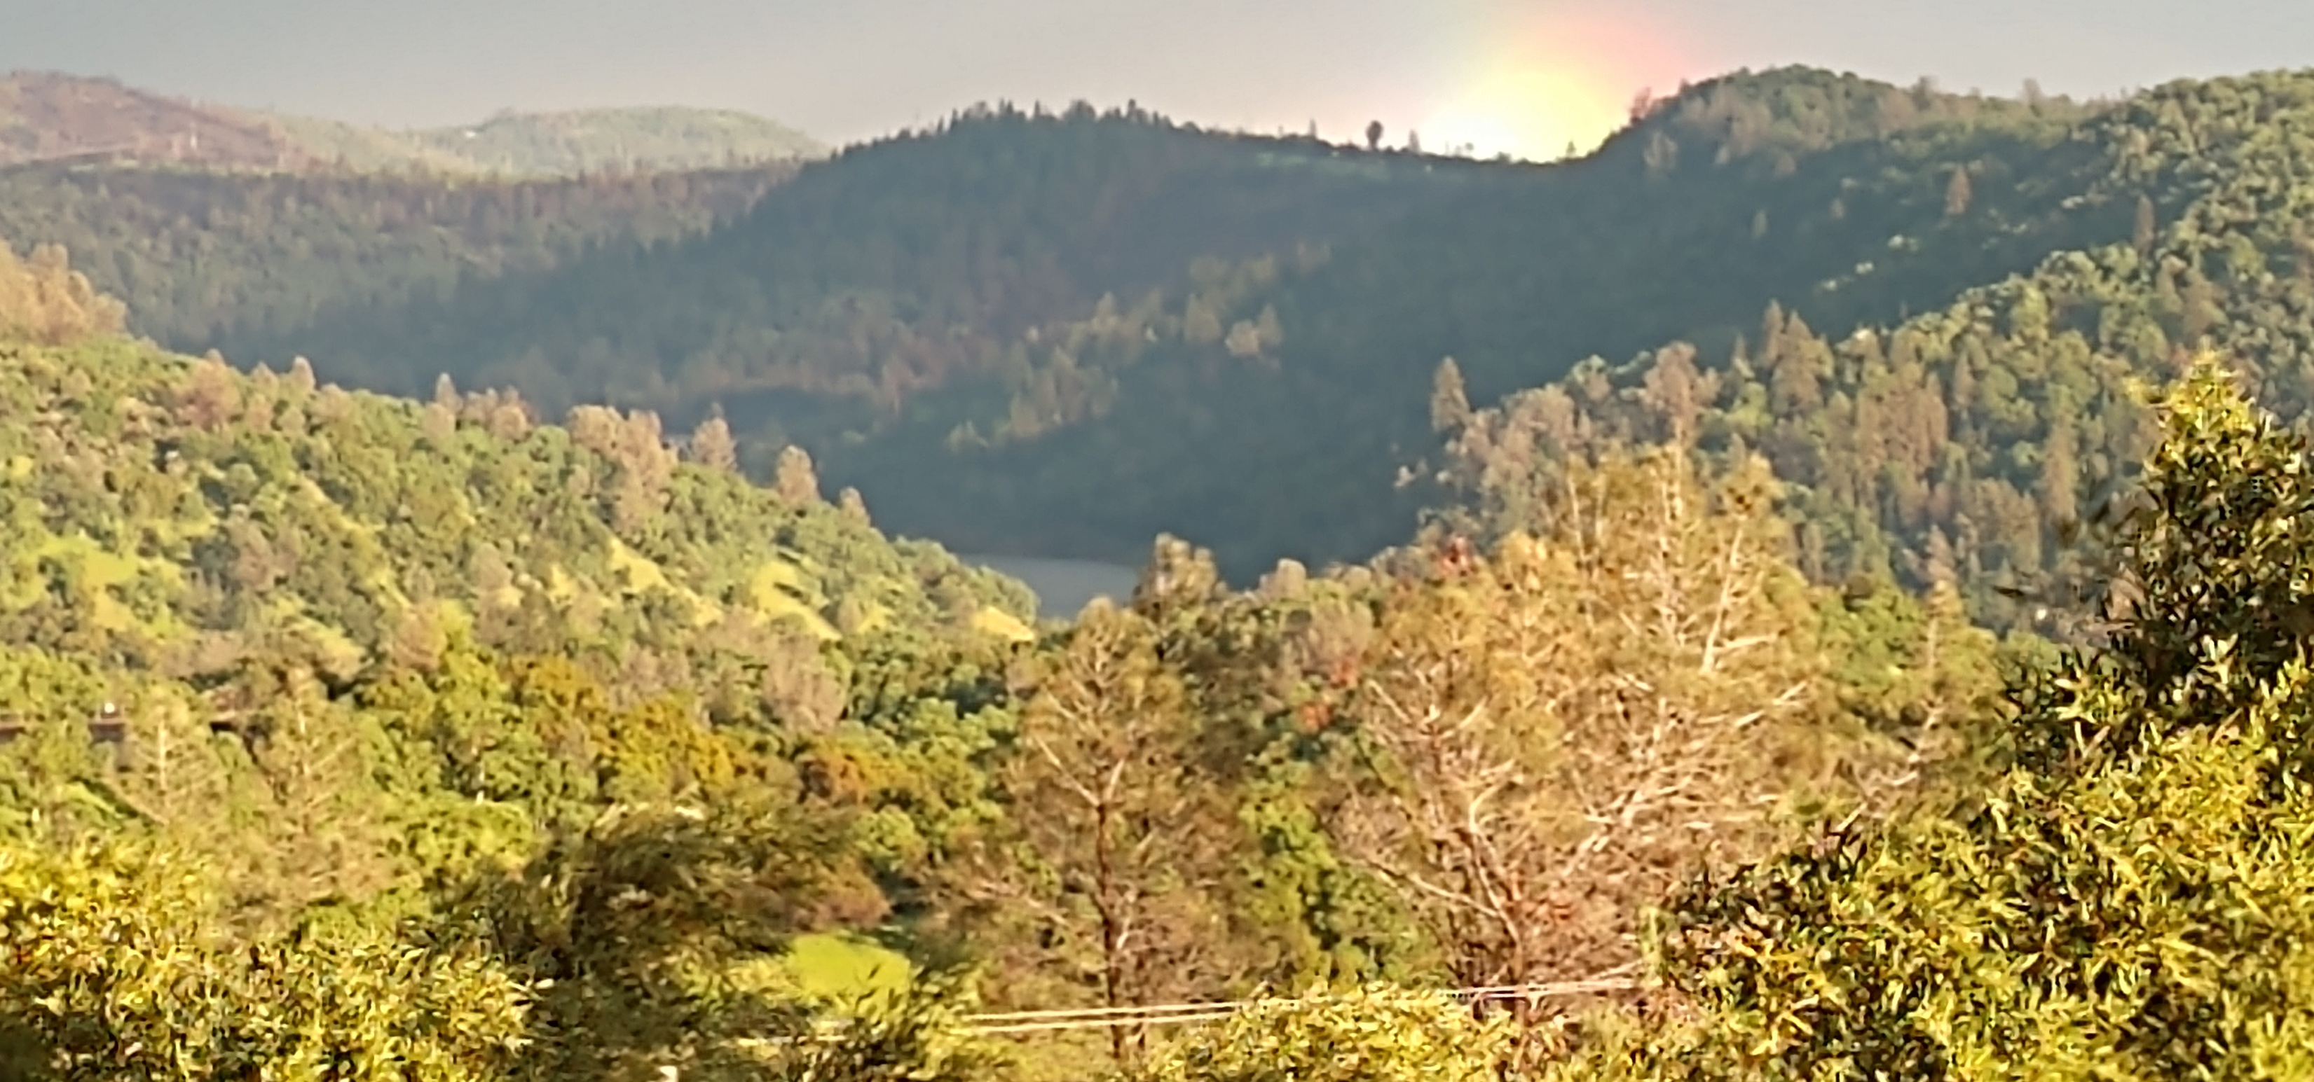
Thank You For Attending!
Please Join us! Become a member today by clicking the link below. https://buttefiresafe.net/membership/

