Slide 1
“Wildfire in the Foothills”
Lesson 4

Slide 2
What is our family’s plan for surviving wildfire?”
A family plan is vital for surviving a wildland fire.
Be prepared!

Slide 3
4.1Family Disaster Plan
Firefighters need to focus on putting out the fire, so it is important that the residents know what to do to stay safe.

Slide 4
4.2 Magnetic Envelope
This is for keeping all the information for the family’s safety during a fire. It should include the following:
“Family Disaster Plan”
4 “Wildland Fire Communication” cards
1 “Five P’s” card

Slide 5
4.3 Emergency Supply List
Go-Bag: supplies needed in case of fire emergency

Slide 6
4.4 More Important Information
Place these reference cards in the red vinyl envelope
“If You Become Trapped” (red)
“Checklist for Residents Returning Home” (yellow)

Slide 7
4.5 Magnetic Envelope
Put “Are You Prepared” into the red vinyl envelope along with all of today’s information
Place the envelope on the refrigerator or in a easy to find safe place

Slide 8
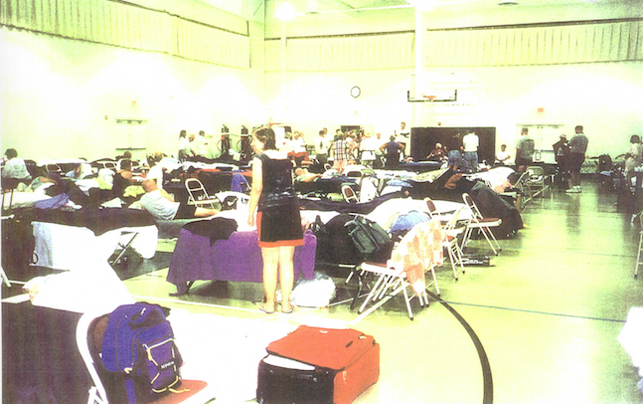
4.6 #1 Assembly Point
The Red Cross will open shelters with cots, food and water
Medical Needs will be addressed
Latest information will be available
Place to reunite with family
Counseling

Slide 9
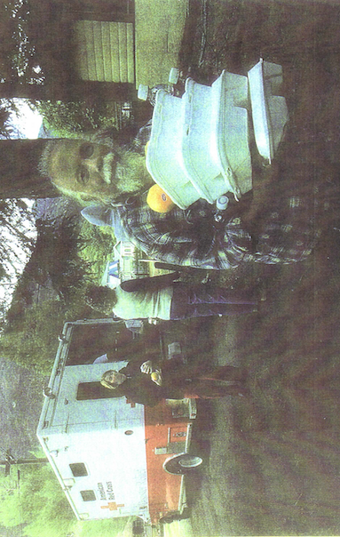
4.6 #2 Red Cross Helpers
These volunteers stay in the shelters to help

Slide 10
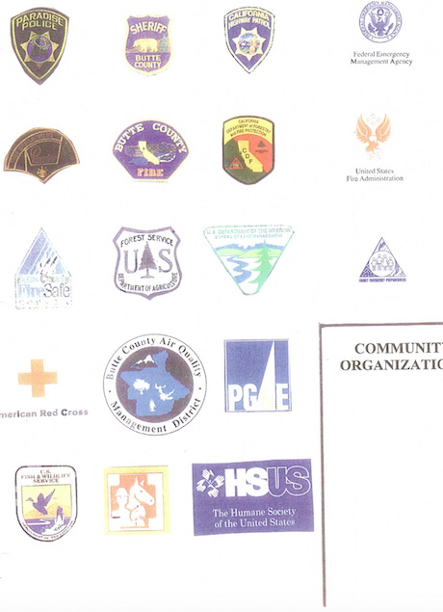
4.8 #3Many Agencies
Many agencies and volunteer groups will help.
How many of their jobs can we figure out?

Slide 11
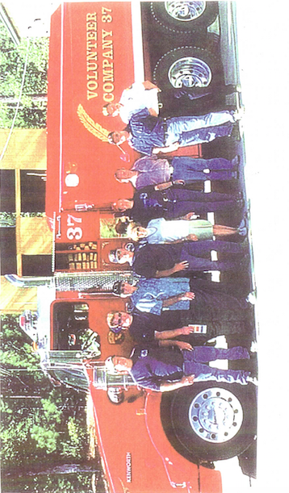
4.9 #4 Volunteer Firefighters
Many volunteer fire fighters from other communities will come to help.

Slide 12
4.10 Town Meeting Skits
Tomorrow’s Review
Each student will portray a person who has something important to do or say about why we have wildfires, what we can do to reduce risks, how to stay safe during a wildland fire and how we can help people recover after a wildland fire
The purpose is to review this important information

Slide 13
4.11 Homework
Work with your parents to create the “Family Disaster Plan”
Think about your role in the skit and any costume or prop you might use

